Slide 1
ZERO
WASTE
STRATEGIES
FOR
COLLEGE CAMPUSES
HOSTED BY LISSETE OCHOA, WASTE PROFESSIONAL STUDENT INTERN,
WITH
UC RIVERSIDE OFFICE OF SUSTAINABILITY & R'GARDEN
Notes:
Hello everyone! thank you Tiffany for that wonderful land acknowledgment and introduction. I'll go ahead and kick off today's final RivCo Recycles Community Summit celebration dedicated to schools with Zero Waste Strategies for College Campuses!
My name is Lissete Ochoa and I will be hosting today's discussion. I am very excited to have UC Riverside's Office of Sustainability and R'Garden join us to discuss zero waste implementation on UCR's campus.

Slide 2
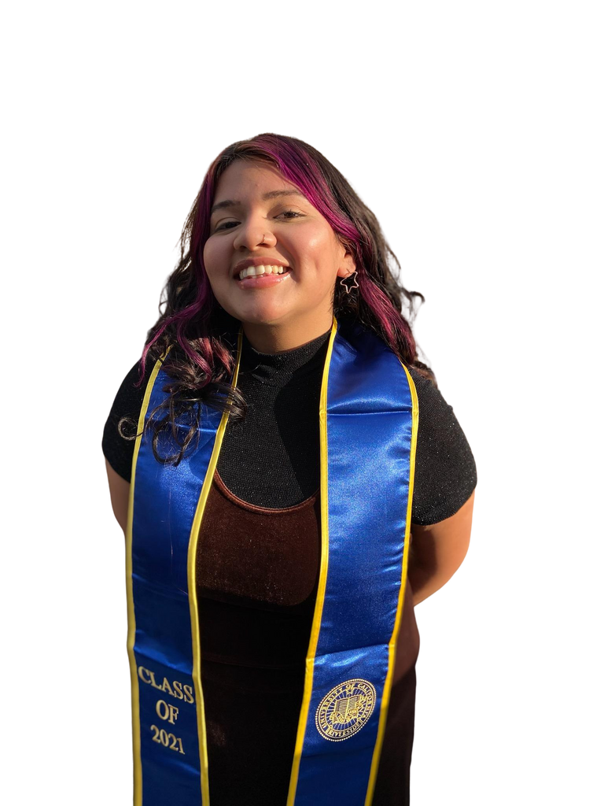
About Me
Recent Sustainability Studies Graduate from UC Riverside; minor in Environmental Sciences
Fun fact: I've been vegetarian for almost 5 years!
Background and interests include Environmental Justice, Climate and Community Resilience, & Waste Reduction
Notes:
So a little bit about me: I am currently a Waste Professional Student Intern here at the Riverside County Department of Waste Resources.
I am also a recent Sustainability Studies graduate from UCR.
Some of background and interests include Environmental Justice, Community Resilience, and all things Waste related. And I have actually gained invaluable experience in the sustainability field as a previous student staff member from UCR's Office of Sustainability.
Given my background, I am very excited to reconnect with and have the UCR Office of Sustainability join us to discuss zero waste efforts and implementation on campus!

Slide 3
DEPARTMENT PROGRAMS AND SERVICES
The Riverside County Department of Waste Resources offers FREE various environmental education classes broadly related to waste mitigation, built environment improvements, and sustainability. Class instructors provide attendees with professional learning and instructional materials that demonstrate environmental diversion themes such as Composting/Vermicomposting, Recycling 1-2-3, Green Landscaping, and more! Attendees from all educational backgrounds, age groups, and interests are welcome to join. Classes are offered live throughout the year as well as on-demand in our resource section.
Composting/Vermicomposting Workshop
December 4, 2021 9:00 am - 11:00 am
WebEx Link
Meeting Number: 145 559 4057
http://www.rcwaste.org/
Password: cUB22Hv
Notes:
So just a quick overview of some programs & services offered here at RCDWR.
In addition to landfill management, our department offers county residents free environmental education classes from recycling basics to how to turn organic waste into nutrients for your lawns and gardens.
Our next free Composting/Vermicomposting workshop will be held on December 4, 2021 9:00am-11:00am. I've provided some of the meeting information on the slide here but you can always visit us at rcwaste.org. For more information!

Slide 4
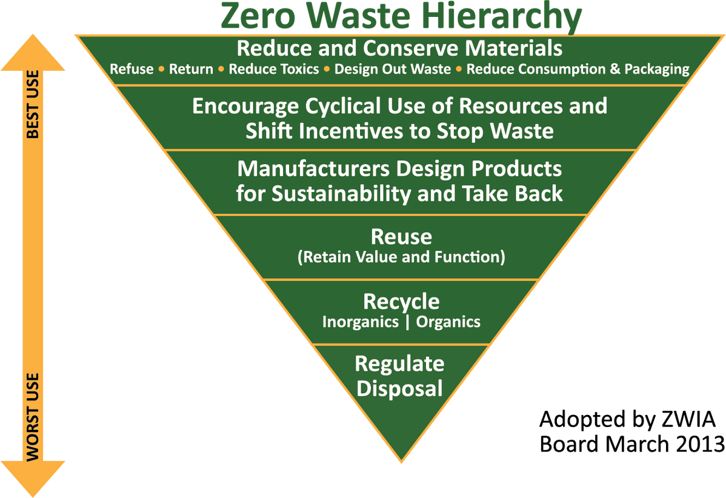
What is
Zero
Waste?
Zero waste, by CalRecycle's definition, is a process and a philosophy that involves a redesign of products and consumption, so that all material goods can be reused or recycled—or not needed at all.
Notes:
Before we dive into our college edition of Zero Waste Strategies, it's important to understand the meaning behind Zero Waste.
Zero waste by CalRecycle's defnition is...
On the righthand side, I've provided a Zero Waste Hierarchy chart from the Zero Waste International Alliance. What we want to look at it is the very top of the hierarchy which is the most advocated strategy to ensure the highest and best use of materials and products. In other words, prioritizing actions like designing out waste and reducing consumption and packaging will keep materials and products from being downcycled and ultimately, from ending up in landfills.

Slide 5
OFFICE OF SUSTAINABILITY AT UC RIVERSIDE
The Office of Sustainability works to implement policies and programs aimed at reporting and reducing resource usage and greenhouse gas emissions. Our programs showcase the environmental, economic, and socio-cultural relationships to suit our current needs and those of future generations. Our vision is to improve the quality of life through enhancing the culture of sustainability at UC Riverside and the community.
Notes:
S just some quick statistics: UC Riverside ranks 16 in greenest universities in the United States, top 35 in The Sierra Club's Cool Schools Ranking for Energy and Sustainability Efforts and 2 systemwide for renewable energy.
The Office of Sustainability promotes sustainability on campus and within the community by implementing policies related to reducing GHG emissions, diverting campus waste from landfills, certifying labs on campus that use sustainable practices, as well as facilitating special engagement programs and events.

Slide 6
R'GARDEN AT UC RIVERSIDE
The R'Garden is a space that grows fresh produce while providing an opportunity to learn about social, environmental, and economic sustainability through a food systems. We are a student resource center as well as a community centered garden which aims to educate folks on the local food systems in Riverside, while actively engaging folks on the importance of having access to local & fresh produce. It serves as a sustainability hub to promote service learning, and community-based research around food systems through student-led projects and collaborations with the campus and community.
Notes:
The R'Garden is a student and community resource space that began in 2009, when a group of students, faculty, staff, and community members set out to increase environmentally centered spaces on UCR's campus.
The R'Garden has recently expanded to 8 acres that includes a community garden, row crops, a Valencia orchard, and a greenhouse area.
With all of that being said, It is my pleasure to introduce one of my former supervisors, Sustainability Program Coordinator, Francis Mitalo and R'Garden Manager, Richard Zapien to provide more information on UCR's current zero waste efforts.
Take it away, Francis and Richard!

Slide 7
Notes:
Thank you Francis and Richard for that wonderful presentation! It's amazing to hear how much UCR has changed in the past couple of years since I first began my college journey.
I hope we will have the chance to collaborate and work together again in the future!
For my information about UCR's Office of Sustainability and R'Garden please visit them at their respective instagrams and websites. And thank you all for joining us on today's discussion on current zero waste efforts
If there are no additional comments or questions, that concludes today's Zero Waste Strategies on College Campuses. I'll go ahead and pass it over to Janet with our next event.

