Slide 1
Vermicomposting
Welcome!
Please use the Chat section for questions during the presentation.
Notes:
Welcome, Thank you for taking the time from your busy schedule to attend this presentation of Vermicompostin.
I am ____________ and I have volunteers ________, ________, ________, here to assist today.
Please turn off or silence your cellphones.
Restrooms are located _________________.
Explain how to fill out the customer service survey and how it is an important tool that the department uses to evaluate the presentations and topics for outreach to Riverside County residents. Your input is valued and appreciated.
Presentations:
Thank the host, attendees, and organization for inviting the Department to do the presentation

Slide 2
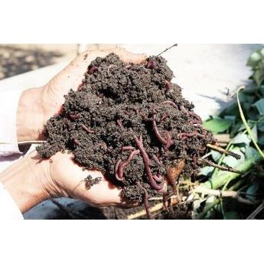
Vermicomposting Program
Vermicomposting Materials
Worm Species and Ecology
Setting up Your Worm Bin
Feeding The Worms
Harvesting the Worm Bin
Using Castings and Leachate
Troubleshooting
Make Your Own Worm Bin in Resource Garden 2022
Worm Bin Kit Sales
Notes:
These are the topics that we will cover in the presentation today.
Mention each one only. NO DETAILS.
You can follow along using the Vermicomposting book you received.
At the end of the presentation, we’ll construct your worm bins.

Slide 3
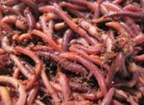
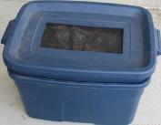
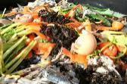
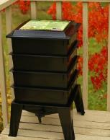
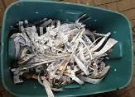
Vermicomposting Material
Worms
Worm bin
Bedding
Food waste
Notes:
To get started you’ll need just a few basic items
Worms, worm bin, bedding, food waste, and you’ll be able to turn your food scraps into nutrient rich compost.
This book will guide you through the steps to a successful vermicomposting adventure.
Links for worms on our website*

Slide 4
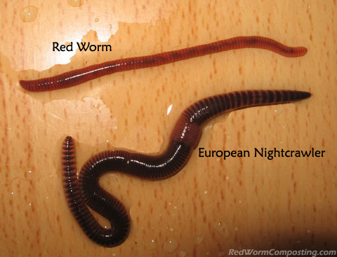
Worm Species
Eisenia foetida (Red Worm/Red Wiggler/Manure Worm)
Notes:
The Red Worm, most often called Red Wiggler, is the most common worm used for vermicomposting and is a cousin to the earthworm.
Red Worms can process large amounts of organic matter and, in ideal conditions, reproduce rapidly.
Worm Ecology
Red Worms can tolerate a wide range of temperatures, but prefer temperatures between 55 - 77ºF.
Bins should be kept in a shady location at all times.
The bins need good air circulation. Without good air circulation, the bin may become very wet.
The bins should be monitored closely to ensure that it is not to dry or wet and there is enough food. Take corrective action to adjust feeding and moisture levels in the bin.

Slide 5
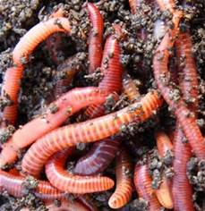
Red Wiggler Worm Facts
No eyes
No teeth
No bones
Hermaphrodites
Produce up to two cocoons/week
Five heart-like organs called aortic arches
Notes:
Red Wiggler Worm Facts
Are decomposers that eat organic material such as fruit and vegetable scraps.
Do not have eyes; they have cells called cerebral ganglion in the front part of their bodies that can detect light.
Do not have teeth; they suck decaying food into their mouth and grind the food by using the grit in their gizzard.
Are used for vermicomposting and adapt well to containers called worm bins.
Can eat half their body weight in food scraps each day!
Are both male and female (hermaphrodites), but still need another worm to reproduce.
They can produce up to two cocoons a week and each cocoon will contain 2 to 5 babies.
Have 5 “heart-like” organs called aortic arches.
Breathe through their skin, require a moist dark environment, but not sopping wet as they can drown.
Have no ears, but their bodies can sense the vibrations in the soil.
Don’t have any bones. That’s why they are squirmy when they move.
Can live up to one year.
If subjected to light for a long period of time, they will secrete a yellow liquid called coelomic fluid, thought to be a defense mechanism against predators as the fluid can smell bad.

Slide 6
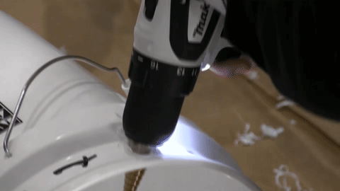
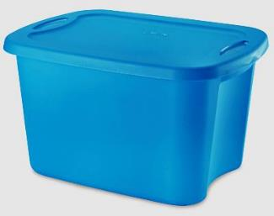
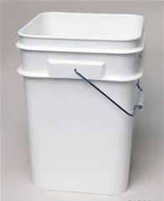
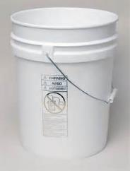
Selecting a Container
10 to 18 gallon plastic storage tote containers
4 or 5 gallon kitty litter pail
4 or 5 gallon white bucket
Notes:
As you can see on the screen there are three types of containers to choose from when building your own bin.
The type and size of container that is best for your use will be determined by answering the following:
How much space do you have?
Do you have weight limitations?
Do you eat a lot of fruits and vegetables?
If you live in an apartment or condominium with limited space or you have weight limitations consider using the kitty litter pails or white buckets.
If you live in a house and space is not a concern, or you do not have weight limitations, you might want to consider using the 10 to 18 gallon plastic storage totes.
If you do eat a lot of fruits and vegetables you may want to build more than one bin.
The 10 to 18 gallon plastic storage totes are recommended since they allow the worms more room to move around and feed.

Slide 7
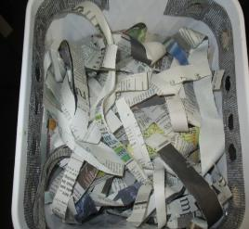
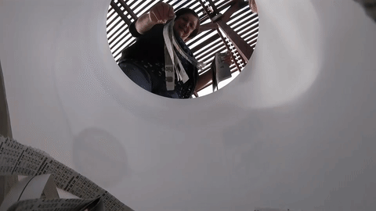
Bedding
Cool, moist, dark
Backup food source
Notes:
Worm bin bedding serves two purposes.
It gives the worms a moist environment in which to live and reproduce.
It also gives them a backup food source if they consume all of the food scraps.
You can use any of the following for your worm bin bedding. You’ll need enough to fill a bin half to three quarters full:
• Torn newspaper (torn not shredded; don’t use glossy sections)
• Leaf mold, coir fiber, finished compost, or peat moss
• Aged manure (outdoor bins only)
• Torn cardboard or corrugated cardboard should only be used sparingly when added to above bedding materials.
Prepare Bedding Material
• Place bedding material in Bin B
• Add water to cover material.
• When completely wet, wring out, fluff and place in Bin A
• Repeat until you have enough bedding to fill Bin A half to three quarters full.

Slide 8
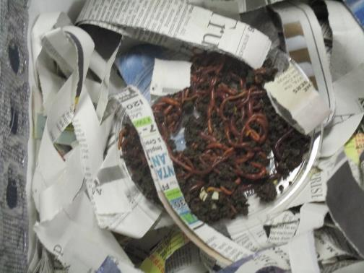
Placing the Worms
Notes:
You will need about one quarter (1/4) to (1) pound of Red Worms. See Vermicomposting Resources for sources.
Place the bins in a well-lit area during this process so the worms will burrow into the prepared bedding.
Place worms by gently laying them on top of bedding in Bin A and walk away for about 10 to 15 minutes to allow worms to burrow into bedding.
Lay prepared newspaper blanket on top of bedding and place lid on Bin A.
Place air space blocks if desired, between Bin A and Bin B where leachate will accrue.

Slide 9
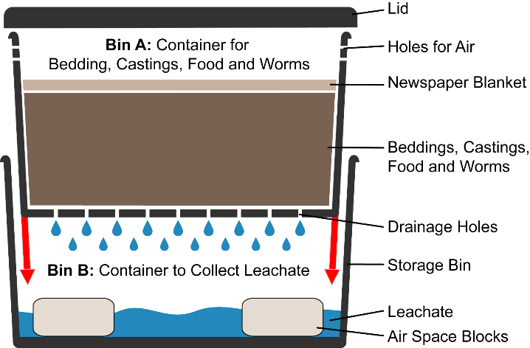
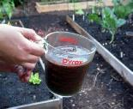
Worm Bin Design
Notes:
The typically worm bin is designed with two bins (Bin A and Bin B).
Bin A is the container for bedding, castings, food, newspaper blanket and worms.
Bin B is the container that collects leachate and holds Bin A.
Describe illustration.

Slide 10
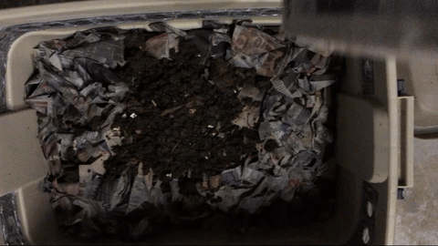
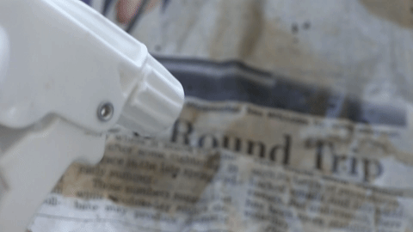
Newspaper Blanket
Helps retain moisture
Keeps out light
Backup food source
Notes:
The newspaper blanket covers the worm bin bedding, helps retain moisture, keeps out light, and can be used as a food source.
To make the blanket, take 12 full size sheets of newspaper layered on top of each other.
Fold to fit inside Bin A, leave ¼ inch space around all sides for air circulation.
Soak in water until thoroughly wet.
Drain excess water and lay on top of moist bedding.

Slide 11
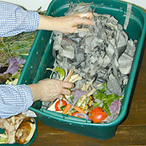
Feeding the Worms
What do worms eat?
Fruit and vegetable scraps
Pasta (cooked)
Bread
Cereal (drain milk)
Coffee grounds
Tea leaves and bags (paper)
Egg shells
Newspaper
Paper towels and napkins
Aged manure
Notes:
Worms do not have teeth and can only eat food that has started or completely decayed.
What do worms eat?
Fruit and vegetable scraps, pasta, bread, cereal, coffee grounds, tea leaves and bags (paper), egg shells, newspaper, paper towels, and napkins, and aged manure to name a few.
Precaution and Helpful Hints
Pasta must be cooked and relatively free of oil and sauce.
Cereal should be drained of milk.
Remove filter from coffee grounds.
Egg shells should be finely crushed.
Use only paper towels and napkins that have been used to wipe up minor food spills.
It is recommended that aged manure be used in outdoor bins only.
Avoid these materials
Yard waste (leaves, grass or twigs). Mixed together they could cause the bin to heat up and kill the worms.
Unwashed fruit and vegetable scraps.
Citrus and citrus peels. They are too acidic for worms to digest.
Animal or dairy products, such as meat, bones, milk etc.
Feces are never to be used.

Slide 12
Feeding the Worms
Avoid feeding these materials:
Yard Waste
Unwashed fruit and vegetable scraps (best if frozen)
Citrus fruit and peels
Animal and dairy products like meat, fat, and bone
Feces
Notes:
Worms do not have teeth and can only eat food that has started or completely decayed.
What do worms eat?
Fruit and vegetable scraps, pasta, bread, cereal, coffee grounds, tea leaves and bags (paper), egg shells, newspaper, paper towels, and napkins, and aged manure to name a few.
Precaution and Helpful Hints
Pasta must be cooked and relatively free of oil and sauce.
Cereal should be drained of milk.
Remove filter from coffee grounds.
Egg shells should be finely crushed.
Use only paper towels and napkins that have been used to wipe up minor food spills.
It is recommended that aged manure be used in outdoor bins only.
Avoid these materials
Yard waste (leaves, grass or twigs). Mixed together they could cause the bin to heat up and kill the worms.
Unwashed fruit and vegetable scraps.
Citrus and citrus peels. They are too acidic for worms to digest.
Animal or dairy products, such as meat, bones, milk etc.
Feces are never to be used.

Slide 13
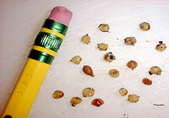
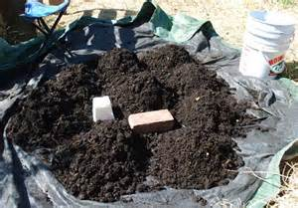
Harvesting the Worm Bin
How often?
How long does it take?
Notes:
When it is time to harvest, there will be many more worms than when the bin was started. Keep in mind what to do with the worms. If worms are placed in the garden 90% will die, because there is not enough food to support them. If starting additional bins have the bins ready before harvesting.
How often and when the bin should be harvested depends on the type of worm bin bedding used, size of the bin, and amount of worms in the bin. Most bins are ready to harvest in 4 to 8 months. It usually takes about 2 to 3 hours to harvest a bin.
The bin can be harvested before all of the worm bin bedding and food scraps have been converted to castings. This is determined when you observe your bin and notice that the material inside is starting to pack down and reduces the amount of available oxygen in the bedding.
Separating Worms from Castings:
• Kitty litter and white buckets - harvest whole container at one time.
• 10 gallon and above plastic storage tote containers - you can harvest one half of the container by, feeding worms for 2 to 4 weeks on one side to corral them, and then harvest the other side where food has been withheld.
• Place worms and castings being harvested onto a table covered with plastic or newspaper.
• Make several small piles of worms and castings.
• Using a stick or your fingers, begin pulling castings from the pile until worms are exposed.
• Allow worms to migrate to the center and bottom of the small pile.
Continue doing this until all that is left is a pile of worms in the center and a ring of castings.
Castings can be placed in the garden for immediately use or stored for later.

Slide 14
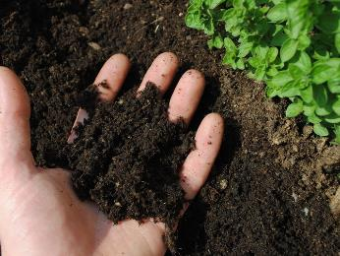
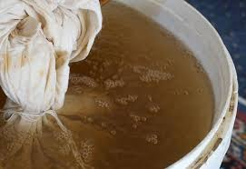
Using Castings
Soil additive
Planting mix additive (4:1)
Worm tea
Notes:
Using Castings
Castings provide natural micronutrients.
They are too fine-grained and dense to be used by themselves as a growing medium and need to be mixed with planting mix or soil.
Worm castings can be used in several ways.
• As a top dressing on your lawn or soil by spreading a thin layer and watering them in.
• Can be added to planting mix or turned into the soil by mixing one part of castings to five parts of soil or planting mix.
• Can be used on container plants. Sprinkle lightly on the surface of the container and water.
• To make worm tea. Place a scoop of castings in old pillow case or a bag with tiny holes and soak in a 5 gallon bucket of water for about a day. Remove the castings and use immediately or place in a container to use later. If the tea is real dark, dilute to look like weak iced tea.

Slide 15
Using Leachate
Dilute before use
Spray on foliage
Drench the soil
Notes:
Using Leachate
Pour the leachate collected in Bin B into a bucket to dilute. Leaving a ½ inch of liquid in the container or if you pour all of it out, replace with a ½ inch of water. It is important that this amount of liquid be retained, as it helps cool the bin system in the summer and maintain the heat in the winter.
The leachate should be diluted by mixing one part of leachate to 4 or 5 parts of water or until it looks like weak iced tea.
The diluted leachate can be used as a spray on foliage, when thoroughly filtered so it doesn’t clog the sprayer, or for drenching the soil, providing nutrients and water for your plants.

Slide 16
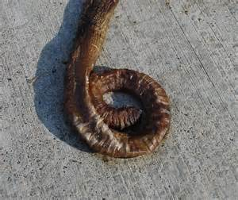
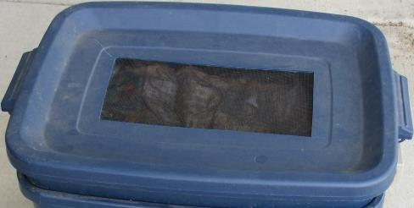
Troubleshooting: Worms Dying
Notes:
Worms Dying
Cause
Solution
Not enough food scraps: Add more food scraps to the bin.
Bin is in direct sun light: Move to where the bin is in the shade.
Bin is too dry: Moisten contents until slightly damp.
Bin is wet: Add dry bedding.
Large amount of moisture collecting on the lid: Increase or add ventilation.
For kitty litter pails or 4 to 5 gallon white buckets cut a 4 to 5 inch circle in the lid. Cut a piece of screen slightly larger and hot glue to inside of lid.
For plastic storage tote containers cut a rectangle in lid that is 6 inches wide and 8 inches long. Cut piece of screen that is slightly larger and hot glue on inside of lid. Figure 7 in booklet.
Bedding is eaten, too many castings
Harvest castings, clean bin and add fresh bedding.

Slide 17
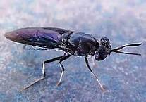
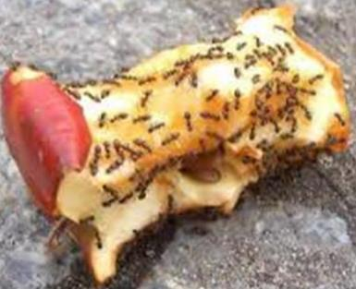
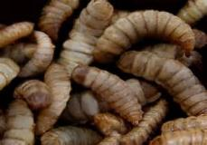
Pest Infestation
Flies
Ants
Larvae
Notes:
Ant Infestation
Food is accessible:
If bin is on a platform or table with legs, place legs in cans of mineral oil.
If bin is located on ground, find a pan that is 2 inches longer, 2 inches wider and about 4 inches deep. Place bin in pan and fill half way with mineral oil.
Fly Infestation
Food is exposed:
Bury food scraps in bedding,
Secure lid/ cover,
If screen has come loose, apply new glue as required;
Place a newspaper blanket with a minimum of 12 sheets of moist newspaper on top of the bedding.

Slide 18
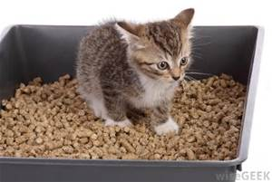
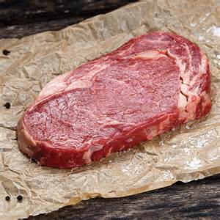
Bin Smells Bad
Notes:
Slide 23 - Bin Smells Bad
Animal or dairy products, such as meat, bones, milk etc.
Feces are never to be used.
Large amount of moisture collecting on the lid: See solution on slide 19

Slide 19
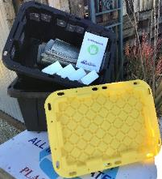
Worm Bin Kit Sales
Worm Bin Kits Available for Purchase – during COVID-19
▪ $25 each. NO CASH. Credit card (Visa and Master Card only). Service fees apply
for credit card purchases.
▪ Call 951-486-3200 and purchase the kit over the phone. Processing of kit sales
available Tuesdays and Thursdays 8:00 a.m. to noon.
▪ Worm bin kits are available for curbside pickup at Riverside County Department
of Waste Resources Administration Office, Tuesdays and Thursdays 8:00 a.m. to
noon. Once you arrive at the Administration Office, call 951-486-3200 and your kit
will be brought out to the parking area.
▪ Purchaser must show proof of identification that matches the credit card used to
purchase the kit at time of pickup.
▪ Kits available to Riverside County residents only.
▪ Limit of one kit per household.
▪ Subject to availability.
▪ No refunds

Slide 20
Make Your Own Worm Bin
Classes
In-person Make Your Own Worm Bin classes will begin 2022 at Waste Resources HQ in Moreno Valley . Check website for updates.
Worm Bins
On-Demand MYOWB classes are available in English and Spanish at www.rcwaste.org/classes/vermicomposting

Slide 21
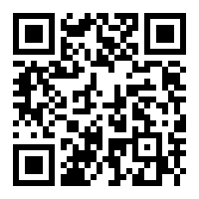
Online Resources
www.rcwaste.org/classes
Vermicomposting
Notes:
Go to rcwaste.org/classes and click on any of the topics. The links will bring you to the registration page for future classes as well as any on demand classes available for that topic.

Slide 22
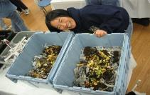
Resources
The California Department of Resources Recycling and Recovery (Cal Recycle)
https://www.calrecycle.ca.gov/organics/worms
Worm Suppliers:
https://www.rcwaste.org/Portals/0/Files/Compost/Red_Wiggler_Worm_Suppliers.PDF
Worms Eat My Garbage
By Mary Applehof (Flower Press, 1997)
Notes:
Here are the resources we discussed during the Workshop or Presentation.

Slide 23
Thank you for being part of the solution
Give us your feedback at:
www.rcwaste.org/report/feedback
Follow us on:
(951) 486-3200
www.rcwaste.org
Notes:
Workshop:
Go online, look for program and free class information. Follow us on social media for recycling tips and places to get more information. And let’s work together to manage our waste responsibly.
Riverside County Department of Waste Resources is proactive in developing sustainable waste recycling programs to conserve resources in our community. We thank you for doing your part to manage waste and care for the environment. Once again, call or follow us if you want more information or sign up for free workshops at rcwaste.org
And if you’re interested in becoming an Outreach Volunteer. You can do that online as well and we’ll tell you when our next orientation class is.
Thank you for attending. For those staying for the Make Your Own Worm Bin portion of the class we have safety items to discuss, after we will take a short break and then we will start the Make Your Own Worm Bin portion of the class.
If there is space available ask if any of those in attendance, that were leaving, would like to stay for the Make Your Own Worm Bin portion. For those that are staying, let them know that we offer worm bin kits for sale.

