Slide 1
Too Toxic To Trash:
What is Household Hazardous Waste?

Slide 2
Household Hazardous Waste
A BRIEF BACKGROUND
EPA considers some leftover household products that can catch fire, react, or explode under certain circumstances, or that are corrosive or toxic as household hazardous waste. Products, such as paints, cleaners, oils, batteries, and pesticides can contain hazardous ingredients and require special care when you dispose of them.

Slide 3
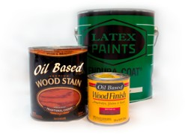
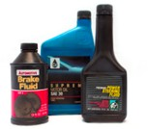
Household Hazardous Waste
Paint Products
Paint (oil based & latex) stain, varnish, adhesive, paint thinner, resin, epoxy, caulking & wood preservatives
Automotive Products
Used oil, oil filters, antifreeze, gasoline, diesel, automotive chemicals, brake fluid and transmission fluid

Slide 4
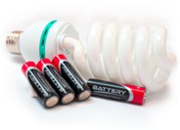
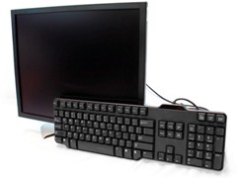
Household Hazardous Waste
Universal Waste
Batteries, fluorescent tube and
bulbs, light ballasts, smoke detectors, mercury devices and cooking oil
Electronic Waste
Televisions, monitors, computers, And electronic devices

Slide 5
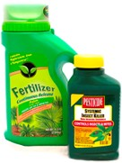
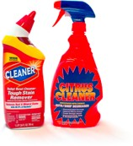
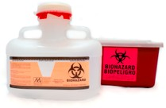
Household Hazardous Waste
Lawn and Garden Products
Pesticides, herbicides, poisons,
fertilizers, moth balls, garden chemicals, flea powder, BBQ propane tanks and kerosene oil
Household Products
Cleaners, degreasers, aerosol cans,
Drain openers, disinfectants, bleach, pool chemicals, air fresheners, lighter fluid, nail polish and hair bleach
Healthcare Products
Needles, sharps and unused medication (except controlled substances)

Slide 6
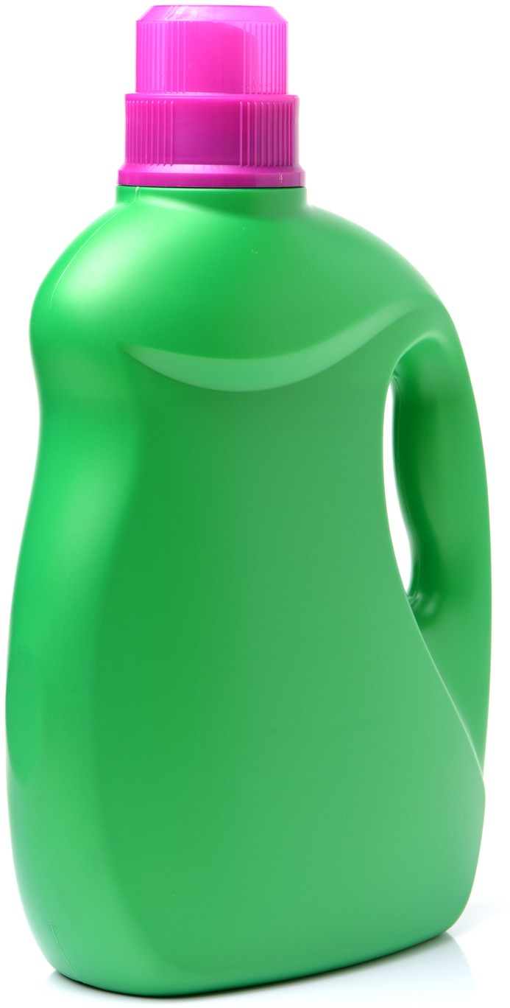
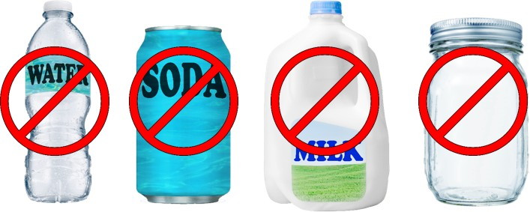
Sharps/Needles
Do Not Use For Sharps!
These items can break or puncture easily.
Food containers ae NOT approved sharps containers.
Plastic rigid containers

Slide 7
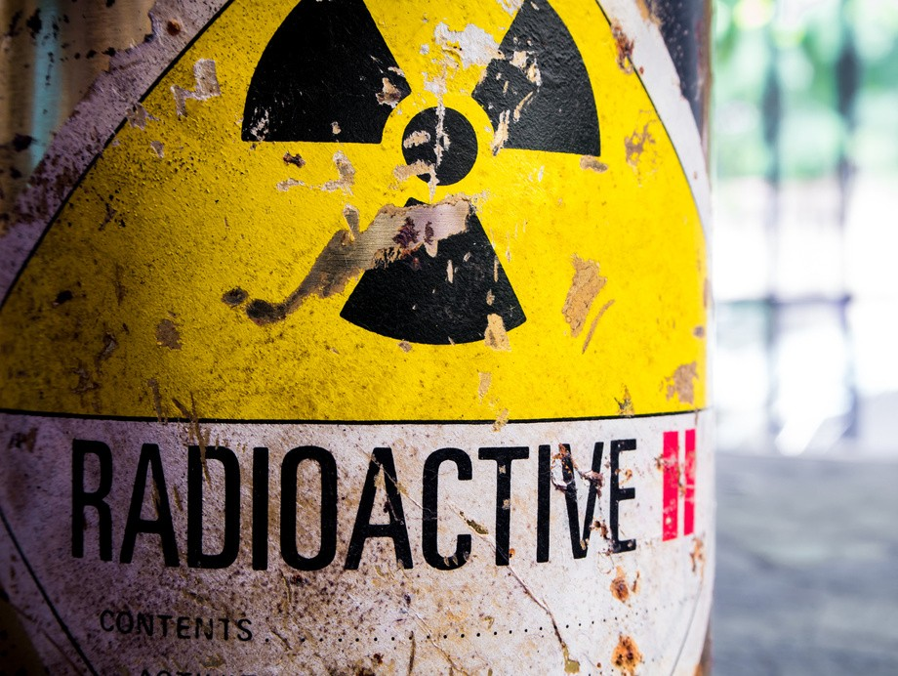
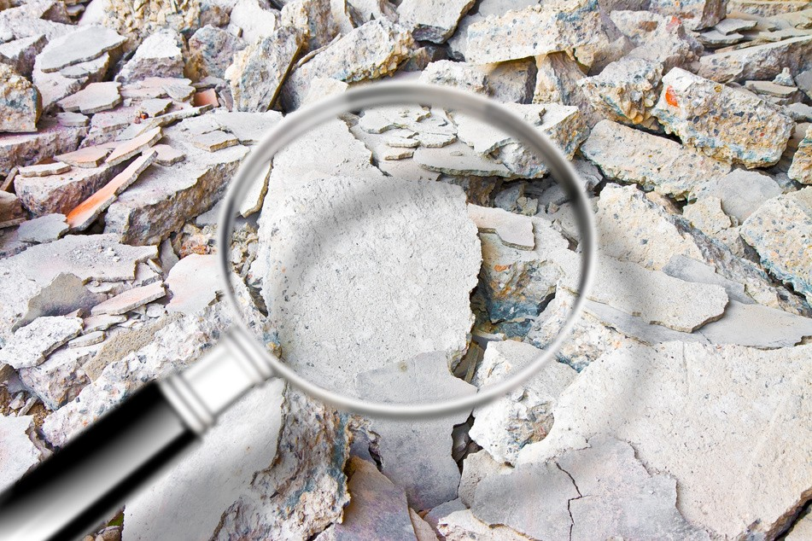
Unacceptable Materials
AT ANY RIVERSIDE COUNTY HHW COLLECTION
Ammunition & Explosives Asbestos
Appliances
Containers larger than five gallons or weighing more than 50lbs
Remediation or Radioactive Waste (except smoke detectors) Compressed gas cylinders greater than 40 pounds
Controlled substances/infectious waste (except sharps)
Business Waste/Real Estate/Non- Profit Organizations

Slide 8
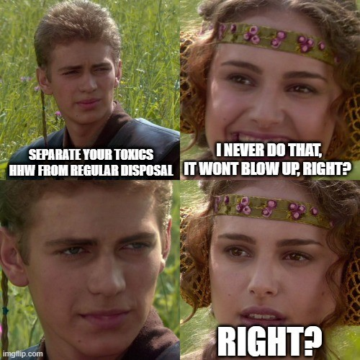

Slide 9
What about
Business Waste?
BUSINESS HAZARDOUS WASTE DISPOSAL
INFORMATION RIVERSIDE COUNTY ENVIRONMENTAL HEALTH (888 ) 722 - 4234 OR (951 ) 358 - 5055
WWW. RIVCOEH. ORG/ HAZMAT/ HAZWASTE
Very Small Quantity Generator (VSQG)
Generate less than 2200 pounds of hazardous waste/month Generate less than 2.2 pounds/month of extremely hazardous waste Accumulate no more than 2200 pounds of hazardous waste on site
at any one time
(951) 486-3200 or vsqg@rivco.org www.rcwaste.org/business/hw/VSQG

Slide 10
Transportation
IT IS ILLEGAL TO TRANSPORT MORE THAN 15 GALLONS OR 125 POUNDS OF HAZARDOUS WASTE PER TRIP
Safe Transportation:
LABEL containers to identify contents or keep in original container DO NOT mix different products into one container
SECURE leaky containers and loose loads TRANSPORT in a box away from passengers
(in the trunk of your car or in the bed of your truck)

Slide 11
HHW Collection
Jurupa Valley, 1780 Agua Mansa Road, Jurupa Valley Lake Elsinore, 512 North Langstaff Street, Lake Elsinore Palm Springs, 1100 Vella Road, Palm Springs
County Road Yard, 25315 Jefferson Avenue, Murrieta Lamb Canyon Landfill, 16411 Lamb Canyon Rd, Beaumont Badlands Landfill, 31125 Ironwood Avenue, Moreno Valley
Edom Hill Transfer Station, 70-100 Edom Hill Road, Cathedral City Anza Transfer Station, 4329 Terwilliger Road, Anza
Coachella Valley Transfer Station, 87-011A Landfill Road, Coachella

Slide 12
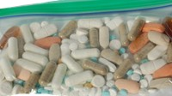
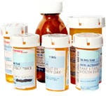
HHW Collection
Bring your medication to a HHW Facility.
Liquid medication & propellant inhaler must have all personal information removed from the containers.
Pills must be removed from original container and put in a sealed plastic bag that is quart size or smaller.
Maximum limit per trip is ONE gallon or 8lbs of medication per trip. Sharps/syringes containing medications are accepted as sharps waste. Residents must follow sharps waste packaging and labeling requirements for proper disposal

Slide 13
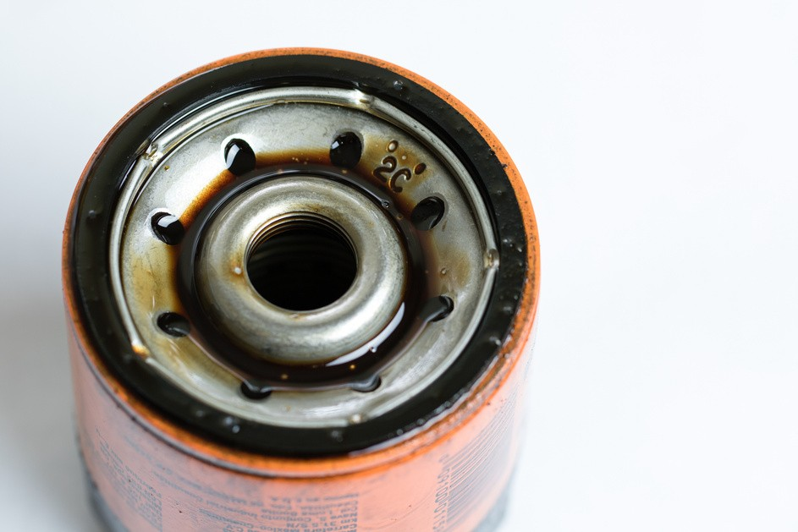
RECYCLE USED OIL & FILTERS
State Certified Collection Centers provide Free recycling and offer recycling incentives
Find a center near you: (800) CLEAN-UP
www.calrecycle.ca.gov/UsedOil/reports/centersearch
.

Slide 14
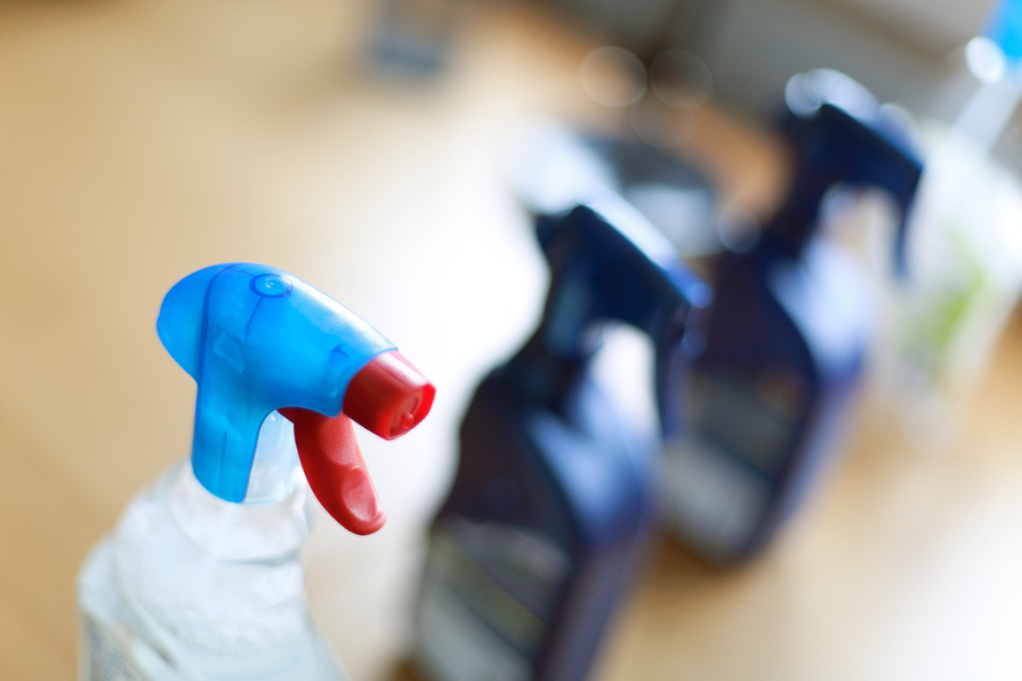
DROP off your hazardous waste and SHOP for free products
All products are inspected and made available to other customers for FREE. Most products are in good condition and sometimes even unopened! Availability of free products varies, but may include: paint, cleaners, pool, spa, lawn care and automotive products.
Open non-holiday Saturdays only during HHW collection hours
www.rcwaste.org/dropandshop
for more information
Agua Mansa (Jurupa Valley) Lake Elsinore
Palm Springs Lamb Canyon Badlands

Slide 15
HHW Prevention
AVOID TOXICS & GO GREEN
FREE online Green Cleaning/Green Gardening classes
For more information, call a
Recycling Specialist at (951) 486-3200
Or visit www.rcwaste.org/outreach

Slide 16
HHW Prevention
Buy Smart
Purchase non-toxic or less hazardous products and only the amount you need. Look for alternative products that don’t contain hazardous waste.
Store Properly
Toxic products are poisonous. Don’t put your family’s health and safety at risk. Keep products out of reach of children and pets.
Use it Up
Finish all unused products and recycle the empty containers or share with friends and neighbors.
Dispose Properly
Keep a box of hazardous waste to be disposed of in a safe place and take to a HHW facility or event at your convenience.

Slide 17
It is ILLEGAL and HHW can seep into the groundwater, waterways, lakes and oceans, causing contamination of our drinking water, beach closures and health hazards to aquatic animal life and humans.
NEVER throw HHW into your garbage, toilets or sinks; never dump on the ground or pour down the storm drain

Slide 18
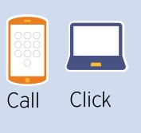
For Hours and
Information
PHONE NUMBER
951-486-3200
WEBSITE
www.rcwaste.org/hhw

Slide 19
Thank you!
QUESTIONS?

