Slide 1
Backyard Composting
Welcome!
The presentation will begin soon.
Please use the Chat section for questions during the presentation.
Notes:
Welcome, Thank you for taking the time from your busy schedule to attend this Backyard Composting class/presentation.
I am ____________ and I have volunteers ________, ________, ________, here to assist today.
Please turn off or silence your cellphones.
Restrooms are located _________________.
Explain how to fill out the customer service survey and how it is an important tool that the department uses to evaluate the presentations and topics for outreach to Riverside County residents. Your input is valued and appreciated.

Slide 2
Waste Programs
Landfill
Backyard
Composting
Not all waste has its own container.
There are special programs to manage waste that should be collected separately and diverted away from the landfill.
Get more information at www.rcwaste.org
Waste
Guide
Vermicomposting
Green Cleaning
Household
Hazardous
Waste
Recycling
Together
Used Oil
Illegal Dumping
Sharps and Needles
Tires
Medical Waste
Community Clean Up
Graffiti Busters
Notes:
The department offers many free programs to residents for recycling and proper disposal of waste.
We encourage all residents to use the recycling containers to separate waste at home and work.

Slide 3
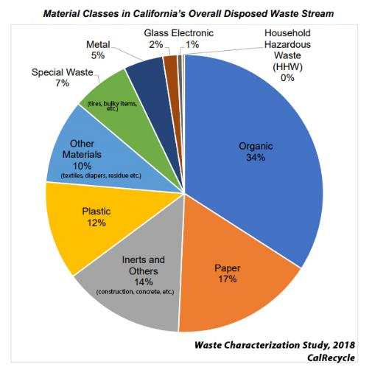
Solid Waste
Our garbage can is full of “waste” only when it is unwanted and unusable by the household.
When many of these items are separated into individual categories, they are treasures or “resources” that can be reused or recycled into new products.
The decision whether to waste our resources or to reuse and recycle them is up to us.
Notes:
What is waste?...Waste studies have been done for many years. Loads of trash are dumped and isolated from other waste so they can separate, categorize, and weigh the waste. The data gathered is then used to develop recycling programs based on the largest percentages of waste which will provide the most effective waste recycling.
Looking at the chart, what are the largest waste streams? (Organics/green waste/food waste, Inert Construction/Demolition debris, Paper)
Organic: green waste from landscaping, tree trimming, weed clearing, food waste, food soiled paper (napkins, paper towels, paper plates, food wrapping, etc.) textiles, agriculture waste, manure, etc.
Inerts and other: concrete, rock, soil, construction demolition debris, roofing material, wood waste, etc.
Paper: mixed papers, white paper, cardboard, chipboard, newspapers, magazines, books, telephone books, etc.
Plastic: electronic housing (plastic around the TV), bottles, food containers, medical supplies, durable plastic (toys, furniture) plastic film (bags, wrapping, VHS tape, etc.), plastic liners,
Special waste: Ash, tires, bulky item, medical waste
Mixed Residue: mixed materials that cannot be separated, fines or waste from MRF, and other materials like kitty litter
Zero Waste is still a long time away so landfills in California will need to exist and keep waste safe in the environment. However, we still need to recycle to conserve landfill space for the future and meet the mandates of the State of California for recycling.

Slide 4
Backyard Composting Program
History of BYC Program
Ingredients
How to Build & Maintain Your Pile
Harvesting & Using Compost
Troubleshooting
Other Methods to Use Organic Material
Compost Bin Sales
Notes:
These are the topics that we will cover in the presentation today.
Mention each one only. NO DETAILS.

Slide 5
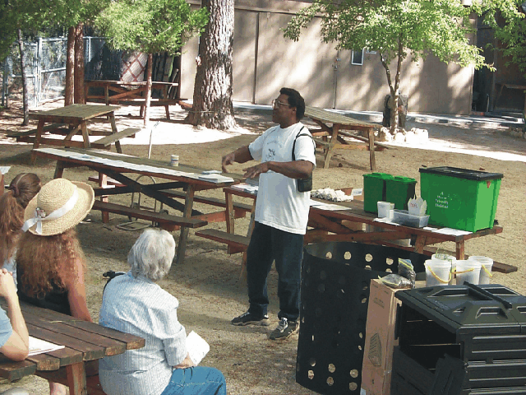
History
Program started 1993
Diversion of waste from landfills
California recycling goal is 75%
Countywide workshops
Low cost compost bins (subsidized by landfill tipping fees)
Volunteer training program
Notes:
The Backyard Composting Program was started in 1993 to help County Jurisdictions meet AB 939 50% Diversion rate.
California’s goal is to reach 75% recycling by 2020.
There are 25 workshops held each year throughout the County.
Workshop:
The Geobin is available for purchase at workshops and Department headquarters in Moreno Valley for $12.00 each. The Department subsidizes the bin from the tipping fees paid at the landfills. Bins are only available to residents of Riverside County, and limited to 3 bins per household. Bins sales will be conducted at the end of the presentation.
This program relies heavily on volunteers for presentation and outreach. We are always looking for new volunteers. If you are interested in becoming a volunteer with the Department, please see me or one of the volunteers after the workshop, or register online on the website www.rcwaste.org.
Introduce next speaker and topics. If one person is doing the presentation state “Next we will be discussing the following topics”.
Presentations:
Let the attendees know they can purchase bins at a workshop on the workshop schedule or they can come to our offices in Moreno Valley.
We are always looking for new volunteers. If you are interested in becoming a volunteer with the Department volunteer program please see me after the presentation on how to enroll.

Slide 6
Compost Ingredients
Brown Material
Green Material
Water
Air (Oxygen)
Helpers (micro and macro organisms)
Labor
Notes:
There are six basic ingredients needed to produce compost.
Browns
Greens
Water
Air
Helpers
And Labor
Compost GIF

Slide 7
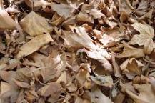
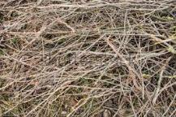
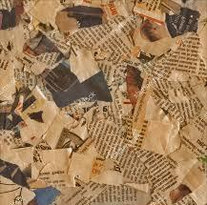
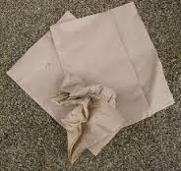
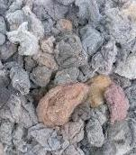
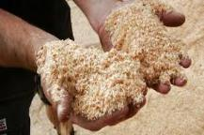
Brown Material
High in Carbon
Dried
50% of pile by volume
Size of Material -- No thicker than little finger
No longer than 6 inches
Notes:
The brown material is dried, high in carbon and is slow to decompose.
These are items where all the nitrogen has been depleted, and are considered to be dead.
The pictures are examples of brown material:
Leaves
Twigs
Cardboard and Newspaper
Napkins and Paper towels
Dryer lint
Sawdust
The brown material is 50% of the pile by volume not by weight.
Browns provide the helpers with steady fuel or energy to breakdown the material. It is suggested that material you wish to compost, be no thicker than your little finger and no longer than 6 inches in length. This will provide the organisms more open surface area for penetration and to begin decomposition process of the material. It also makes the turning and mixing of the material easier.
If you happen to put material in that is thicker and longer, don’t worry, when the compost is finished you can pull the partially composted large pieces and add them to the new compost pile.

Slide 8
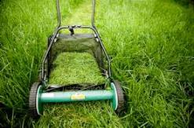
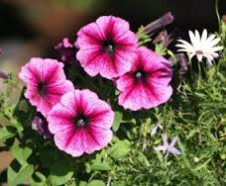
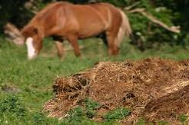
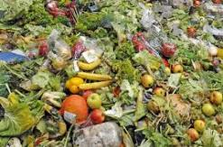
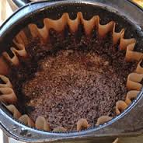
Green Material
High in Nitrogen
Fresh
50% of pile by volume
Notes:
Green material is fresh, high in nitrogen, fast to decompose and provides fuel for helpers to generate heat to speed composting.
The pictures are examples of green material:
Grass
Flowers
Manure
Food waste
Coffee grounds
Green material comprises 50% of the pile in volume, not by weight. Generally, green materials weigh more than brown materials because of the moisture in the material.
Workshop:
Let the attendees know about the ingredient list in the bag they received.
Presentations:
Let the attendees know about the ingredient list is available today.

Slide 9
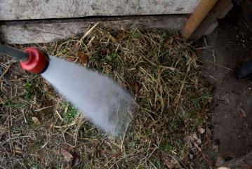
Water and Air
Water
Damp as a wrung-out sponge
Air (Oxygen)
Add by turning pile
Notes:
The next ingredient needed is water. The pile should be kept as damp as a wrung-out sponge. To determine this, take a hand full of compost and squeeze it. The water should barely run out.
Air can be added by turning and mixing the pile about once a week and we will explain more about turning the pile when we address maintaining the pile.
Introduce next speaker and topics. If one person is doing the presentation state “Next we will be discussing the following topics”.

Slide 10
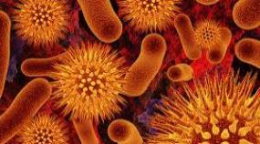
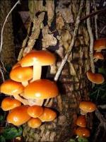
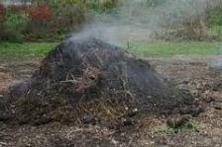
Helpers
Microorganisms
Psychrophilic 50 - 70°F
Mesophilic 70 - 90°F
Thermophilic 90 - 150°F
Temperature Objectives:
130 - 140°F
Maintain for 3-4 weeks by aerating/turning the pile
Destroys most weed seeds and disease germs
Actinomycetes
Gray ashy look
Bacteria
Fungi
Actinomycetes
Notes:
Your helpers are micro and macro organisms.
Microorganisms are tiny and you need a microscope to see them. They are all present on the material in the pile and the ground.
Three microorganisms are present in the pile at the same time. Psychrophilic near the outside or coldest part, mesophilic half way between the outside and middle, and the thermophilic in the very center were the pile is the hottest.
Some like cool temperatures and are called psychrophilic. They prefer temperatures in the 50 to 70°F range. As they start to eat, move around and reproduce, they generate heat. When the temperatures gets hotter than they prefer, they may get eaten by others, die or move to a cooler part of the pile.
The next group of microorganisms are called mesophilic. These are the hardest working helpers in the plie. They prefer temperatures in the 70 to 90°F range. They work when the pile is heating up and cooling down. Just like the psychrophilic, when the temperatures get hotter than they prefer, they may get consumed by others, die or move to a colder part of the pile.
The thermophilic microorganisms can heat the pile temperatures from 90 to 150°F range. When the pile starts to cool down they stay in the very center where the pile is the hottest.
We are trying to reach temperatures that are between 130 - 140°F, and maintain these temperatures for 3 to 4 weeks by turning the pile once a week.
By maintaining these temperatures for that length of time, 85 to 90% of the weed and grass seeds will be destroyed. It will also help destroy some of the disease germs.
When you turn your pile, you may see the activity of actinomycetes. They are a cross between a bacteria and fungus. You cannot see one, but when there are millions present you can see them. When some people see them they think they may have had a fire in their plie. What makes them think this, is when they go to turn their pile, they see steam coming off the pile and then they see the activity of the actinomycete, that has a gray ashy look. Don’t worry your pile was not on fire, just cooking.

Slide 11
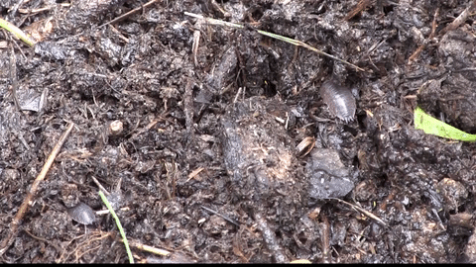
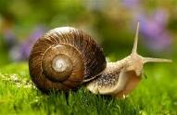
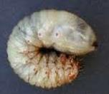
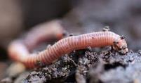
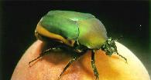
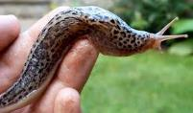
Helpers
Macro organisms
Bugs you can see
Already in your yard
Present in pile when cool
Continue decomposition
All good for your pile
Notes:
The five shown are just examples of what you may see in your pile:
Sow bug
Snail
Springtail
Worm
Green fruit beetle larvae or aka Figeater
Slug
Green fruit beetle or aka Figeater beetle
After about 4 to 5 weeks when the pile cools down, the temperatures stays between 90 - 100°F and you can no longer recognize any of the material in the pile, it all looks the same, is when the macroorganisms will appear.
Don’t worry these bugs were already in your yard and your neighbors’ yard. You have built a beautiful 5 star hotel and restaurant that calls to the bugs telling them to come live and eat for free.
These helpers will only come to the pile when the pile cools and stays at ambient air temperatures.
They continue the decomposition process, and all the bugs in your pile are good for this process, they eat and poop to make the compost richer.
They are the bigger bugs that you can see.
The bug on the middle is the larvae from the green fruit beetle below it and is the one most people see in their pile. The fruit beetle gets blamed for destroying fruit, but it can’t eat healthy fruit. It does not have a sharp mouth or the type of mouth parts to bite fruit. Its mouth is shaped like a scoop and can only eat damaged or decomposing fruit.
Introduce next speaker and topics. If one person is doing the presentation state “Next we will be discussing the following topics”.

Slide 12
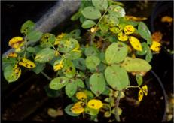
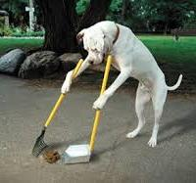
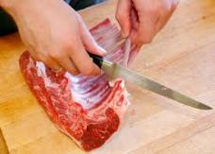
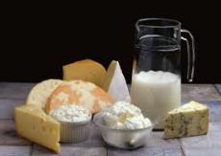
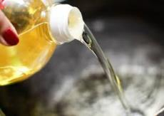
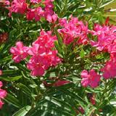
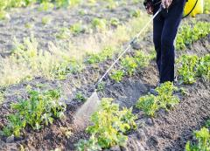
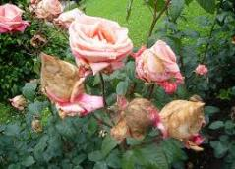
Ingredients to Avoid
Notes:
Diseased Plants: Diseased plant material can spread the disease to other plants. Temperatures in the pile may not be hot enough to kill plant diseases.
Material that was recently treated with pesticides should be avoided.
Fecal waste: The difference between fecal waste and manures, is that fecal waste has pathogens that the heat produced in home composting may not be hot enough to kill.
Meat, fat, bones, dairy products, and oils: Will decompose, but the odor given off by them may attract unwanted pests.
Poisonous plants: When it comes to poisonous plants, such as Oleander, we err on the side of safety. If not completely composted, and compost is used in a vegetable garden, there could be residue of the poisonous plant left on the root vegetables is they are not completely washed prior to consumption.
Plants or grass that has been treated with fungicides or pesticides .
Thorns: Thorns on thorny plants are very high in oils, very hard, and take a very long time to decompose. If used in your pile, you might get stuck touching compost with your hands.
Additional cautions:
Do not use material that was recently treated with pesticides or fungicides, because pesticides don’t know the difference between good and bad bugs and will kill both.
Invasive plants: Mowed grass is okay, but dug up Bermuda grass stolons may regrow. If you are using horse manure, ask what type of hay is being fed, if Bermuda is in the hay, it may regrow in the compost pile.

Slide 13
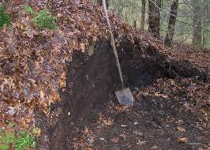
Bins or Piles?
Open Pile
About 1 to 5 cubic yards
Larger: hard to turn
Smaller: may not maintain heat
Bins (Contained Pile)
Store-bought bins
Home built bins
Notes:
Piles in Backyard Composting should be between 3 X 3 X 3 feet (27 cubic feet or 1 cubic yard) to 5 X 5 X 5 feet (125 cubic feet or 4.6 cubic yards). For ease of turning.
Larger piles are hard to turn and are very time consuming.
Smaller piles will not generate or maintain the heats required and will take longer to compost.
Contained piles can be built using store-bought compost bins, like the Geobin or you can build your own bin.
More plans are available on the California Department of Resources Recycling and Recovery (CalRecycle) web site shown on the Resources slide at the end of the presentation.

Slide 14
Benefits of Using a Compost Bin
Aesthetics/Appearance
Contains material
Less water loss
Easier to keep covered
Notes:
A compost bin is more pleasing to the eye than an open pile, and may meet your Home Owner Association requirements.
The bin, unlike an open pile, contains the compost material and keeps the material from spreading out on the ground, and aids in the heating up process.
There is less water loss in a bin than with a pile. Water loss is a big concern today in California.
The material in a pile on the ground is harder to keep covered than the material in a bin, but you can use tarps or carpet to cover a pile.

Slide 15
Location
Convenient to water & turning
Shade/sun
Direct soil contact
Not up against house or fence
2x the space (for turning)
Notes:
The bin or pile needs to be convenient for your use and close to water.
In Southern California, because of the heat, most people prefer to have their bin or pile in the shade. The heat in the pile is generated internally and not dependent on sun or shade.
The bin or pile must have direct contact with the soil for drainage, and so helpers and migrate to the pile or come up through the soil. It cannot be on asphalt or concrete – leachate from over-watering or drainage can stain concrete.
The composting area needs to be twice the size of the bin, so that you can easily move the bin to turn the material, and work it from different angles.
Introduce next speaker and topics. If one person is doing the presentation state “Next we will be discussing the following topics”.

Slide 16
Building the Anaerobic Pile
Pile material as gathered
Without oxygen (Cesspool-septic tank)
Odor/Smelly
Cold
Slow (6+ months)
Water if desired
Cover pile if desired
Notes:
Anaerobic composting is nothing more than piling your material as you gather it.
It is the way nature does composting. When the leaves fall from the trees they build layers. Over time these layers decompose and form earthy smelling humus.
A true anaerobic climate is like a Cesspool or Septic Tank where all of the oxygen has been replaced with water.
It can have an odor and be smelly. The anaerobic pile is not turned and the oxygen level in the pile decrease to low levels.
It is a cold process that does not produce any heat (and will not kill weed seeds).
Without the infusion of water and air, the microorganisms needed to break the pile down, do not need oxygen and will not cause the pile to heat-up.
Most of the composting is done by macro organisms.
Because of the conditions we just discussed, the anaerobic system is a very slow process and depending on the material, size, and texture, can take 6 months or more to compost. The composting process starts at the bottom and goes up, as opposed to the aerobic system where the composting takes place throughout the pile simultaneously.
As in nature, there is no need to turn or add any additional water. If you want to, you can water, turn the pile or cover, but it is not necessary
Anaerobic Composting is the lazy man’s way to compost. Just let it sit and compost will happen.

Slide 17
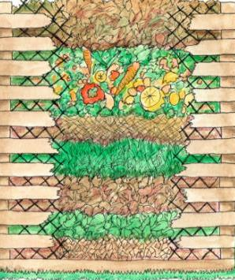
Building the Aerobic Pile
Alternate browns; greens; add water
Requires turning for oxygen
Pleasant odor
Hot (goal 130 -140°F)
Fast (10 to 12 weeks)
Cover pile
Bury food scraps (if used)
Notes:
Most composters prefer the aerobic method over the Anaerobic method because it is a faster process, however it is more labor intensive.
We need a 50:50 ratio of brown and green material by volume. Simply start with a layer of brown material, add a layer of green material, and then add water. Continue this process until the bin is full to the top.
Add oxygen by turning weekly.
If done correctly, it has a pleasant odor and smells like fresh damp earth.
It is a hot process and can produce heats between 130 to 140°F.
To get finished compost in 10 to 12 weeks you need to maintain this heat for 3 to 4 weeks by turning and watering the pile.
Cover the pile with cardboard, newspaper, black plastic bags, or a piece of remnant carpet to help maintain moisture levels.
Secure the cover from blowing away.
When adding food scraps, bury them one foot deep in the pile. This helps reduce food odor and will keep unwanted pests away.
Workshop:
In your bag is a book called “Home Composting Made Easy”, this book will help answer questions you many have after the workshop.
On the Resources slide and in the handout you have, there are two other books listed as references, these are very good references.
Presentation:
Mention the three books listed on the Resources slide.

Slide 18
Raw Material to Finished Compost
Turning the pile:
Once a week until finished
Speeds up process
Adds oxygen to maintain heat
Eliminates matting
How to turn
Remove the bin
Move material
Replace cover
Notes:
To obtain finished compost in a 12 week timeframe, the pile needs to be turned on a weekly basis.
This speeds up the process, helps maintain the heat needed (130 – 140 degrees), prevents the material from matting (sticking together) and also destroys 80 – 85% of weed seeds and pathogens.
Less than weekly turning will significantly length the time to completed compost.
Remove the bin from the composting material. This could take two people, it can be done with one person, but it is harder.
Place the empty bin one to two feet from the composting material. This makes the turning process easier (Presenter should demonstrate)
Moving the material requires a pitch fork or garden fork.
Starting from the outside edge, take a pitch fork of material and fluff it into the empty bin. (Demonstrate)
Add water as needed to maintain the damp as a wrung out sponge consistency.
(Presenter: tell the participants that the material will no longer fill the bin to the top because it is beginning to breakdown.)
Replace cover.
Introduce next speaker and topics. If one person is doing the presentation state “Next we will be discussing the following topics.
Presentation:
If bin is available, demonstrate above procedure, otherwise, explain thoroughly.

Slide 19
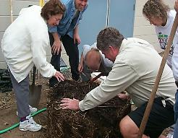
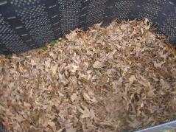
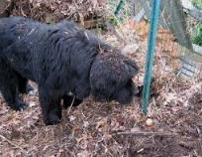
Troubleshooting Problems
Odors
Ammonia – too much green
Putrid or sulfur – too much water
Pile not heating up
Pile too small
Too dry
Not enough green
Pests
Pets, wild animals
Flies
Ants
Notes:
These are some of the common problems you might encounter.
Let’s discuss them…

Slide 20
Harvesting Compost
Should be ready in 10-12 weeks
Dark and crumbly
Rich earth smell
Notes:
The pile should be ready to use in about 10 to 12 weeks.
You can tell it’s done when it is dark, crumbly like chocolate cake, smells like fresh damp earth, and looks like nothing you started with.
We started with the compost bin full to the top. When the compost is finished you will have about 1/3 to ½ bin full of nutrient rich compost. Just think about how much material you keep out of the landfill.
This is enough cover a 6 foot square area 3 to 4 inches deep with compost.

Slide 21
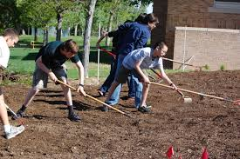
Using Compost
Uses
Soil incorporation
Mulch
Tea
Notes:
Compost in the soil provides natural nutrients to plant roots, helps to hold moisture through periods of drought, and helps to create healthier soil to aid plants in fighting diseases.
Soil incorporation is adding the compost to your soil and digging it into the earth.
Mulching is placing the compost on top of the ground, being sure to keep it away from stems and trunks. Layer the compost 2 to 4 inch deep.
Compost tea is a soil amendment made by steeping finished compost in a bucket of water for a day and then used as a foliar spray of plant drench.

Slide 22
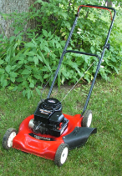
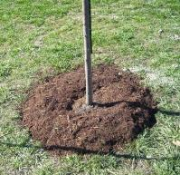
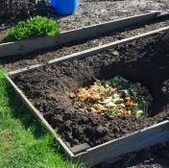
Other Organic Material Methods
Grasscycling
Cut 1/3 of grass blade
Mow more frequently
Leave cuttings to decompose
Mulching
Layer 2-4 inches thick
Grass clippings, leaves, wood chips
Post-hole composting
Food scraps only
Notes:
If you choose not to compost, here are some alternatives
Discuss the properties of each method and the benefit of using yard waste on-site instead of sending away for processing.

Slide 23
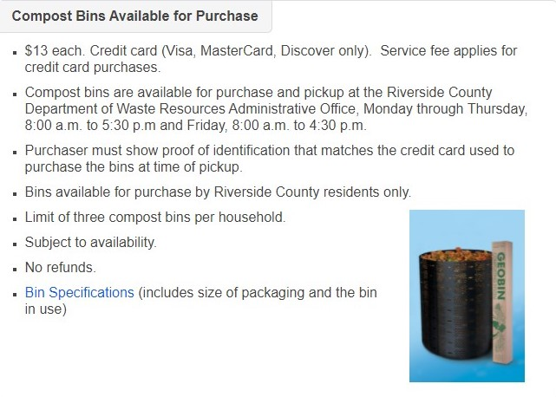
Compost Bin Sales

Slide 24
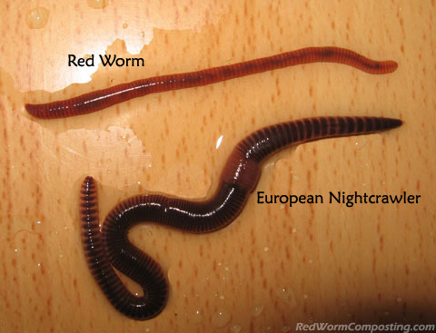
Vermicomposting
Worms turn food into compost!
Attend a FREE Vermicomposting Class!
For more information: www.rcwaste.org/Vermicomposting
Notes:
Vermicomposting is an easy way to compost food waste. It can be done is a small area indoors or outdoors. It is a ideal way to turn your food scraps into a useful product if you cannot do backyard composting.

Slide 25
Online Resources
Free Classes
www.rcwaste.org/classes
Notes:
Go to rcwaste.org/classes and click on any of the topics. The links will bring you to the registration page for future classes as well as any on demand classes available for that topic.
The Department has adapted this program from a presentation by Kevin Marini, and thanks him for his permission to use.
Kevin is a Master Gardener with the UCCE Placer/Nevada Counties.

Slide 26
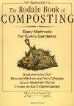
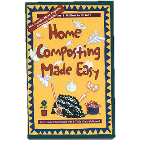
Additional Resources
The California Department of Resources Recycling and Recovery (CalRecycle)
https://www.calrecycle.ca.gov/organics/homecompost, includes links to build your own bin.
Home Composting Made Easy
By C. Forrest McDowell, PhD & Tricia Clark- McDowell (Cortesia Press)
Let It Rot
By Stu Campbell (Storey Book 3rd Edition)
The Rodale Book of Composting
By Gracy Gershuny and Deborah I. Martin (Rodale Press)
Notes:
Here are the resources we discussed during the Workshop or Presentation.

Slide 27
Thank you for being part of the solution
Give us feedback at:
www.rcwaste.org/report/feedback
Follow us on:
(951) 486-3200
www.rcwaste.org
Notes:
Go online, look for program and free class information. Follow us on social media for recycling tips and places to get more information. And let’s work together to manage our waste responsibly.
Riverside County Department of Waste Resources is proactive in developing sustainable waste recycling programs to conserve resources in our community. We thank you for doing your part to manage waste and care for the environment. Once again, call or follow us if you want more information or sign up for free workshops at rcwaste.org
And if you’re interested in becoming an Outreach Volunteer. You can do that online as well and we’ll tell you when our next orientation class is.

