Slide 1
RIVERSIDE COUNTY
D E P A R T M E N T O F W A S T E R E S O U R C E S
WASTE WISE CHAMPION

Slide 2
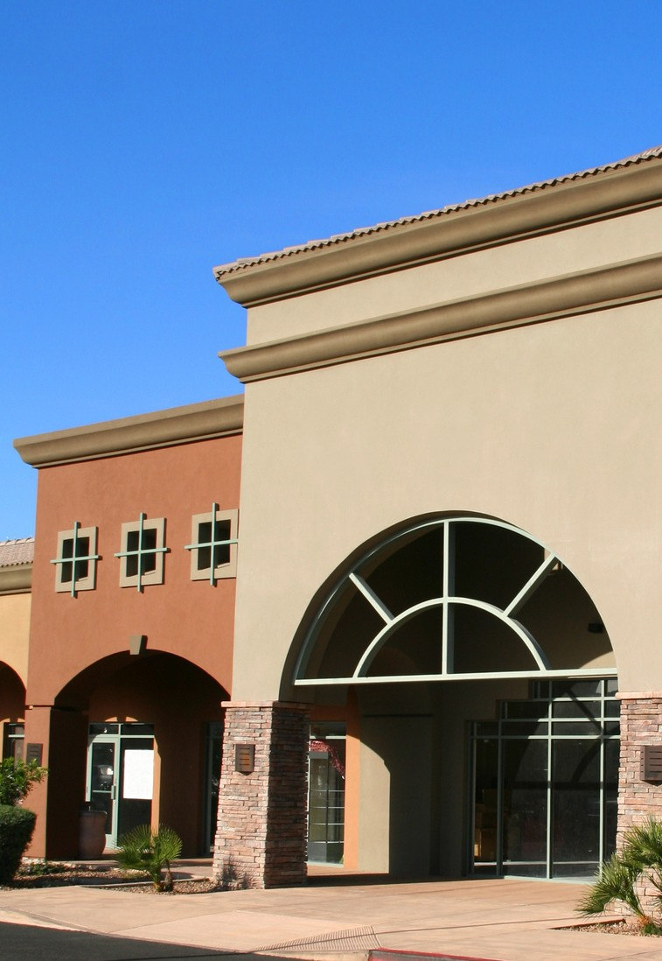
WHAT IS THE RIVCO WASTE
WISE CHAMPION?
The Riverside County Waste Wise Champion Program hopes to achieve a cleaner environment by helping businesses integrate environmental responsibility into their operations in a manner that is sustainable as
well as profitable and driven. Sustainable
community business
practices promote not only healthy environments, but also healthy communities.

Slide 3
WHY JOIN?
Environmental regulations and mandates in California are
continuously changing, this sustainable plan is one step ahead of new laws while cutting costs and taking advantage of various
benefits such as:
Waste reduction strategies
Attracting environmentally-conscious customers Improving efficiency of productions to cut costs
Providing a safer environment to improve employee health and morale
Free technical assistance from Riverside County Department of Waste Resources
Free Sustainable Business marketing material as well as county-wide recognition

Slide 4
WHO CAN JOIN?
Any business, non-profit, faith based organizations, businesss to name a few located within unincorporated Riverside County can be certified as a Riverside County Waste Wise Champion.
Arts, Entertainment, and Recreation
Mining Manufacturing- All Other
Agriculture Medical & Health
Construction Public Administration
Durable Wholesale and Trucking Restaurants;
Education Retail Trade: Food & Beverage Stores
Hotels & Lodging Services: Management, Admin, Support, and Social Manufacturing Electronic Equipment Services: Professional, Technical, and Financial Manufacturing Food & Nondurable Wholesale Services: Repair and Personal

Slide 5
HOW CAN WE JOIN?
Visit www.rcwaste.org/business/recycling/wwc
Fill out the "Intent to Register" form located on the website A Recycling Specialist will reach out with the scorecard and necessary documents
Fill out the Waste Wise Scorecard and email it back to the Recycling Specialist
A Specialist will evaluate the scorecard and provide additional methods for improvement

Slide 6
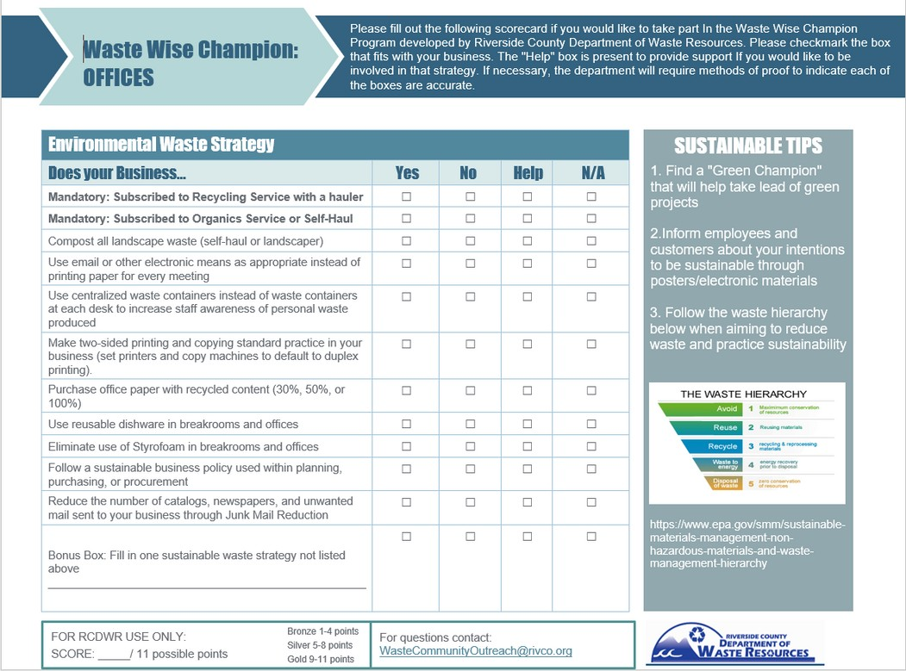

Slide 7
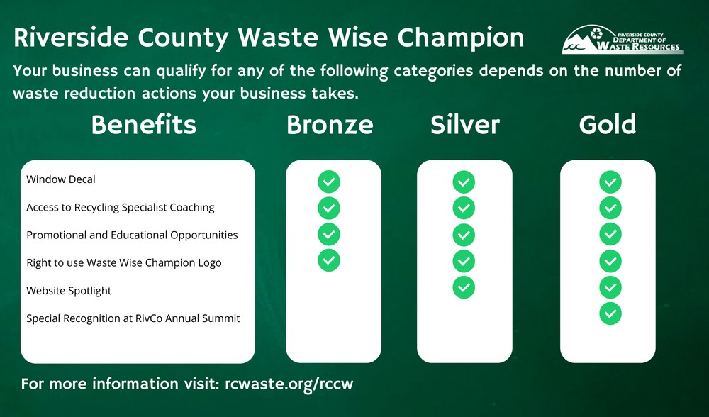
BUSINESS TIERS

Slide 8
ANYTHING ELSE?
There is no cost to participate in the Riverside County Waste Wise Champion Program.
The process from beginning to approval can take up to two weeks, or longer, depending on how quickly the
business schedules their virtual site visit.
Please direct all questions to wastecommunityoutreach@rivco.org and title the subject line “RivCo Waste Wise Champion” https://www.rcwaste.org/business/recycling/wwc

Slide 9
LAKE SKINNER
RECREATION AREA
G O L D L E V E L W A S T E W I S E C H A M P I O N

Slide 10
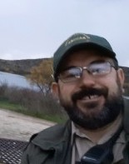
SONNY
WALDRON
Park Ranger II at Riverside County
Regional Parks and Open-Space District

Slide 11
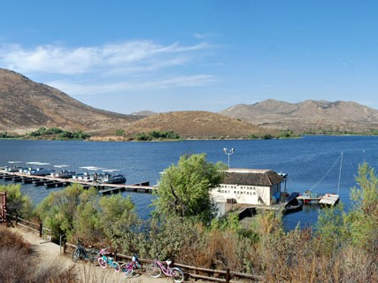
Standard Operating Procedures
PARK
SUSTAINABILITY

Slide 12
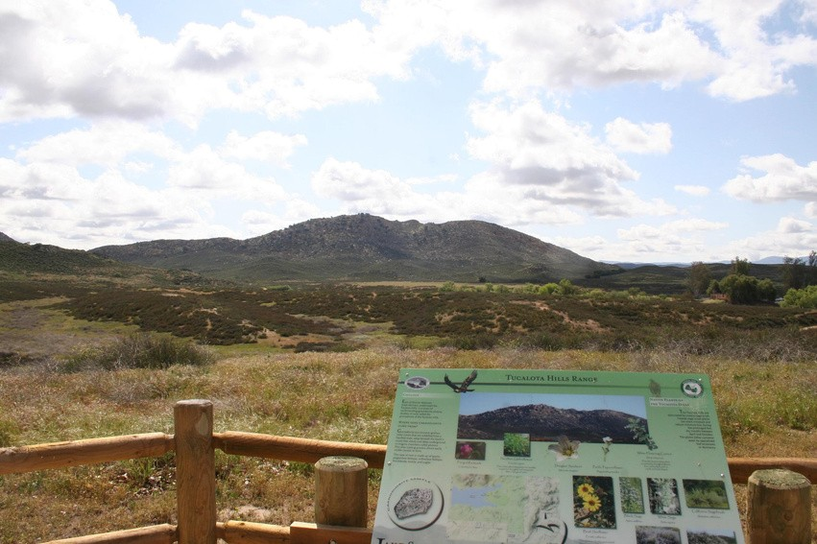
GETTING
STARTED ON THE PATH TO
1
Reduce
SUSTAINABILITY
2
Reuse
3
Recycle

Slide 13
R E D U C E
Energy
AC and heaters Timers
Set points
Trash
Lights
Sensors
Led upgrades
Printing practices Narrow margins
Two-sided printing
Water
Single use items
Kitchen utensils, cups, and plates become reusable
Cleaning supplies
Rags and sponges instead of Paper towel
Trash emptied into
containers instead of bags
Turf reduction
Winter irrigation change Splash Pad actuators
Fuel
Idle time reduction
Smart vehicle choices

Slide 14
Paper
R E U S E
Scratch paper
Printing both sides Craft projects
Plant materials
Landscaping Craft projects
Excess material from projects
Donation to libraries
Shade shelter rehabilitation Horseshoe pits
Repair instead of replacing

Slide 15
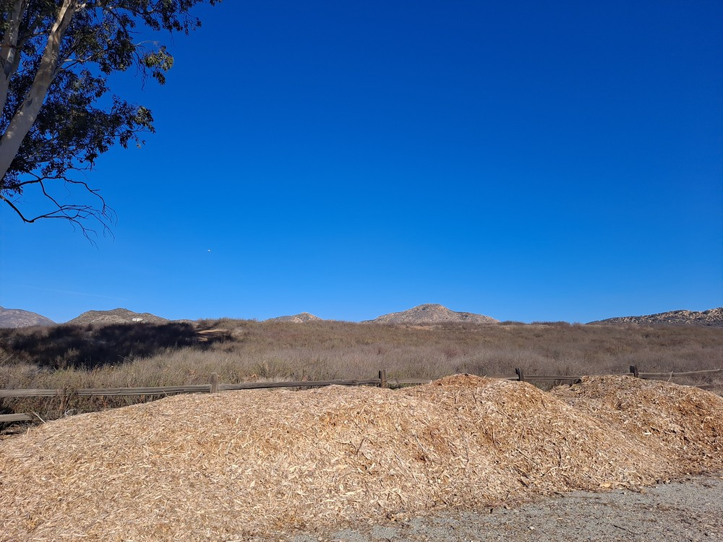
GREEN WASTE TURNED INTO LANDSCAPING
MATERIAL

Slide 16
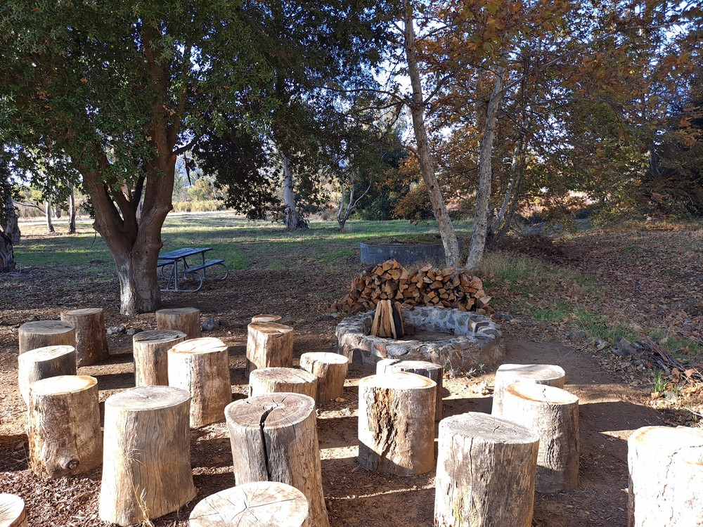
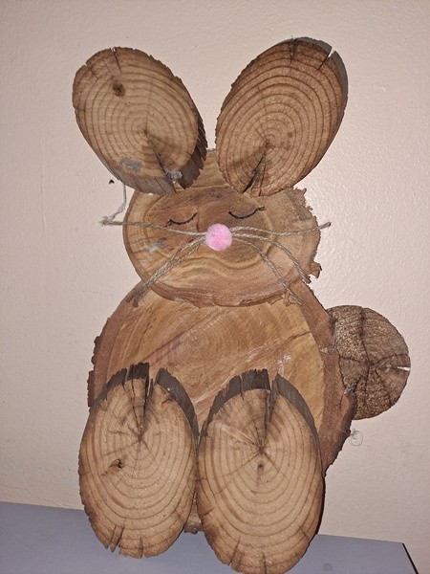
GREEN WASTE UTILIZED IN SEATING, FIREWOOD AND CRAFTS

Slide 17
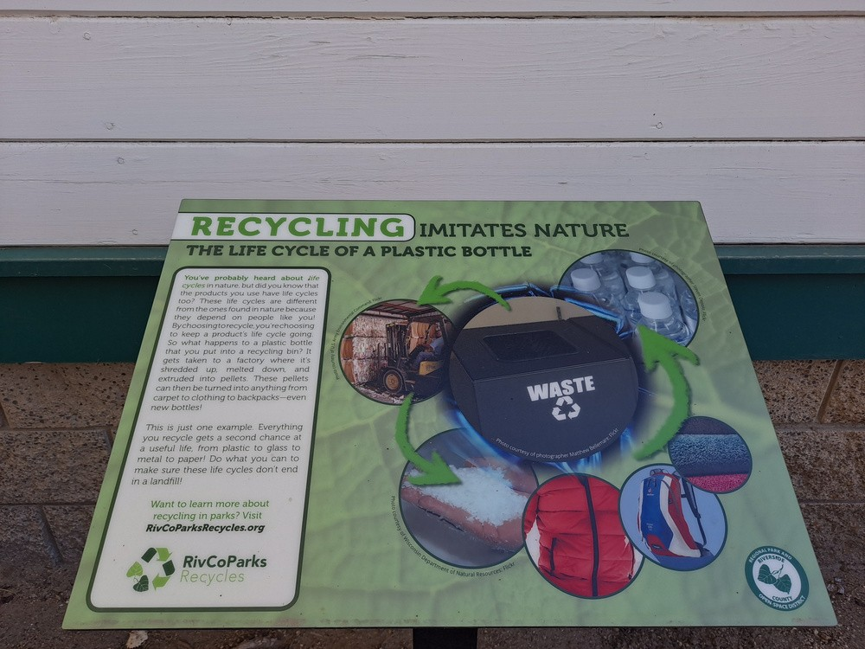
RECYCING EDUCATIONAL SIGNAGE POSTED IN THE GARDEN

Slide 18
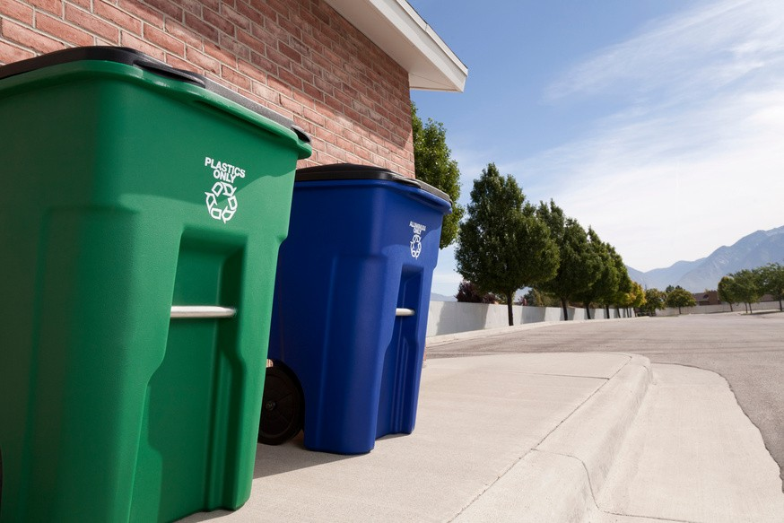
Add recycle bins next to trash cans
R E C Y C L E
Reclaim items Fishing line
Hazardous waste Used oil
Batteries
Light bulbs Paint
Electronics

Slide 19
STANDARD OPERATING PROCEDURE
The Sustainability Standard Operating Procedures (SOP) will establish best practices for Lake Skinner Recreation Area, and its associated offices and facilities. The SOP document outlines the scope and plans for implementation and enforcement. The SOP provides ongoing operational procedures for park
development, climate impact, community engagement, energy conservation, mind full purchasing, sustainable transportation,
and water and waste
reduction and recycling. The document establishes parameters for existing and ongoing projects, sites, and buildings. New projects and buildings should take SOP guidance into consideration during design and construction phases. It is intended that the document evolve over time.

Slide 20
WHAT IS IN
OUR SOP?
Park development
Climate impact
Community engagement Energy & water efficiency Purchasing
Transportation
Waste Reduction & Recycling Accountability

Slide 21
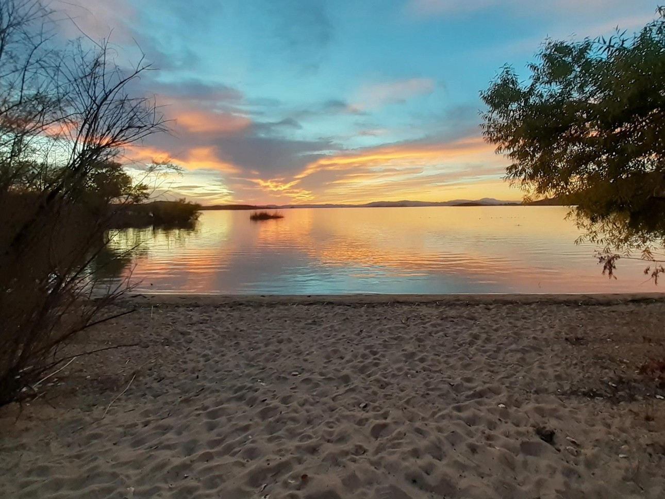
THANK YOU!
swaldron@rivco.org Rivcoparks.org

