Slide 1
Waste Reduction in Retail and Office
Kathleen Utter

Slide 2
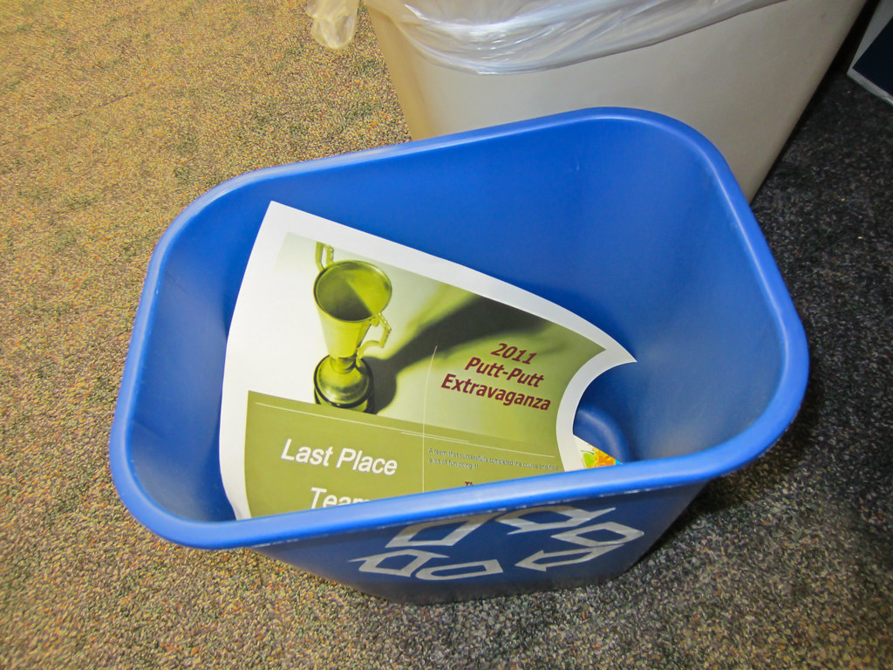
​Why Is Recycling at Work Important?​
Businesses are Required to Follow State/County Recycling Regulations
There are requirements for business, employees and customers
containers (AB 341, AB 1826, AB 827 and SB 1383)
Most of us spend more time at work than at home
Ex: 9-6PM at work for 5 days a week​
You sometimes create more waste at work without knowing it​
The average American office worker goes through 500 disposable
cups over the course of 12 months
Notes:
Why Is Recycling at Work Important?
For Employers
Businesses are Required to Follow State/County Recycling Regulations
There are requirements for business, employees and customers
containers
Right size your waste/recycling/organics options
Waste/recycling/organic is a business expense, but reducing it could save money
For Employees
Most of us spend more time at work than at home
Ex: 9-6PM at work for 5 days a week
You sometimes create more waste at work without knowing it
The average American office worker goes through 500 disposable
cups over the course of 12 months

Slide 3
Waste Audits
Prior to beginning it is important to determine who oversees waste management at your business space. This could be several people, including an individual in accounting and facilities management. If you have a property management handling any waste management, then it will be important to have a representative there as well. These individuals can be the beginning of your Green Team, or you can select others for the team. The most important thing would be for the Team to understand the goal and requirements.
The next step would be to determine what is in all of your bins. Please remember to check the bins prior to the waste being picked up as well as indoor and outdoor bins. This gives you a better idea of what is being put in each bin and the fill level of the containers.
Your waste hauler will be able to assist you with a waste audit if you would prefer.
Notes:
Prior to beginning it is important to determine who oversees waste management at your business space. This could be several people, including an individual in accounting and facilities management. If you have a property management handling any waste management, then it will be important to have a representative there as well. These individuals can be the beginning of your Green Team, or you can select others for the team. The most important thing would be for the Team to understand the goal and requirements.
The next step would be to determine what is in all your containers. Please remember to check the containers prior to the waste being picked up as well as indoor and outdoor bins. This gives you a better idea of what is being put in each container and the fill level of the containers.
Your waste hauler will be able to assist you with a waste audit if you would prefer.

Slide 4
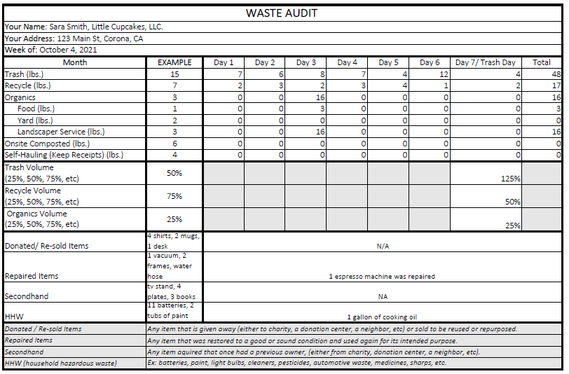
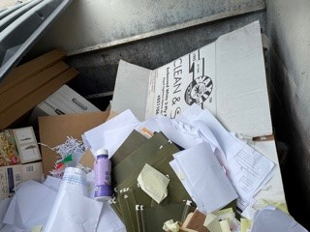
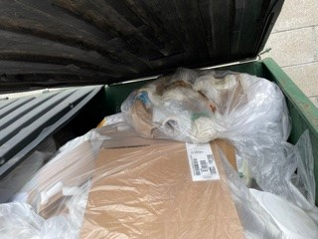
Example of Waste Audit
Recycling Bin – day of pickup
Waste Bin – day of pickup
 |  | ​
Notes:
While completing the waste audit please keep the following in mind:
Include fill level of containers
How many waste/recycling containers and where they are located, again both inside and outside
What is most of the material in each container, this can be visually and does not have to be weighed
Also keep in mind other items you might have that can be recycled but may not go in the waste/recycling bins, such as, computer, cell phones and other e-waste, so include these on your waste audit. these items are not placed in the waste/recycling bin; however, still need to be recorded
Landscaping also needs to be analyzed. If you have an organics container that your landscaper utilizes, or do they take the material to a greenwaste facility, this is required.

Slide 5
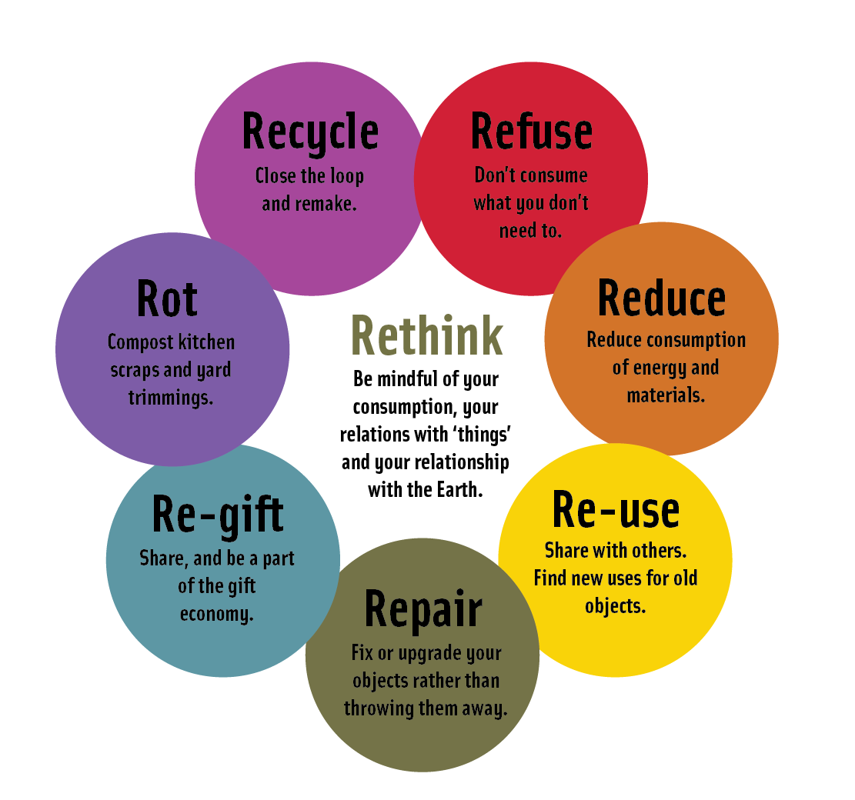
The Eight "Rs"
Notes:
The next step is to remember the eight R's. Traditionally we have been taught the three R's (Reduce, Reuse and Recycle), but with Zero Waste we need to add another 5 R's (Refuse, Repair, Re-gift, Rot and Rethink). These will hopefully start us thinking about waste as resources.

Slide 6
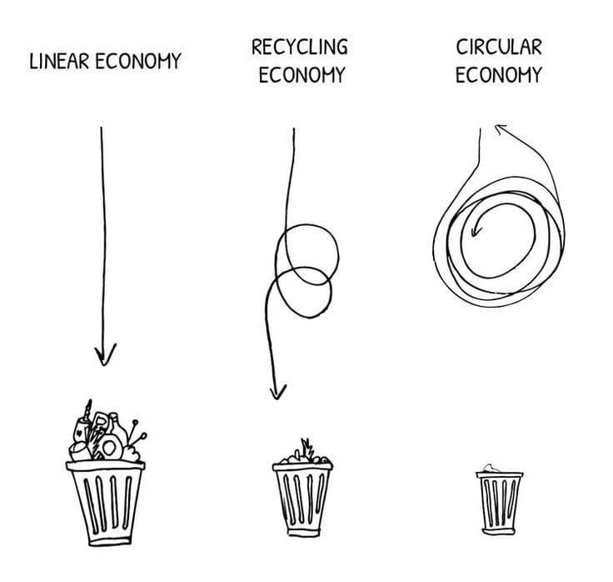
What is the Circular Economy and How Does it Relate to Waste Reduction for Business?
Circular Economy is an alternative to a traditional linear economy (make, use, dispose) in which we keep resources in use for as long as possible, extract the maximum value from them whilst in use, then recover and regenerate products and materials at the end of each service life.
https://treadingmyownpath.com/2020/08/06/zero-waste-circular-economy/
Notes:
Circular Economy is an alternative to a traditional linear economy (make, use, dispose) in which we keep resources in use for as long as possible, extract the maximum value from them whilst in use, then recover and regenerate products and materials at the end of each service life. This is also called a closed loop system. It is associated with Zero Waste because it plans to extract the maximum value of any resource, from the production to the final ending, which hopefully will be able to circulate within the economy for many lives. This saves natural resources and disposal costs and landfill space.
A circular economy is a systemic approach to economic development which is designed to benefit businesses, society and the environment.
This is in contrast to our current model, which is linear, and operates as ‘take-make-‘waste’.
A circular economy is regenerative by design – resources aren’t ‘used up’ but are kept in circulation, and are eventually remade, repurposed, refitted or recycled.
This illustration is an excellent simple summary of the linear, recycling and circular economies. (Source: Plan C – Empowering circular futures.)

Slide 7
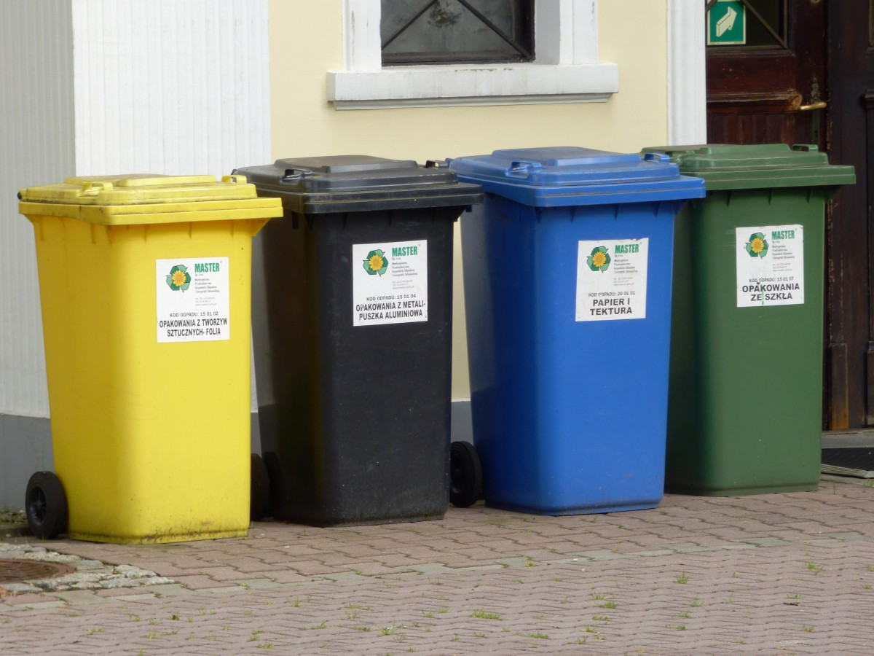
Right Size and Centralized Bins
Choose appropriate waste/recycling/organic bins.
Locate waste/recycling/organic bins strategically and label them clearly including educational
messages that show what is acceptable in each bin.
Monitor waste/recycling/organic bins for contamination on a regular basis.
Report during staff meeting or internal memos
Notes:
Now that you know what is being put in the waste/recycling/organic bins both inside and outside, here are some suggestions that might help reduce the amount of waste, help report and promote your successes.
Choose appropriate waste/recycling/organic bins.
Locate waste/recycling/organic bins strategically and label them clearly including educational
messages that show what is acceptable in each bin.
Monitor waste/recycling/organic bins for contamination on a regular basis.
Report during staff meeting or internal memos

Slide 8
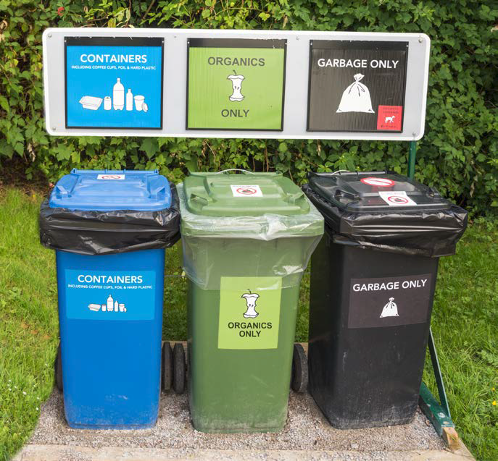
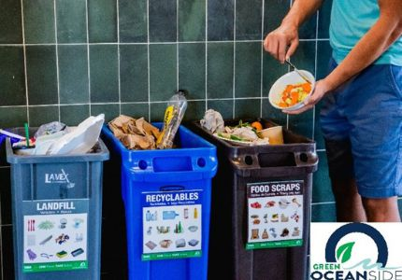
Example of Educational Signage
https://www.calrecycle.ca.gov/recycle/commercial/organics/prtoolkit
Notes:
Now that you know what is being put in the waste/recycling/organic bins both inside and outside, here are some suggestions that might help reduce the amount of waste, help report and promote your successes.
Choose appropriate waste/recycling/organic bins.
Locate waste/recycling/organic bins strategically and label them clearly including educational
messages that show what is acceptable in each bin.
Monitor waste/recycling/organic bins for contamination on a regular basis.
Report during staff meeting or internal memos

Slide 9
What is the cost of Contamination?
Contamination is a concern for everyone. While the individual may receive an extra charge on their next bill, if the contaminated material reaches the sorting facility it could potentially impact a much larger amount of material. Recyclables are sold through markets so the cleaner the material the more opportunity to sell that material.
In order to help control contamination, the following are a few suggestions:
Always ensure a recycling and organic bins are next to a waste bin. This allows customers to have the correct bins on hand.
Provide clear signage on all bins, include graphics. If you have any question on what is acceptable, please contact your waste hauler.
Ensure that you have a waste or green team that monitors waste/recycling/organics of the business.
Notes:
Contamination is a concern for everyone. While the individual may receive an extra charge on their next bill, if the contaminated material reaches the sorting facility it could potentially impact a much larger amount of material. Recyclables are sold through markets so the cleaner the material the more opportunity to sell that material.
In order to help control contamination the following are a few suggestions:
Always ensure a recycling and organic bins are next to a waste bin. This allows customers to have the correct bins on hand.
Provide clear signage on all bins, include graphics. If you have any question on what is acceptable, please contact your waste hauler.
Ensure that you have a waste or green team that monitors waste/recycling/organics of the business.

Slide 10
Reduce Paper Use
When printing a document, consider whether you really need the whole document.
When photocopying, only make the necessary number and copy on both sides whenever possible.
Use fewer sticky notes by keeping an Outlook or on-line calendar.
When proofreading a document, try to do it on your computer screen instead of printing a hard
copy to mark up. It will save you time, ink/toner, and paper.
Sign-up for electronic newsletters when possible.
Instead of copying and sending materials to employees, send them an e-mail or post your
message on a common site.
Notes:
Using less paper in the first place means you’ll save money, fewer trees will be cut for paper pulp, less energy and water will be wasted in the manufacturing process, and fewer greenhouse gasses will be produced. Develop a habit of thinking ahead about what you use; it may affect your purchasing needs.
When printing a document, consider whether you really need the whole document.
When photocopying, only make the necessary number and copy on both sides whenever possible.
Use fewer sticky notes by keeping an Outlook or on-line calendar.
When proofreading a document, try to do it on your computer screen instead of printing a hard
copy to mark up. It will save you time, ink/toner, and paper.
Sign-up for electronic newsletters when possible.
Instead of copying and sending materials to employees, send them an e-mail or post your
message on a common site.

Slide 11
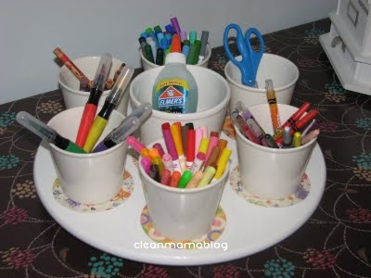
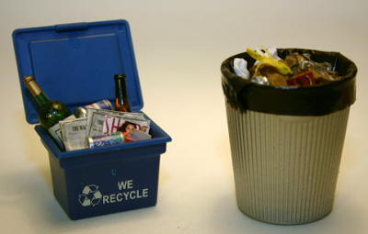
Reuse
Use the blank backs of copies for scratch paper.
Reuse envelopes, folders and boxes when possible.
Bring your own plate, silverware and coffee mug to work instead of using disposable ones.
Notes:
Reuse
Use the blank backs of copies for scratch paper.
Reuse envelopes, folders and boxes when possible.
Bring your own plate, silverware and coffee mug to work instead of using disposable ones.

Slide 12
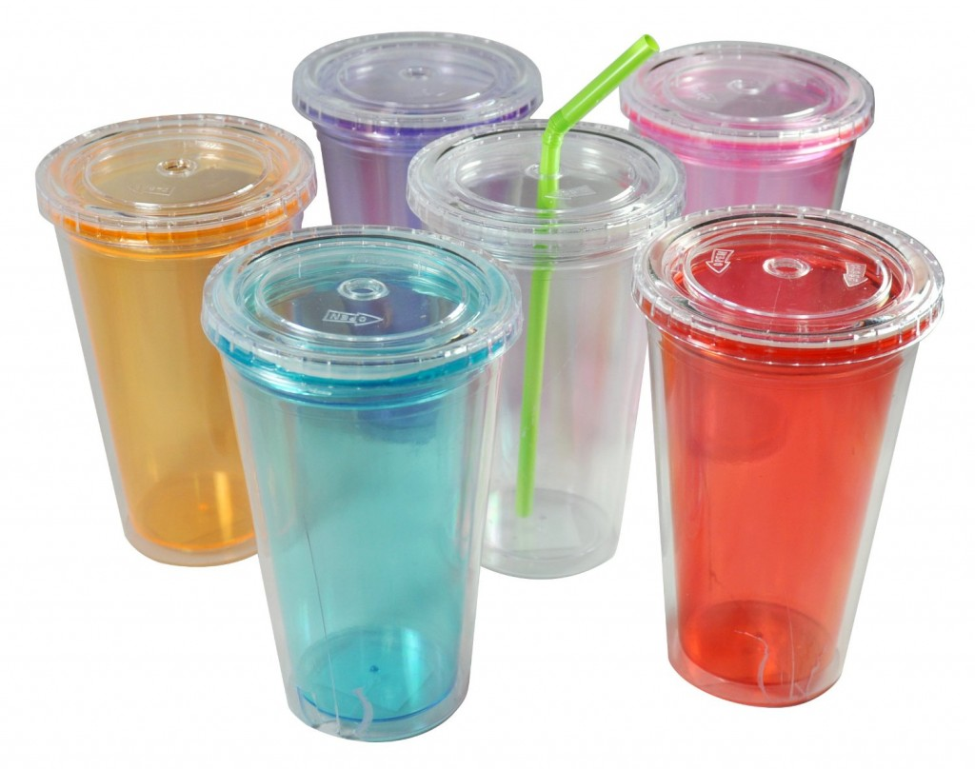
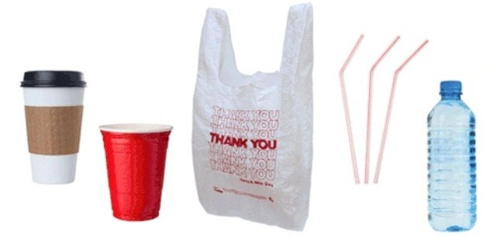
Reducing Packaging and Single-Use Products As Much As Possible
Reduce Packaging
Reuse packing material whenever possible and look for ways to reduce its use when you send products to customers or if possible, packaging material that is reusable or compostable
Instead of using single-use products investigate purchasing more reusable items
Purchase items in refillable containers and buy in bulk whenever possible.
Notes:
Reduce Packaging
Reuse packing material whenever possible and look for ways to reduce its use when you send products to customers or if possible, packaging material that is reusable or compostable
Instead of using single-use products investigate purchasing more reusable items
Purchase items in refillable containers and buy in bulk whenever possible.

Slide 13
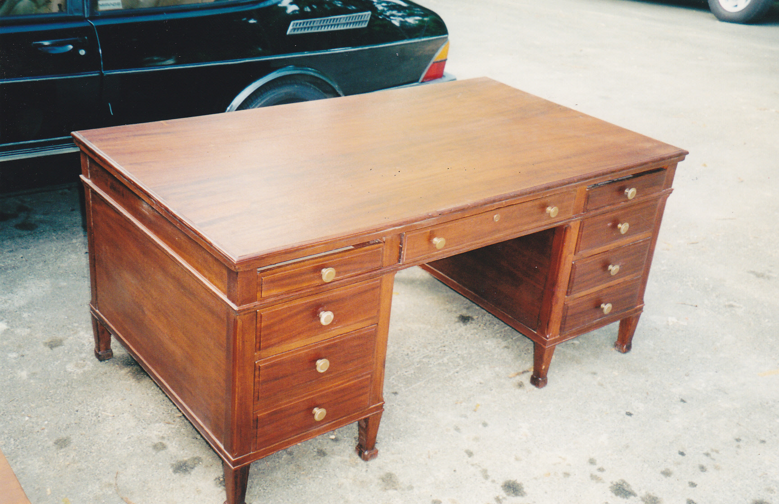
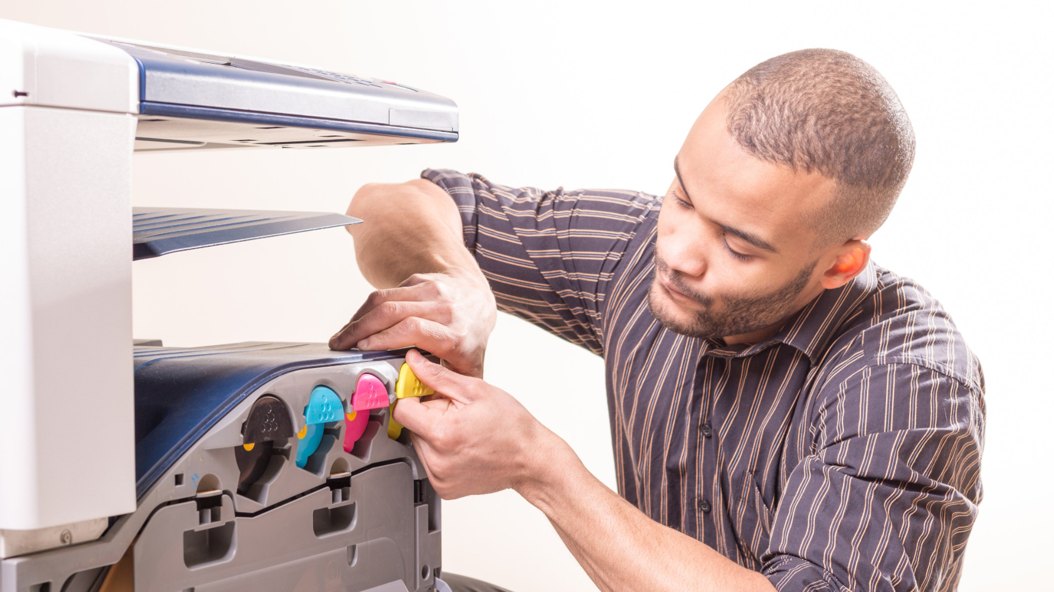
Repair
Many items that we would normally throw out can be repaired, upgraded, or reused. This is usually cheaper than buying new and saves money as well as landfill space. These items include office furniture and equipment, lighting fixtures, electronics, and automotive parts.
Consider reupholstering, refinishing, or donating old furniture to be used again.
Have equipment repaired instead of buying new.
Consider Leasing office equipment.
Notes:
Many items that we would normally throw out can be repaired, upgraded, or reused. This is usually cheaper than buying new and saves money as well as landfill space. These items include office furniture and equipment, lighting fixtures, electronics, and automotive parts.
Consider reupholstering, refinishing, or donating old furniture to be used again.
Have equipment repaired instead of buying new.
Consider Leasing office equipment.

Slide 14
Recycle
The following are a few items commonly found around the office that can be recycled.
Copy/printer paper
Manila/file folders
Soda/water bottles and cans
Notepads (with wire removed)
Magazines and newspapers
Cardboard
At work, ask your suppliers if they will back haul empty containers, pallets, and cardboard to be recycled or reused.
For a complete list of recyclable materials, please contact your refuse hauler.
Notes:
Recycle
Take the next step and begin purchasing at least 30% post-consumer recycled content paper for your copying needs.
The following are a few items commonly found around the office that can be recycled.
Copy/printer paper
Manila/file folders
Soda/water bottles and cans
Notepads (with wire removed)
Magazines and newspapers
Cardboard
At work, ask your suppliers if they will back haul empty containers, pallets, and cardboard to be reused.
For a complete list of recyclable materials, please contact your refuse hauler.

Slide 15
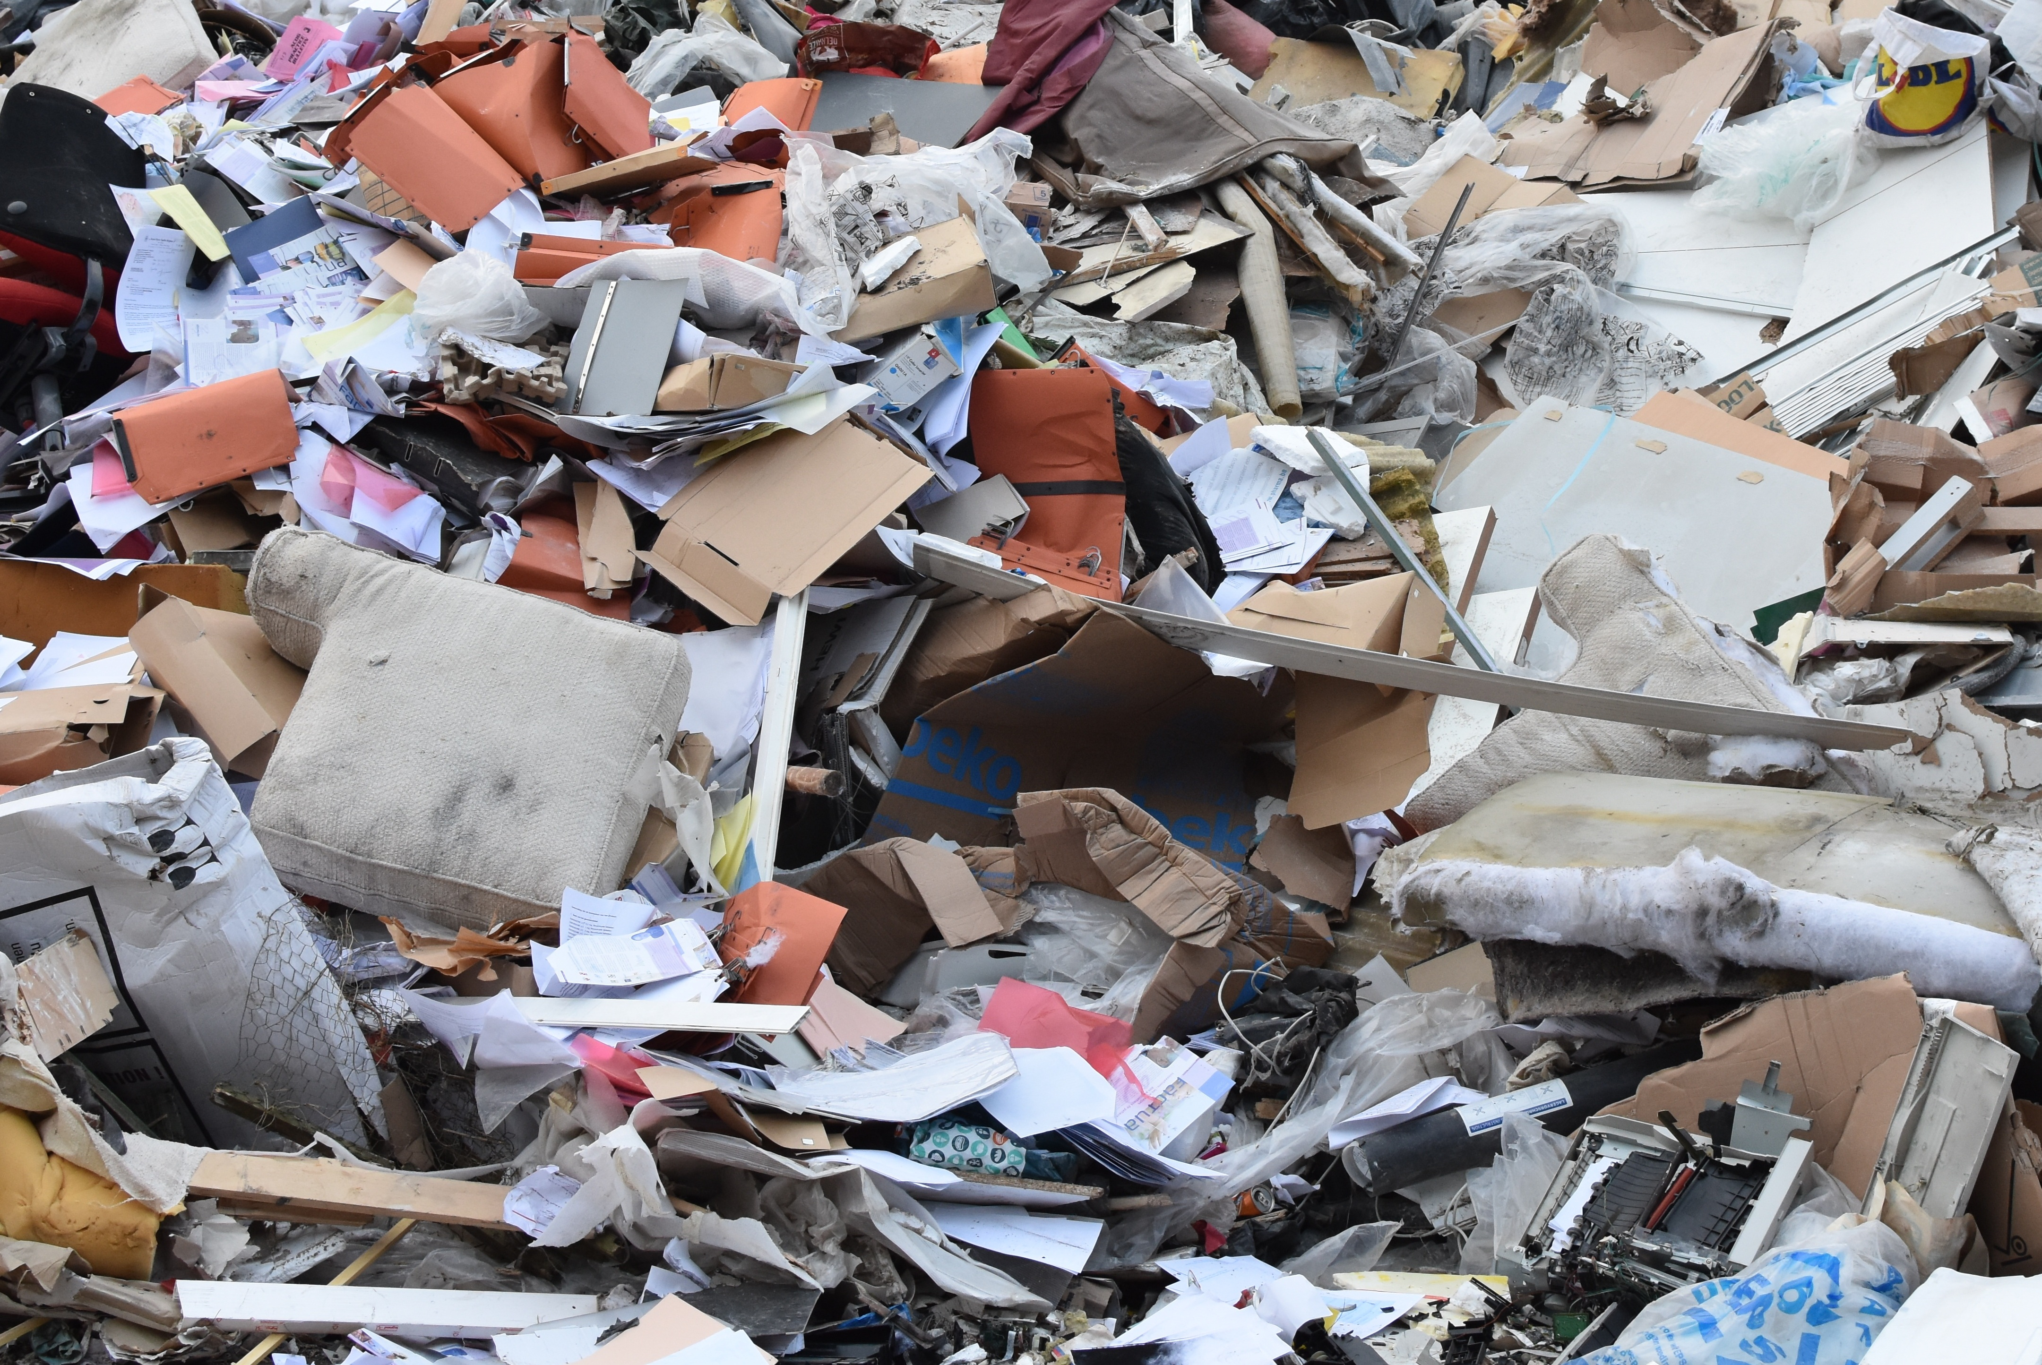
Purchasing and Reduce the Amount of Waste Coming Into Your Facility
Look for the type and the amount of recycled content in anything that you buy
Buy only what you know you will use
Buy Recycled products wherever possible
Purchase items in refillable containers and buy in bulk whenever possible
When buying a new product, take into consideration its potential life span.
Notes:
Purchasing and Reduce the Amount of Waste Coming Into Your Facility
Look for the type and the amount of recycled content in anything that you buy
Buy only what you know you will use
Buy Recycled products wherever possible
Purchase items in refillable containers and buy in bulk whenever possible
When buying a new product, take into consideration its potential life span.

Slide 16
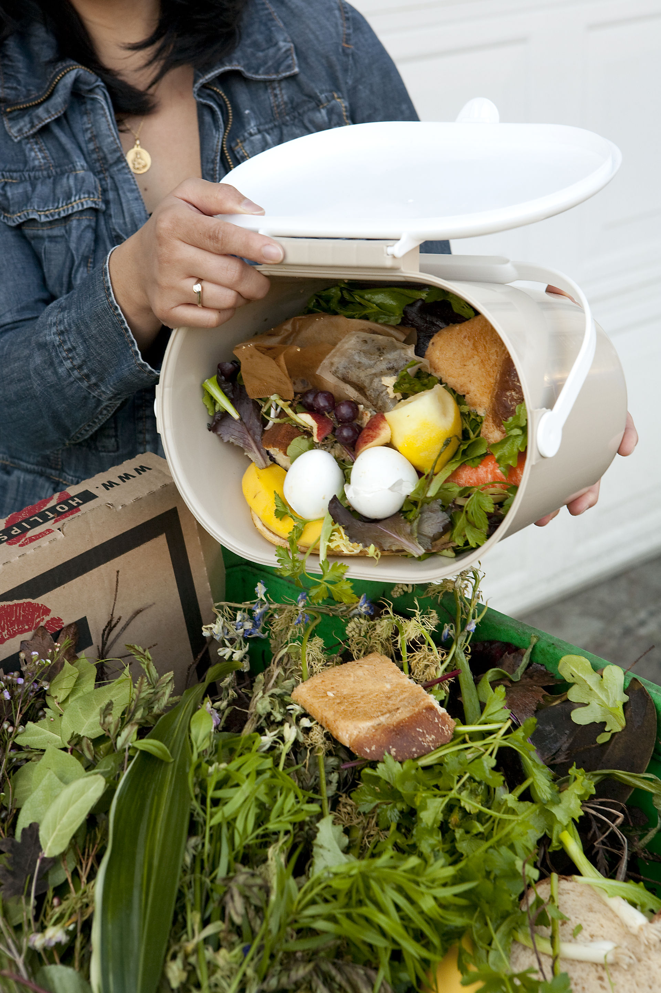
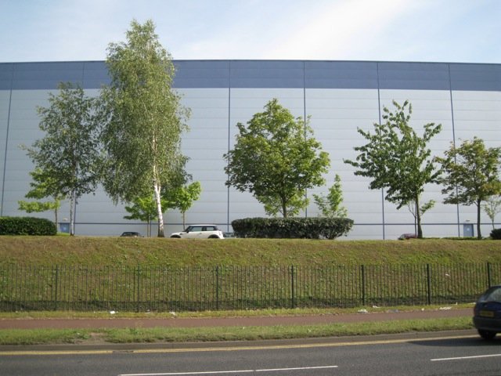
Rot or Separate Organics
If your business has landscaping you need to make sure that whoever handles the greenwaste makes sure that material is taken to a greenwaste facility, composted onsite or placed in the business's organics bin.
If your business produces food waste, then you will be required to have an organics recycling bin both for employees and customers. If you have edible food as part of your business, do you donate edible food to a food bank or service organization? http://www.rcwaste.org/Waste-Guide/organics
Notes:
A business with landscaping need to make sure their landscapers take the greenwaste to a greenwaste facility or deposit the material into the business's organics bin.
If your business produces food waste, then you will be required to have an organics recycling bin.
If you are a restaurant or have edible food as part of your business, do you donate edible food to a food bank or service organization? http://www.rcwaste.org/Waste-Guide/organics This website provides information on organic recycling and provides a link to the Riverside County Environmental Health Food Bank list.

Slide 17
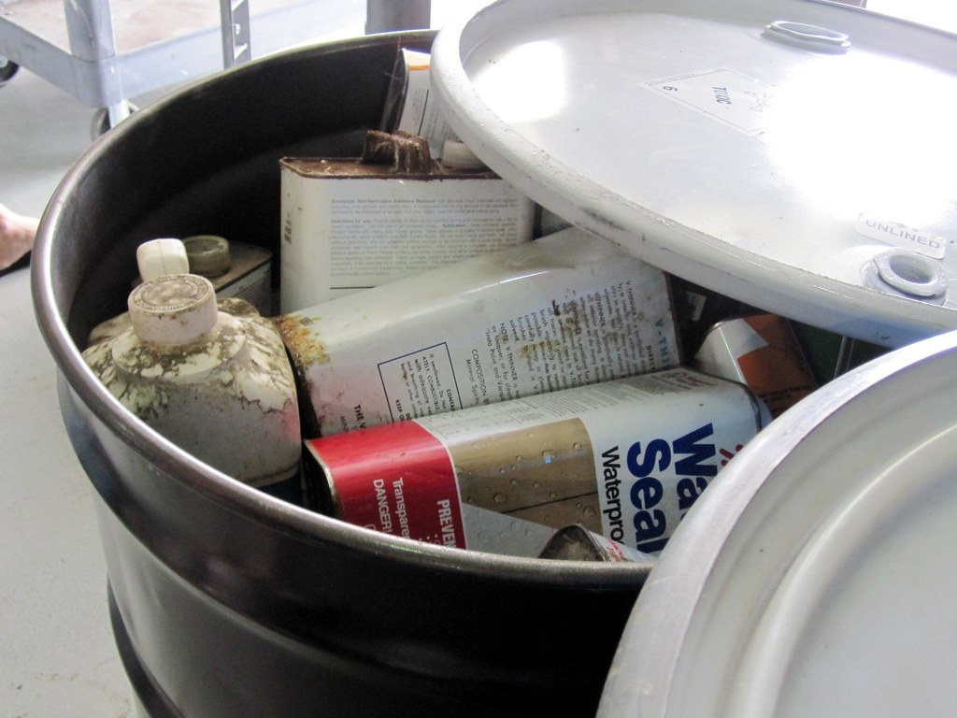
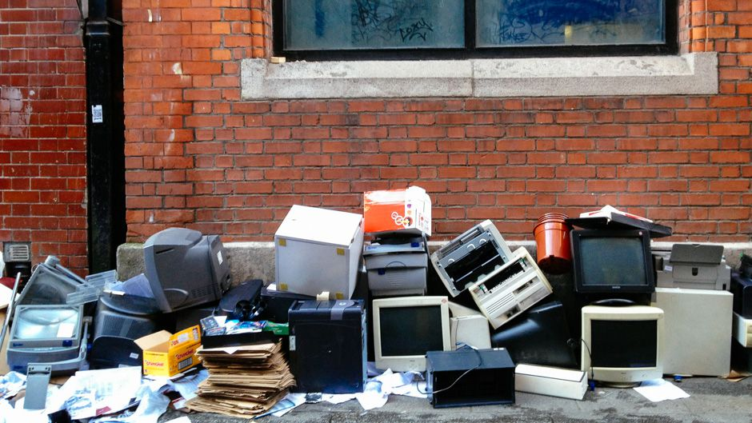
Electronic and Hazardous Waste
Businesses utilize many pieces of electronic equipment and utilize hazardous waste that is not allowed to be placed in the waste bins. Disposal of these materials may require a separate contractor to dispose/recycle these materials.
The Riverside County Department of Waste Resources has a low-cost hazardous waste drop-off program for business – Very Small Quantity Generator (VSQG) - http://www.rcwaste.org/business/hw/VSQG
Notes:
Businesses utilize many pieces of electronic equipment and utilize hazardous waste that is not allowed to be placed in the waste bins. Disposal of these materials may require a separate contractor to dispose/recycle these materials.
The Riverside County Department of Waste Resources has a low-cost hazardous waste drop-off program for business – Very Small Quantity Generator (VSQG) - http://www.rcwaste.org/business/hw/VSQG
For Questions:
The Riverside County Department of Environmental Health maintains a list of Hazardous Waste Transporters and it can be found on their Department website - https://www.rivcoeh.org

Slide 18
Litter Less Lunch Time or Meetings
Meetings:
Pitcher and cups instead of water bottles
Use reusable plates, cutlery, cups and cloth napkins for lunches. Or ask that everyone bring their own.
For any overages, have a plan to take to a food bank or offer to employees
Lunch Time:
Keep reusable plates, cutlery, cups and cloth napkins at your desk
Meal prepping and bringing your own lunch and snacks every day saves you money and reduces
your waste tremendously!
Pro-tip – if you like condiments, consider keeping a large size at your desk.
Notes:
Meetings:
Pitcher and cups instead of water bottles
Use reusable plates, cutlery, cups and cloth napkins for lunches. Or ask that everyone bring their own.
For any overages, have a plan to take to a food bank or offer to employees
Lunch Time:
Keep reusable plates, cutlery, cups and cloth napkins at your desk
Meal prepping and bringing your own lunch and snacks every day saves you money and reduces
your waste tremendously!
Pro-tip – if you like condiments, consider keeping a large size at your desk.

Slide 19
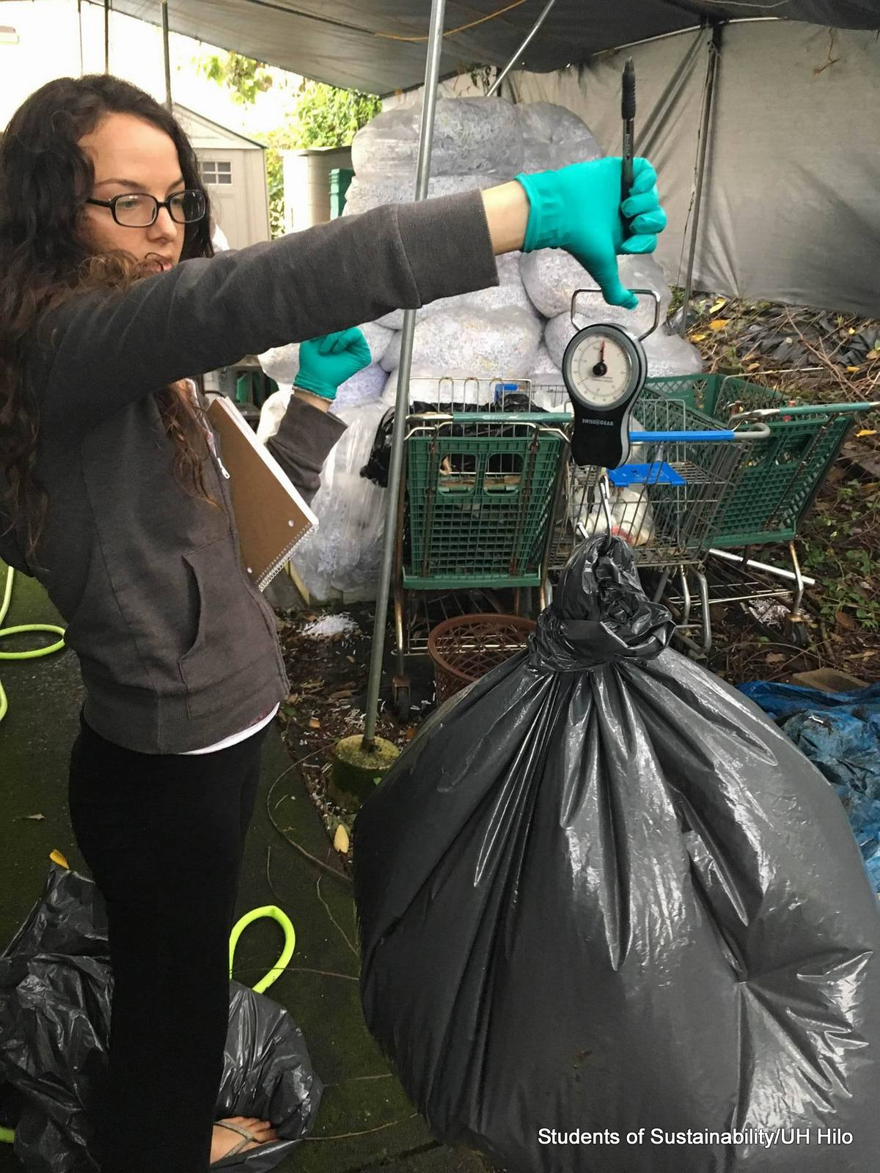
Measure and Report
It is important to keep track of your businesses waste management progress, internally as well as externally. This allows each business to monitor and ensure that you are right sizing and make changes, as necessary, it also gives ready information when asked to provide by the County.
The County will be contacting you yearly to see if you are complying through letter as well as phone call or email.
8
Notes:
It is important to keep track of your businesses waste management progress, internally as well as externally. This allows each business to monitor and ensure that you are right sizing and make changes, as necessary, it also gives ready information when asked to provide by the County.
The County will be contacting you yearly to see if you are complying. This also allows you to change programs that you offer to both employees and customers.

Slide 20
Spread The Word
Publicize your waste prevention efforts, either online or through an employee email.
Award and/or Recognition Programs
RivCo Waste Wise Champions
http://www.rcwaste.org/business/recycling/wwc
Notes:
Publicize your waste prevention efforts, either online or through an employee email/newsletter. Perhaps in brochures and advertisements, discretely display a small paragraph somewhere that tactfully boasts of your office waste prevention practices. Many of your clients will be favorably impressed; probably none will find it distasteful. A good example is the best motivator, and you might help persuade other businesses to practice waste prevention.
The Riverside County Department of Waste Resources has a RivCo Waste Wise Champions Award that Recycling Specialist would be happy to work with you on completing the application.

Slide 22
Any Questions?​​

