Slide 1
Waste Reduction
& Food Rescue: Restaurant
Notes:
Janet Hi everyone! Welcome to Food Waste / Food Rescue where we will address food waste & how to prevent it.
Thank you so much for sharing your time with me today. My name is Janet Moreland and I am a Recycling Specialist here with Riverside County Department of Waste Resources.
The topic for today is on Food Waste – what is it, why is it an issue, and ways to prevent it! This presentation will not be recorded, however we do have a 15-minute condensed version of this workshop on our website: http://www.rcwaste.org/classes/foodwaste I just posted the link in the chat of how to find it. Scroll to the bottom of the page and you can see we have an English video AND a version with Spanish Subtitles! For questions, please use the chat box to post questions and feel free to post any time during the presentation. I hope to address the questions as we go along, but at least by the end of the presentation and as time allows.

Slide 2
Agenda
Impacts of Food Waste
SB 1383 Compliance - Reducing Short-Lived Climate Pollutants in California
Food Donation Options

Slide 3
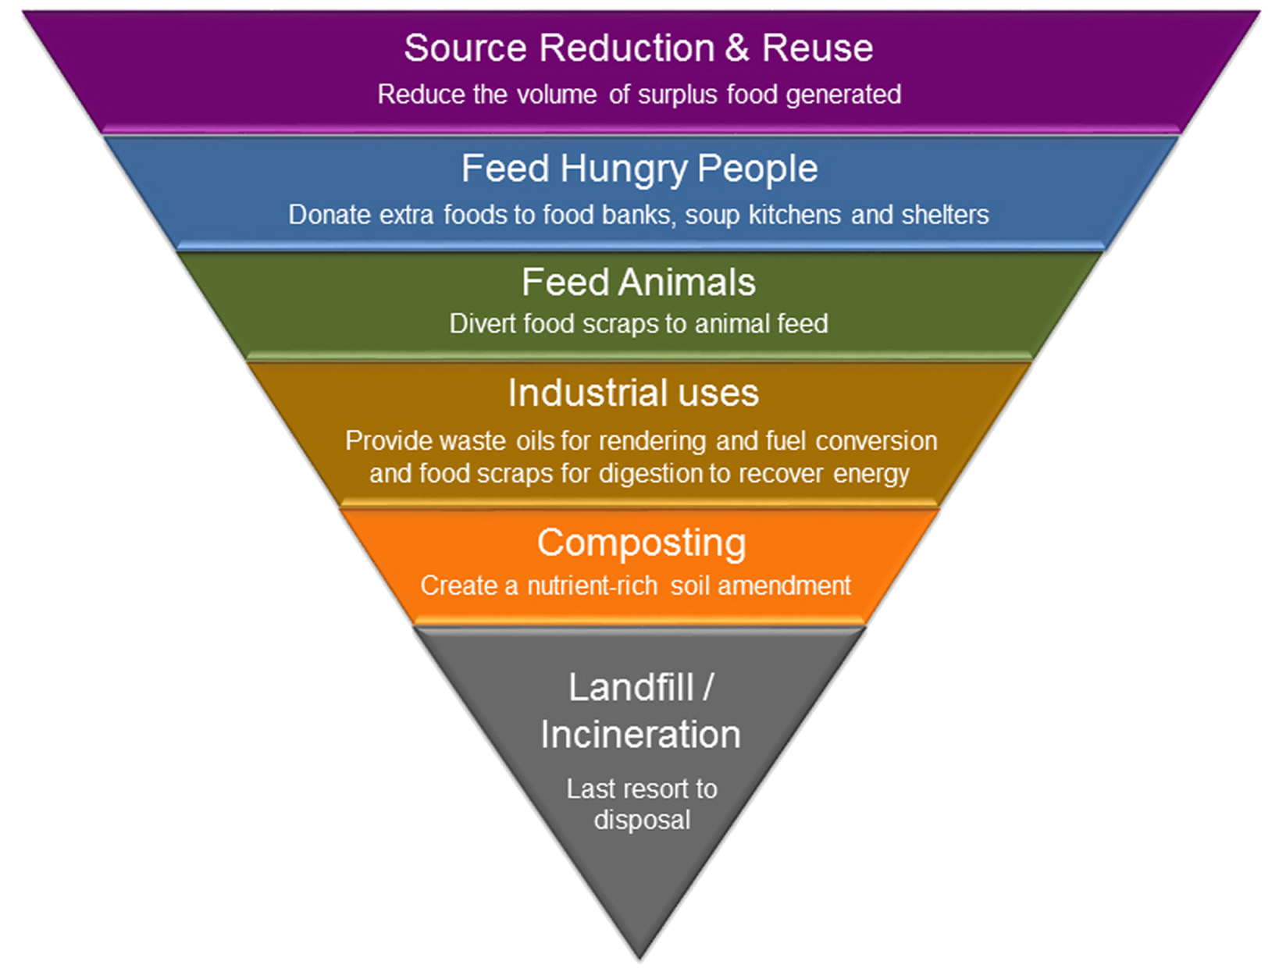
EPA Food Recovery Hierarchy
Food rescue/recovery, source reduction and diversion means
keeping food out of the landfill
Notes:
This is the EPA’s Food Recovery Hierarchy This is how the EPA (the Environmental Protection Agency) views how food waste should be addressed. The top priority is source reduction – meaning – Don’t create excess food in the first place...Basically businesses don't make money throwing away food. The second tier – Feeding hungry people is the BEST option of how to handle excess food and it’s what we will be discussing today.
Next is feeding food waste to animals and livestock.
Industrial would be recycling/changing food waste into oils, pet food, fuel, or energy
Composting is recycling this material into soil amendment
Lastly, landfilling For information on the rest of the triangle, we host bi-annual classes on composting and food waste food rescue that cover the rest of the triangle. We also have on-demand videos on these topics as well. www.rcwaste.org/classes
According to the EPA, here is the hierarchy of how to reduce the amount of food waste that goes to the landfill. The biggest difference we can make is our behavior through preventing food waste from the beginning. And we’ll talk more about it in a minute.
Then they say we should recover what we don’t prevent and we’ll talk about that. Next we should use food waste to feed other animals and there are programs about that we won’t go into here. Every state, almost every type of animal, has different standards so you should check your local regulations about that. Then there is industrial use, such as converting grease into fuel. Finally, there is composting, which we will also discuss.

Slide 4
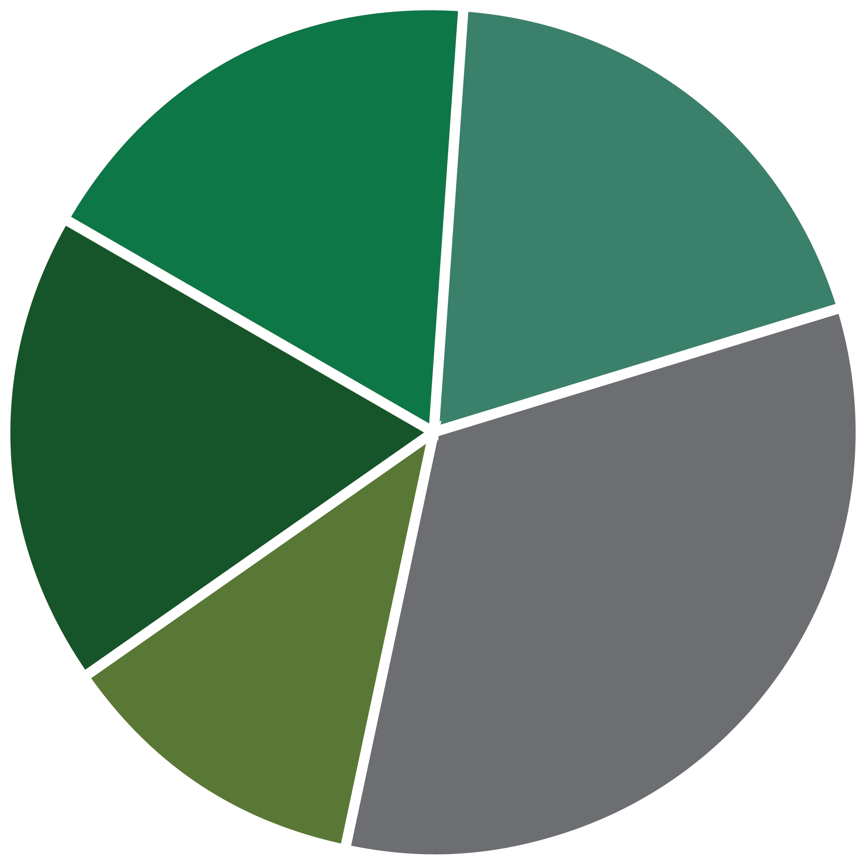
Organic Waste Is the Largest Waste Stream in California
In California, Millions Are
Food Insecure
California Disposed of approximately 27 million tons of organic waste in 2017
Paper 18%
Other Organics 19%
1 in 8 Californians
1 in 5 Children
Food 18%
Non-Organic Waste 33%
Lumber 12%
California Throws Away
More than 6 Million Tons
of Food Waste Every Year!
California’s Waste Stream
Notes:
Food waste alone is the largest waste stream in California.
According to CalRecycle’s last waste characterization study in 2014, food waste comprised 18 percent of waste disposed.
SB 1383 requires California to recover 20 percent of currently disposed edible food.
CalRecycle currently doesn’t know how much of the food waste stream is edible.
CalRecycle is conducting a waste characterization study in 2018/19 that is taking a closer look at California's food waste stream.
The results of this study will help determine how much edible food waste is landfilled on average throughout the state.
Here’s what we do know:
1 in 5 children go hungry every night in California – redirecting perfectly edible food that is currently being disposed could feed those in need.
For every 2 ½ tons of food rescued, that’s the equivalent of taking 1 car off the road for a year. (https://www.epa.gov/energy/greenhouse-gas-equivalencies-calculator)

Slide 5
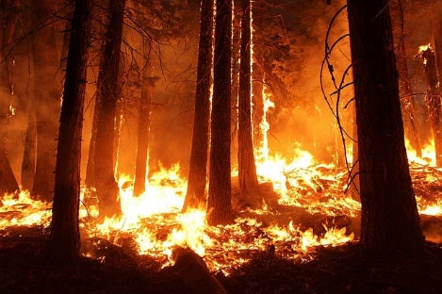
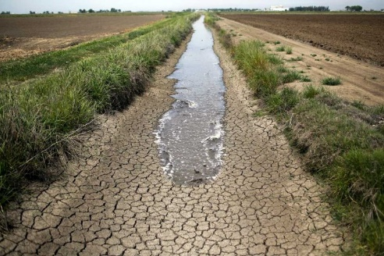
Climate Change Negatively Impacts California
Landfilled Organic Waste Emits Methane Gas— A Super Pollutant More Powerful than C02
Methane Gas Contributes to Climate Change in California
Notes:
Landfilling organic waste leads to the anaerobic breakdown of material, which creates methane gas.
Landfills are responsible for 21% of the state’s methane emissions. Landfills are the THIRD largest producer of methane. (Agriculture and Energy)
Methane is 72 times more potent than Carbon Dioxide (C02) over a 20-year horizon.
Climate change may seem like a distant problem, but there are other more localized environmental impacts associated with landfill disposal of organic waste that have immediate negative impacts on our community.
Landfilling organic waste is a significant source of local air quality pollutants (NOX and PM2.5).
These pollutants have an immediate negative impact on the air in our community and it can cause respiratory issues and hospitalizations.
Diverting organic waste to recycling can significantly reduce these local air quality emissions and the associated negative impacts.
We are starting to see the effects of climate change in cities and counties throughout California.
Longer droughts and warmer temperatures are drying our forest and contributing to the ever increasing number of wildfires in CA (which also impact air quality).
Cyclical droughts
Bigger storms
Coastal erosion due to rising sea levels
We should not underestimate the cost of these climate change impacts.
The state and communities are spending billions fighting wildfires, removing debris and rebuilding homes.
That means WE are paying for the effects of climate change today.
The financial and public health impacts are here and we need to take action to mitigate climate change now
That is why the state enacted SB 1383, which is designed to reduce the global warming gasses like methane, which are the most potent and are “short-lived”
Reducing this gas now, through actions like organic waste recycling will significantly reduce emissions, and will reduce the impacts of climate change in our life time.

Slide 6
SB 1383 Requirements
2020
50 Percent Reduction in Landfilled Organic Waste
(11.5 Million Tons Allowed Organic Waste Disposal)
2022
Regulations Take Effect
75 Percent Reduction in Landfilled Organic Waste
(5.7 Million Tons Allowed Organic Waste Disposal)
2025
20 Percent Increase in Recovery of Currently Disposed Edible Food
2025
Notes:
Overview of SB 1383: Short Lived Climate Pollutants
SB 1383 establishes aggressive organic waste reduction targets.
SB 1383 also builds upon Mandatory Commercial Organics Recycling law AB 1826. Our jurisdiction has been implementing this law since 2016.
SB 1383 requires Californians to reduce organic waste disposal by 50% by 2020 and 75% by 2025.
These targets use the 2014 Waste Characterization Study measurements when 23 million tons of organic waste were disposed.
These disposal reductions will reduce at least 4 million metric tons of greenhouse gas emissions annually by 2030.
Additionally as a part of the disposal reduction targets, the Legislature directed CalRecycle to increase edible food recovery by 20 percent by 2025.
The food recovery goal is unique.

Slide 7
CA laws Businesses
AB 1826 (2016)
Mandatory Organic Recycling requires businesses to recycle their organic waste if:
Jan 1, 2019: All that generate 2 cubic yards of solid waste/week
Food waste · Food-soiled paper · Green waste · Landscaping and Pruning waste · Non-hazardous wood waste
SB 1383 (2016)
Short Lived Climate Pollutants focuses on methane reduction:
January 1, 2020, state must achieve a 50% reduction in the level of the statewide disposal of organic waste from 2014 level
January 1, 2025: state must achieve a 75% reduction in the level of statewide disposal of organic waste from the 2014 level PLUS not less than 20% of currently disposed edible food must be recovered for human consumption
Notes:
Not only is donating food good for business moral or good for the environment, but it’s also mandated by the State of California. AB 1826, is the mandatory organics recycling law which requires businesses to recycle their organic waste in some way. This is required of all business that have a trash service level of a 2 or more cubic yards of waste per week. Meaning if a business has a 2 CY dumpster, they are obligated to comply to AB 1826. And organics refers to landscape waste, non-hazardous wood waste, but also food soiled paper AND food-waste. This law is even further enforced by SB 1383 which will require the state to achieve organic waste reduction of 75% by 2025, and requiring that no less than 20% of edible food is recovered for human consumption.
Riverside food rescue program uses Chow Match to match up food donations with food banks and hunger organizations. If you need food, you can put your needs on Chow Match and if your business has food to donate, you can tell them what you have to set up a pick up.

Slide 8
Rescuing food Businesses
Bill Emerson Good Samaritan Food Donation Act
www.gpo.gov/fdsys/pkg/PLAW-104publ210/pdf/PLAW-104publ210.pdf
Any food facility may donate food to a food bank or to another
nonprofit organization for distribution to persons free of charge.
A permitted food facility that donates food would not be subject to civil or criminal liability or penalty for violation of any laws, regulations or ordinances regulating the labeling or packaging of the donated product or, with respect to any other laws, regulations or ordinances, for a violation occurring after the time of donation.
Exceptions are gross negligence and willful act
Notes:
When it comes to donating food, there are laws that protect business from liability which makes donating edible food easier then ever. The Bill Emerson Good Samaritan Food Donation Act provides liability protections for food agencies who are donating in good faith. It protects businesses from civil and criminal liability should the product donated in good faith later cause harm to the recipient. The purpose of the Good Samaritan Food Donation Act is to encourage the donation of food and grocery products to nonprofit organizations for distribution to needy individuals.
So, laws are on your side!
One of main concerns about food rescue programs is the liability to the donating organizations. The Good Samaritan Act protects businesses from anything except grow negligence or a willful act.
Review the Act above.

Slide 9
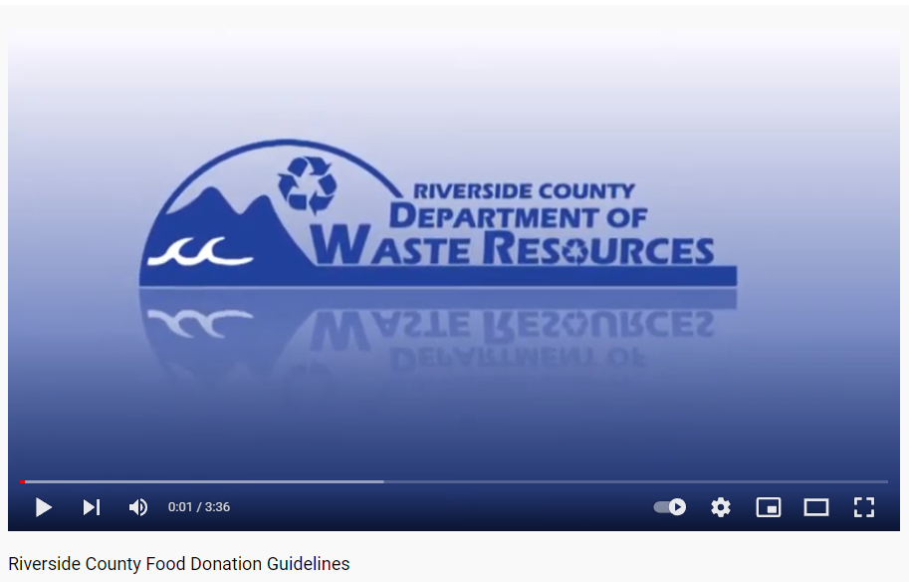
Food Donation Process
Riverside County Food Donation Guidelines PLAY MP4
https://www.youtube.com/watch?v=oSxr9FT5CaU&t=24s
Notes:
Please watch this video of the typical food donation process

Slide 10
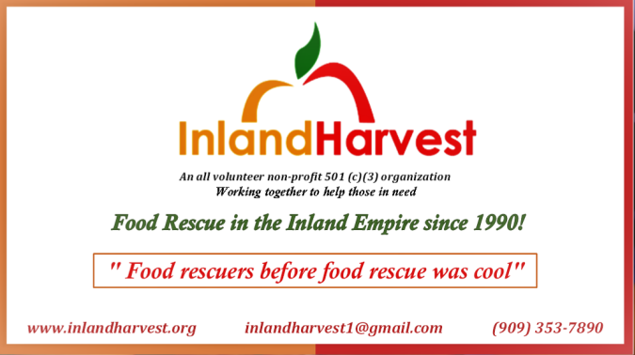
Notes:
Inland Harvest is just one of many food rescue services in the inland empire
www.inlandharvest.org
inlandharvest1@gmail.com
(909)353-7890

Slide 11
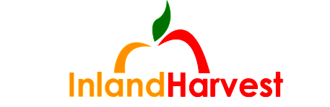
1.) Call or email Inland Harvest (IH).
Your business or your name and address
Your telephone number
A brief description of the type and total weight of the food
Best time for pick up
2.) IH will respond to arrange one-time pick/adhoc pick-up arrange a regular pick-up schedule.
Schools: UC Riverside, California School for the Deaf, University of Redlands
Restaurants: 15 local KFC’s, 15 Pizza Hut Stores, 2 Starbucks, Olive Garden, Donut House (Grand Terrace), Chipotle, Red Lobster SBD, Elks Lodge
Hospitals LL East Hospital & LLUMC Hospital, Arrowhead Regional Hospital
Grocery Stores Ranch Market, Von’s Redlands, Von’s Yucaipa, Trader Joe’s Riverside, 5 El Super Markets, Clark’s Nutrition Loma Linda
Notes:
Inland Harvest currently picks up from schools, restaurants, hospitals and grocery stores. Schools: UC Riverside, California School for the Deaf, University of Redlands
Restaurants: 15 local KFC’s, 15 Pizza Hut Stores, 2 Starbucks, Olive Garden, Donut House (Grand Terrace), Chipotle, Red Lobster SBD, Elks Lodge
Hospitals LL East Hospital & LLUMC Hospital, Arrowhead Regional Hospital
Grocery Stores Ranch Market, Von’s Redlands, Von’s Yucaipa, Trader Joe’s Riverside, 5 El Super Markets, Clark’s Nutrition Loma Linda
You can call or email anytime to schedule a one-time pick-up. Although, their specialty is arranging a regular schedule. For instance, you can arrange an IH volunteer to come back every Wednesday at 10am. OR even twice a week if need be.

Slide 12
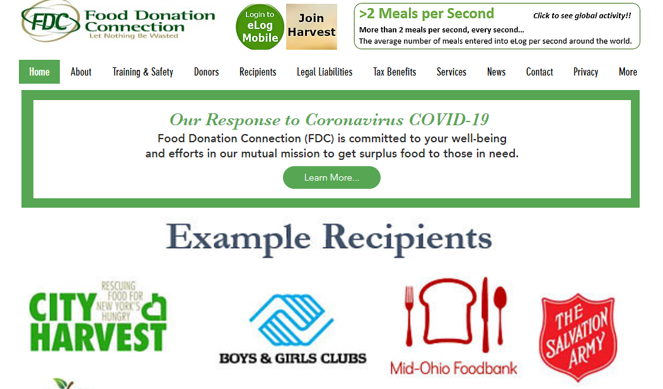
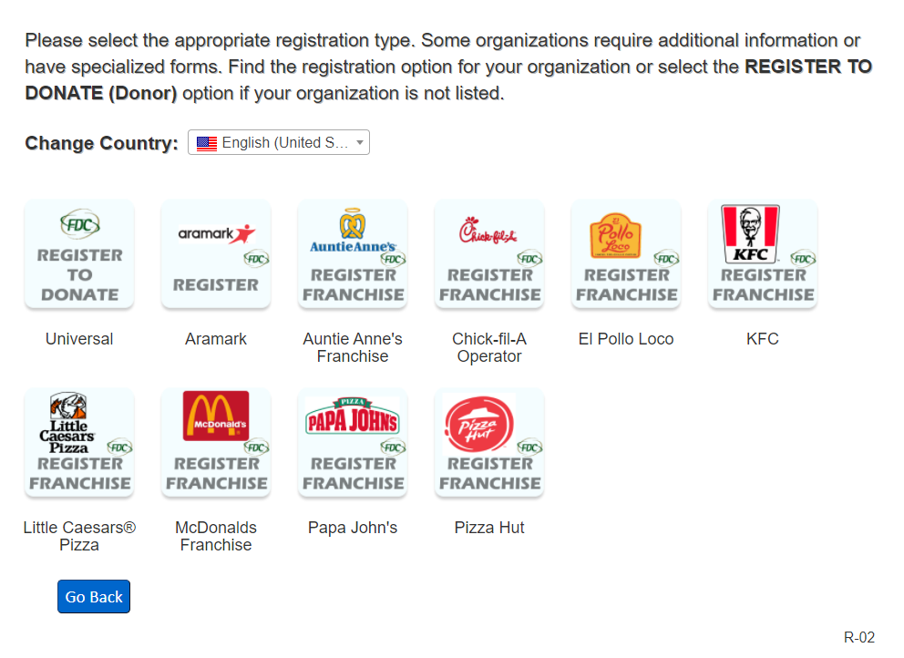
How to find a Food Rescue Agency
GO TO: www.foodtodonate.com/donors
Notes:
One option is to go directly the website GO TO: www.foodtodonate.com/donors Or type in “Food Connection Donation” into your web browser. The screenshot on the right is the website’s home page. The first thing you want to do is click on the yellow box that says “ Join Harvest.” That leads you to a page asking if you are a donor or a recipient. After choosing “Donor” then you will see the page that’s on the left. If you are part of any of the listed franchise, then there’s options for adding to the existing contracts. If your franchise is not listed, if this is a completely new registration, then choose “Register to Donate – Universal” which is highlighted in yellow.

Slide 13
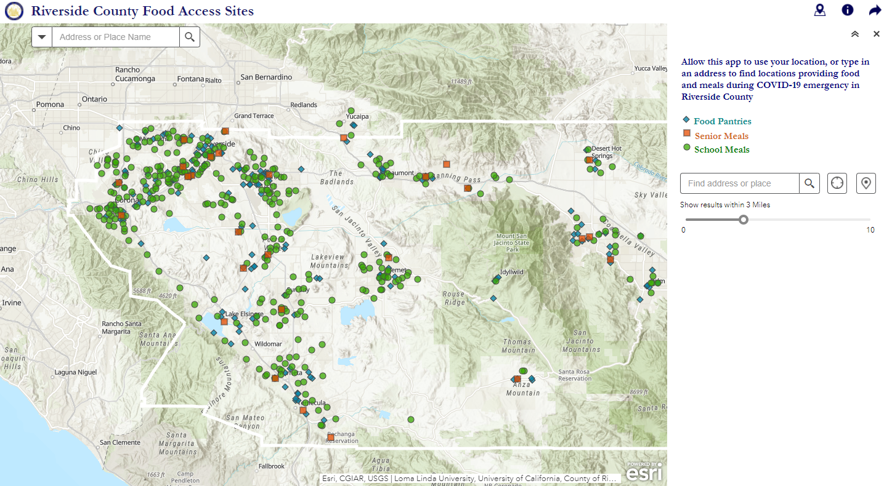
Where is the food taken?
To local non-profit
food pantries
Notes:
AnaLisa: All donated food is taken to Local non-profit agencies or food pantries that feed needy men, women, and children. Among the 50 agencies currently receiving food are the Salvation Army Shelter, Community Settlement, Central City Lutheran Mission, Riverside Settlement Association, Group homes, Oasis community church, Fruit of our Hands ministries, and University food pantries. Here is a map of the many food pantry and food banks in Riverside County. Whichever food rescue agency helps pick-up your excess food will determine which food pantry will receive your food. Normally, this decision is dependent on open times of the food pantry and proximity to your food establishment. LINK TO MAP: ​
https://countyofriverside.maps.arcgis.com/apps/webappviewer/index.html?id=52ca2b425fd14b2387f3676bf6db294e&extent=-13100249.8739%2C3944965.339%2C-12940037.8626%2C4040817.3725%2C102100​ ​ ​
​ ​ ​

Slide 14
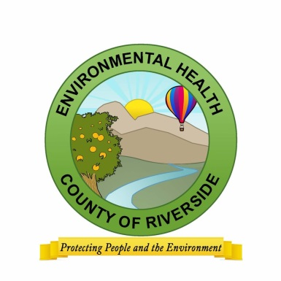
Rescuing food Businesses
Check with your local health department
Cartons of milk
Packaged cheese, yogurt cups/tubes, granola, muffins and
meat jerky
Prepackaged sauces (applesauce, pasta sauce)
Prepackaged apple slices, nuts, dried fruits
Whole fruits and vegetables with an intact peel/outer skin
Sealed bottles of water, cartons of juice and other beverages
Depending on food bank, “back of the house” unopened cans and jars of food
What CAN’T be donated?
Hot food or food that was hot at one time
Open meat products
Opened/resealed products
Notes:
These lists of foods are generally your do’s and don’t’s when it comes to donating. If you have a question about food for donation, Contact Riverside County Environmental Health to find out what types of food are fit for donation and what isn’t. Generally anything sealed as long as it’s not expired is accepted, and that includes refrigerated milk cartons, and diary products like sealed yogurt cups or string cheese.
Same with sealed fruit cups or pudding. Even packaged sauces, jarred sauces, and canned foods are usually safe to donate as well as dried fruits, sealed sliced fruits, whole fruits and beverages. You will want to talk to your food pantry or food bank on what they will accept. Food banks can take big donations, pallets of food at a time, for example, Feeding America, a huge food bank will not accept liquids in jars. Since it’s too much of a mess if anything breaks. Food pantries will most likely accept jarred items, BUT they sometimes might not be able to take big quantities of anything since they’re just smaller. Food pantry space varies day-to-day so you never know until you call. And generally what can’t be donated is food that’s been sitting out in a buffet line, or unsealed or open products of any kind. Please don’t just write off a product because you just assume it won’t be accepted. It’s always worth a call or a visit to a food pantry, since your donated items, no matter how big or small will always make a huge difference in more ways than one.
The key starting point for any food service operation that wants to develop a food rescue program is to start with their local Environmental Health department. There are health and safety concerns relative to storing and donating food so please consult with your local inspectors.
https://www.rivcoeh.org/
Review the basics above.

Slide 15
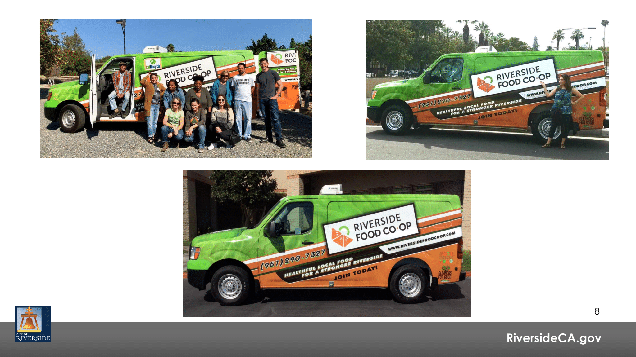
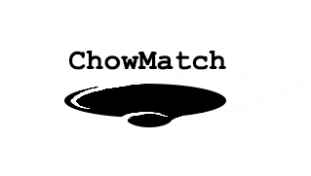
Rescuing food Businesses
Notes:
AnaLisa
Here is an example of the type of program you might find in your community. A program like the Riverside Food Co-Op may service your area. Really all that’s needed for food runs is any vehicle to move food around. On the slide before, Inland Harvest enlists volunteers to collect food donations between businesses and non-profit food pantries – these volunteers use their own personal vehicle for food runs and deliver the food to a food pantry.
Chowmatch is an example of an app that can be used to create food runs between a donor and a recipient. As a business, you might be able to log in that you have a food donation, then a volunteer is alerted through the app, and can come pick it up and transport it to a nearby food pantry.
Riverside food rescue program uses Chow Match to match up food donations with food banks and hunger organizations. If you need food, you can put your needs on Chow Match and if your business has food to donate, you can tell them what you have to set up a pick up.

Slide 16
Waste Reduction & Food Rescue:
Restaurant
Managing waste for a better tomorrow
14310 Frederick St.
Moreno Valley, CA 92553
(951) 486-3200
Waste-CompostingRecycling@rivco.org
www.rcwaste.org
Notes:
We hope that will shed a little light on some of the regulations and how you might be able to feed hungry families and comply with the regulations at the same time, with the help of a food rescue organization.
Any questions?
Do you have a food rescue program that you are already implementing?
Have you had to alter your food purchasing during the fluctuating needs during the pandemic?
How will you track the amount of food you are donating?

