Slide 1
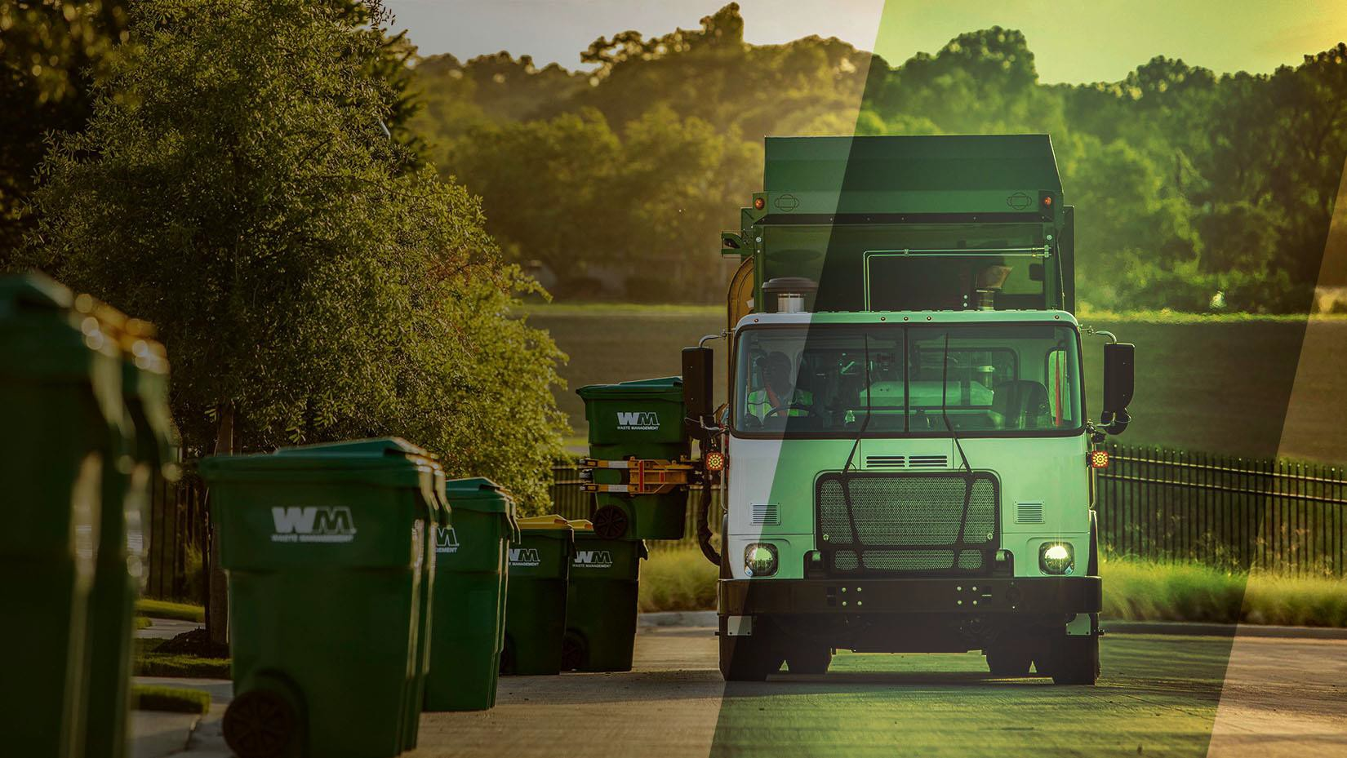
November 16, 2021
SB 1383
A proactive, innovative solution to help reduce contamination and overages

Slide 2
SB 1383 - New Statewide Mandatory Organic Waste Collection Regulation
What is the new law?
The California State Legislature passed Senate Bill 1383 (SB 1383) which requires cities and counties to reduce organic waste disposal by 75% by 2025. Beginning January 1, 2022, all California residents, businesses, and multifamily complexes will be required to separate food waste and yard waste from their trash and recycle in a separate organics cart.
SB 1383 Goal:
Reduce organic materials going to the landfill, decrease greenhouse gas emissions, and slow climate change.

Slide 3
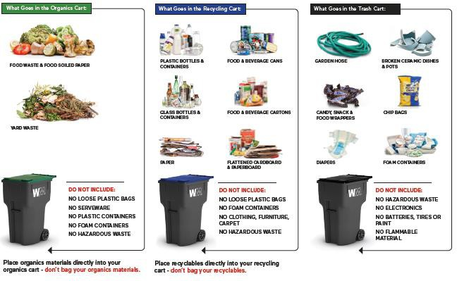
SB 1383 - New Statewide Mandatory Organic Waste Collection Regulation
What changes for Residents?
Recycle food scraps with your yard trimmings in your existing
green waste container.
Check the Lid for instructions on how to use the carts correctly
and avoid contamination.
Follow the following instructions...

Slide 4
SB 1383 - New Statewide Mandatory Organic Waste Collection Regulation
SB 1383 Cart Monitoring and Enforcement
Regulations passed by the state from SB 1383, requires a contamination cart monitoring and enforcement program to help reduce contamination in the recycling and organic collection cart.
Keeping organics waste streams clean will help ensure that the organic material can be processed
What is contamination?
Contamination occurs when you place non-acceptable items in the wrong cart. Contaminants can ruin an entire load of organics or recyclables and prevent these materials from going on to have a second life.
Loose plastic bags and bagged materials in organics and recycling containers are the most common contaminants. Please empty your organics and recyclable materials directly into your organics or recycling carts to give them the best chance of becoming new products.

Slide 5
SB 1383 - New Statewide Mandatory Organic Waste Collection Regulation
Cart Colors

Slide 6
SB 1383 - New Statewide Mandatory Organic Waste Collection Regulation
Where can I learn more?
Create a My WM profile online to put you in control of your WM account. Visit https://www.wm.com/us/en/user/register to create your profile today.
For more information about the law, visit California Department of Resources Recycling
and Recovery (CalRecycle) website at https://www.calrecycle.ca.gov/organics/slcp/
For updates and further information on how to Recycle Right, visit https://www.wm.com/us/en/recycle-right

Slide 7
Commercial Service Offered
Trash Bin Service
Recycling Bin Service
Organic Bin Service
Monday – Saturday
Available Sizes
•
•
Monday – Saturday
Available Sizes
Monday – Friday
Available Size/Frequency
2yds
3yds
4yds
2yds
3yds
4yds
64g carts.
Multiple carts
Increased collection frequency

Slide 8
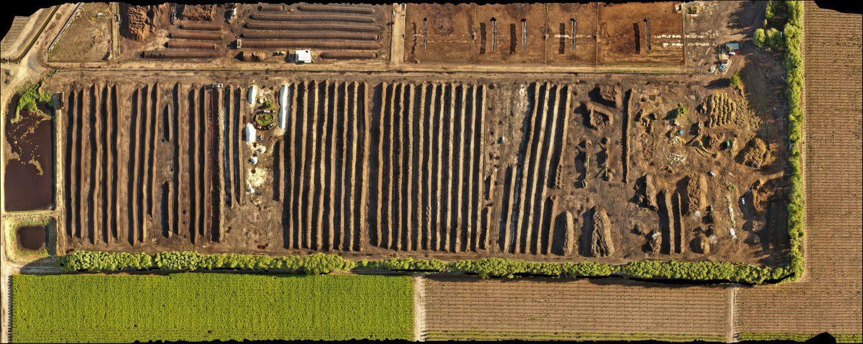
SB 1383 - New Statewide Mandatory Organic Waste Collection Regulation
WM South Valley Compost
35 permitted acres, 1,000 ton per day permit (500 tpd processing), windrow
composting that receives feedstocks including green waste, food waste, anaerobic digester digestate, and agricultural waste.

Slide 9
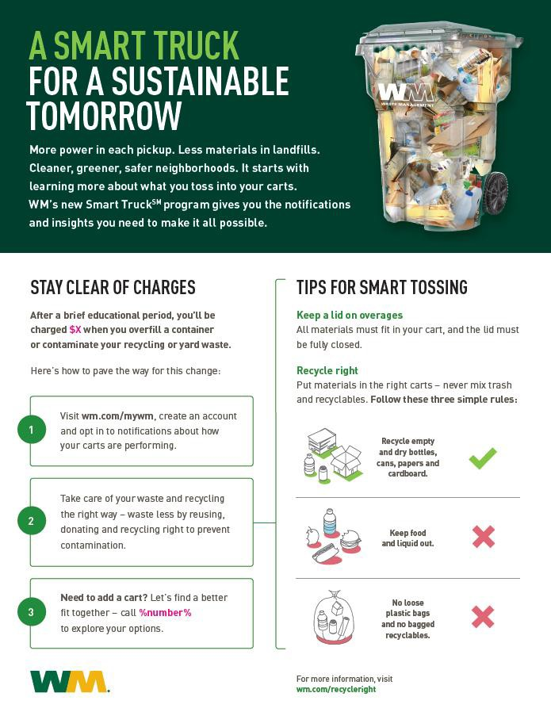
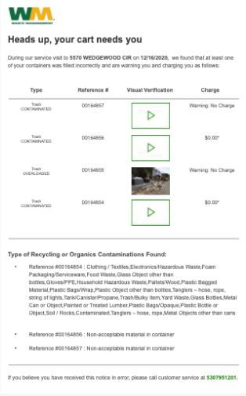
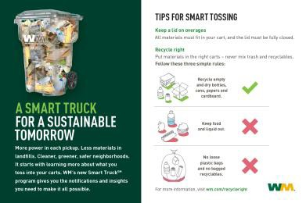
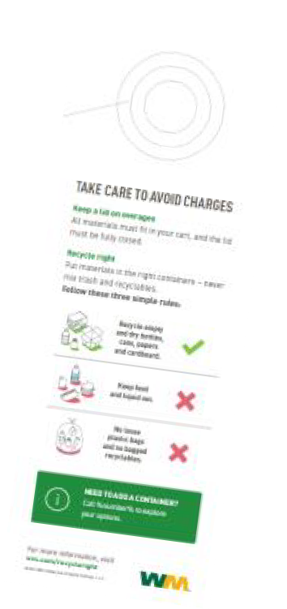
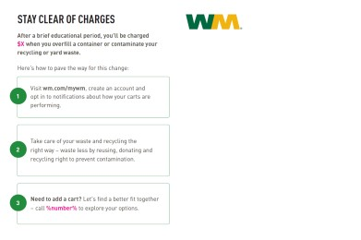
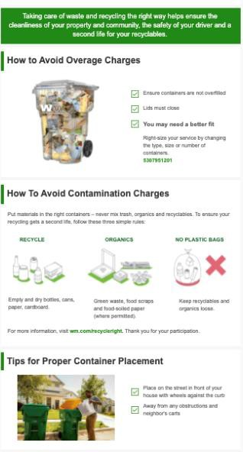
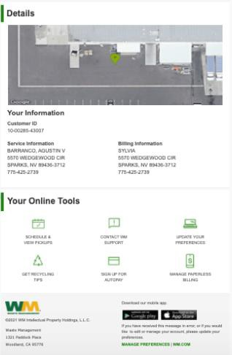
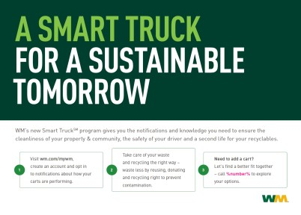
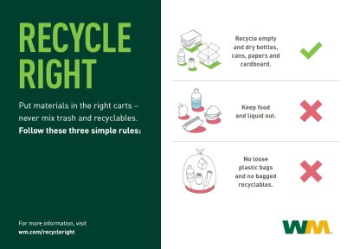
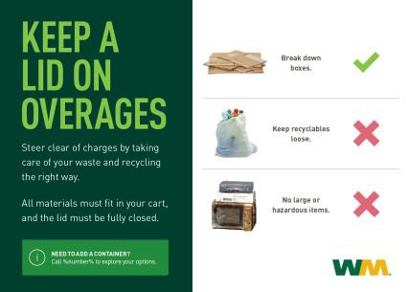
Suite of Education & Outreach Communication Materials
Full suite of materials using all communication channels and multiple touch points
Postcard & Cart Hanger
Program Introduction One-Pager
Automated Email Notice
Social Media Posts

Slide 10
Thank you.

