Slide 1
Commercial Recycling

Slide 2
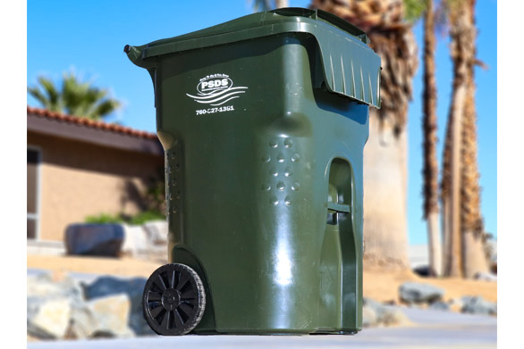
What Happened in 2021 3 Bin Roll Out

Slide 3
Food Waste

Slide 4
We are here to help

Slide 5
What is coming in 2022

Slide 6
Help and Resources
Web Resources
CalRecycle is the State's leading authority on recycling, waste reduction, and product reuse. It plays an important role in the stewardship of California's vast resources and promotes innovation in technology to encourage economic and environmental sustainability.
CalRecycle eWaste
CalRecycle HHW
Riverside County HHW

Slide 7
We are here to help

