Slide 1
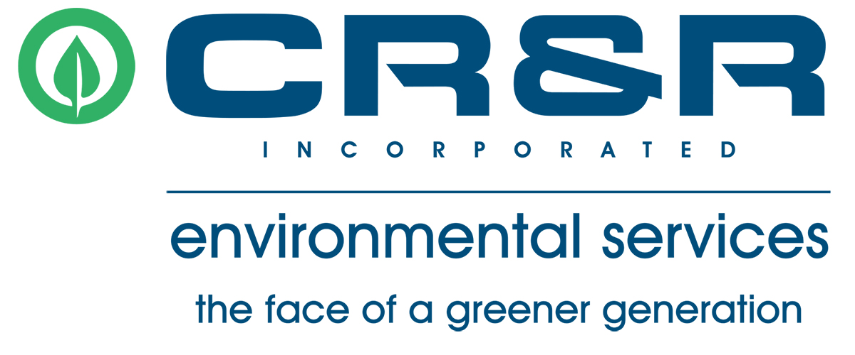
County of Riverside Summit - SB 1383 Overview
November 16, 2021

Slide 2
Senate Bill 1383 (SB 1383)
Barbara Jimenez is the Regulatory Compliance Manager at CR&R Environmental Services. She has been with the company for almost a year, and in the waste and recycling industry for 10 years. Barbara oversees compliance for all cities in the Inland Empire and assists them with compliance for CalRecycle mandates. She also works with the commercial sector to make sure they are subscribed to the necessary services regulated by AB 341, AB 1826 and SB 1383.
She enjoys working in the communities outreaching to the public to educate them and assist them on the various services that are offered.
Barbara loves working in the Waste Industry and keeping up with all regulations to provide the necessary changes, services, and outreach to our customers.

Slide 3
Senate Bill 1383 (SB 1383)
Signed into law by Governor Brown in 2016
Requires the State to reduce organic waste disposal by 75% by 2025
75% reduction = 20 million tons annually Statewide
Requires the State to increase edible food recovery by 20% by 2025
SB 1383 regulations go into effect January 1, 2022

Slide 4
Investments in the Community
Back in the early 2010’s CR&R began planning for organics recycling
We looked at trash as a “commodity” not a material destined for the landfill. We are driven by “landfill avoidance”
We worked with legislators and cities early on to better understand their diversion goals
Conducted extensive R&D and determined the Anaerobic Digestion was our proposed solution for organic waste (OW) in the future
CR&R embarked on this one-of-a-kind project in 2014 and our jurisdictions began delivering OW in 2016
Today, all our Inland Empire Cities’ green and food waste are brought to our AD Plant where capacity is GUARANTEED for all their residents and businesses.

Slide 5
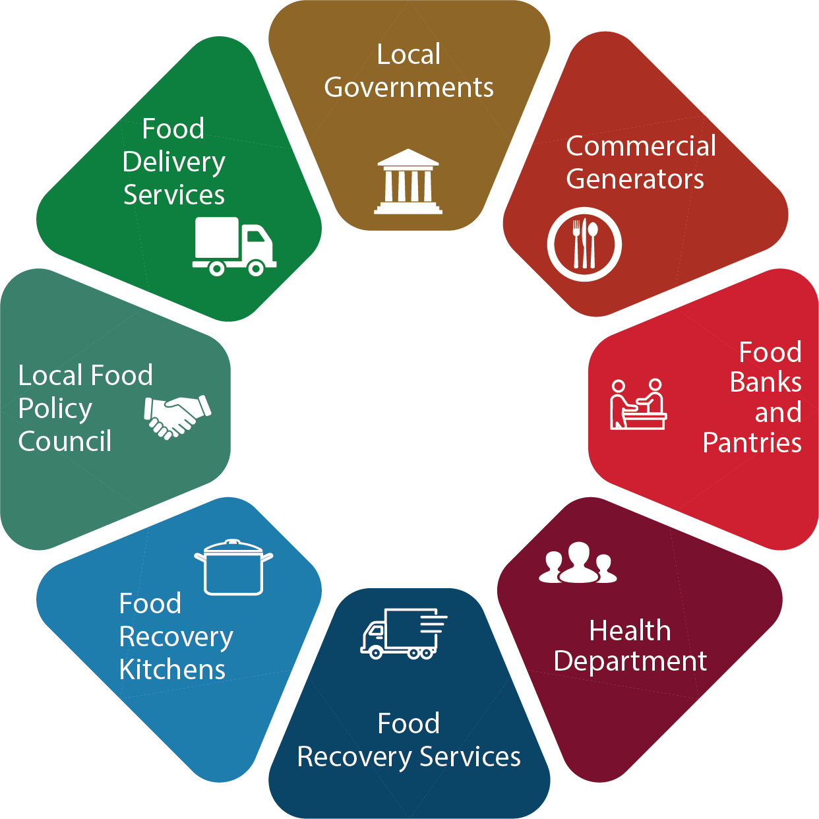
Edible Food Recovery – Increase By 20%
Identify Existing Food Recovery Capacity
Expand Existing Capacity if Needed
Ensure Commercial Edible Food Generators Have Access to Food Recovery Services
Identify Commercial Food Generators (Tier 1 & Tier 2)
Monitor Commercial Edible Food Generators for Compliance

Slide 6
Education Requirements
Annually educate all organic waste generators, commercial edible food generators, and self-haulers about relevant requirements
Jurisdictions must provide print or electronic communication
Jurisdictions may supplement with direct communication

Slide 7
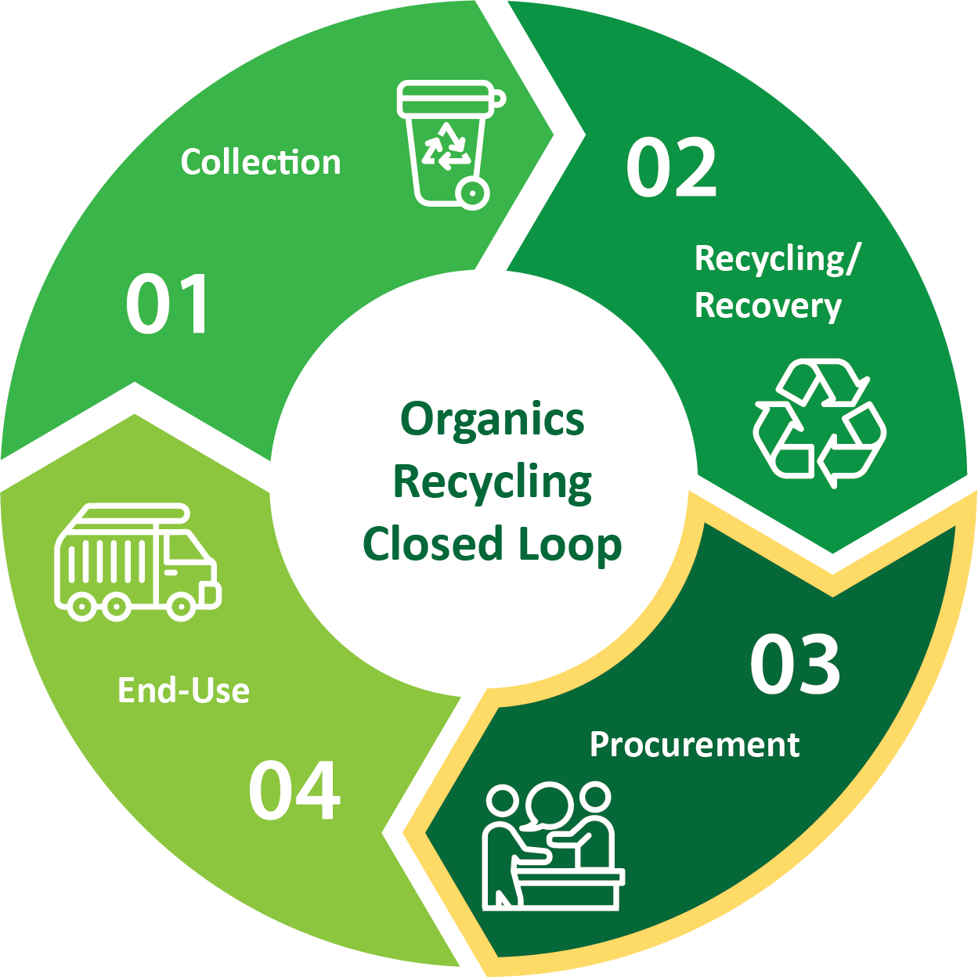
Jurisdiction Procurement Requirements
Procurement Target = .08 tons of Organic Waste per resident per year
Compost, Renewable Natural Gas & Electricity
Compost for City Managed/Public Landscaping (Our cities are able to procure compost from CR&R’s AD Facility to assist in meeting procurement targets)
Renewable Natural Gas for City Owned Vehicles or Hauler Vehicles (CR&R, as a direct service provider in our cities, is able to provide these cities DGE credits for renewable natural gas (RNG) in the form of transportation fuel)

Slide 8
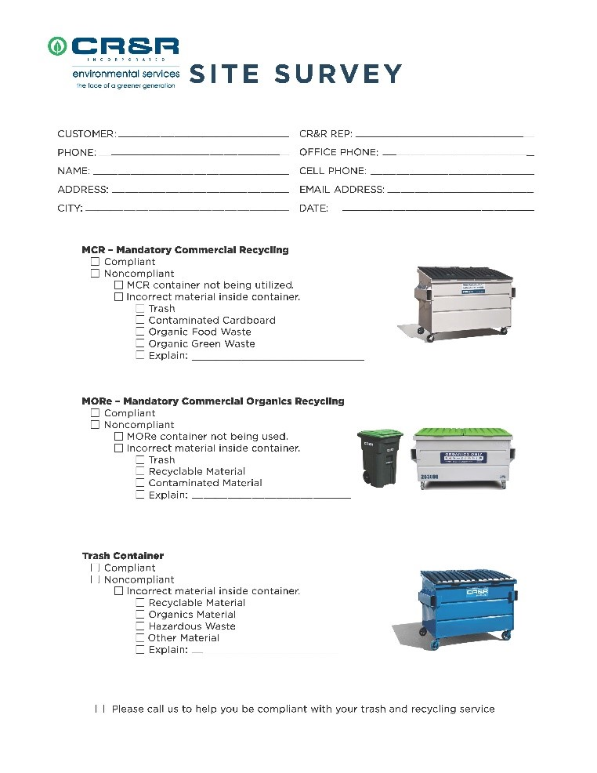
Compliance Review and Contamination Monitoring
Annual Compliance Review
All Commercial businesses must have an organics collection program.
Verify businesses are subscribed to organic service or self-hauling
All our cities’ residents are provided a 3-cart collection system.
All our cities in Western Riverside are subscribed to our AD for guaranteed capacity.
Contamination Monitoring SB 1383
Route reviews of commercial and residential areas to verify service and inspect for contamination
Randomly sample containers along a hauler route
All routes must be reviewed annually
Notify a generator if contaminants are identified

Slide 9
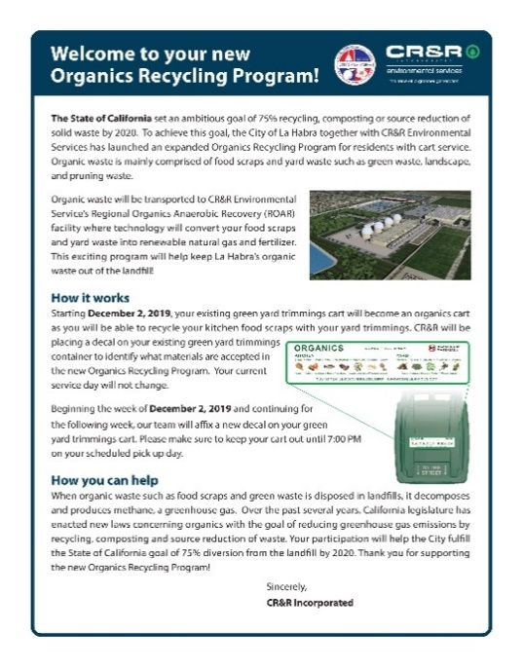
CR&R Solutions for SB 1383 Compliance
Converted residential yard waste cart into an organics cart (AD 2016)
Added food waste to yard waste
Phasing-in Appropriate labels and containers
Commercial Customer Compliance
CR&R added new staff (2018) to sign up new commercial organics and recycling accounts getting our cities at an average of 95% compliance in 2021 with the goal of 100% compliance by 12/31/21.
Future Compliance
We will assist our cities with outreach materials through direct mail or bill inserts
We will assist our cities to ensure businesses and commercial edible food generators are compliant
2022 - Perform on site contamination monitoring (resi & comm customers)

Slide 10
Solutions for SB 1383 Compliance
Infrastructure
CR&R is one of the only environmental service companies in California to offer co-collection of residential food and green waste combined for energy recovery and nutrient production with 100% capture of methane emissions.
CR&R can guarantee our cities capacity for organics processing/disposal for many years to come via our Perris Anaerobic Digester and our Yuma Composting Facility.
Procurement
CR&R will provide the City the opportunity to procure compost for use at City parks and other City designated facilities.
CR&R can also provide DGE credits for renewable gas in the form of Transportation Fuel.

Slide 11
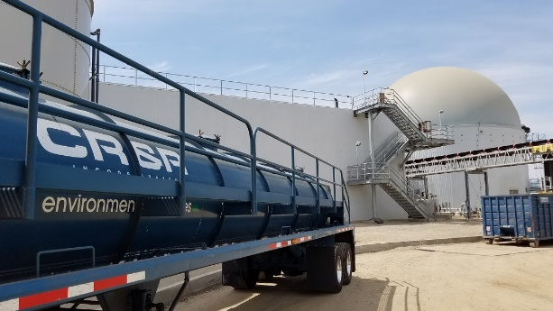
CR&R Partnering with our Cities
CR&R is working with our cities on SB1383 rate adjustments, which will take place in July of 2022.
CR&R is hiring boots on the ground, auditing team members, to assure continued compliance with AB341/AB1826 as we will with more stringent SB1383 requirements.
CR&R has a dedicated team of personnel to assist our jurisdictions with their SB 1383 requirements. Our goal is to maintain and exceed our cites expectations with regards to California’s new organics diversion mandates.

Slide 12
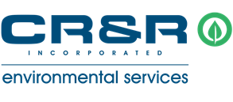
Thank you for your time!
Barbara Jimenez,
Regulatory Compliance Manager

