Slide 1
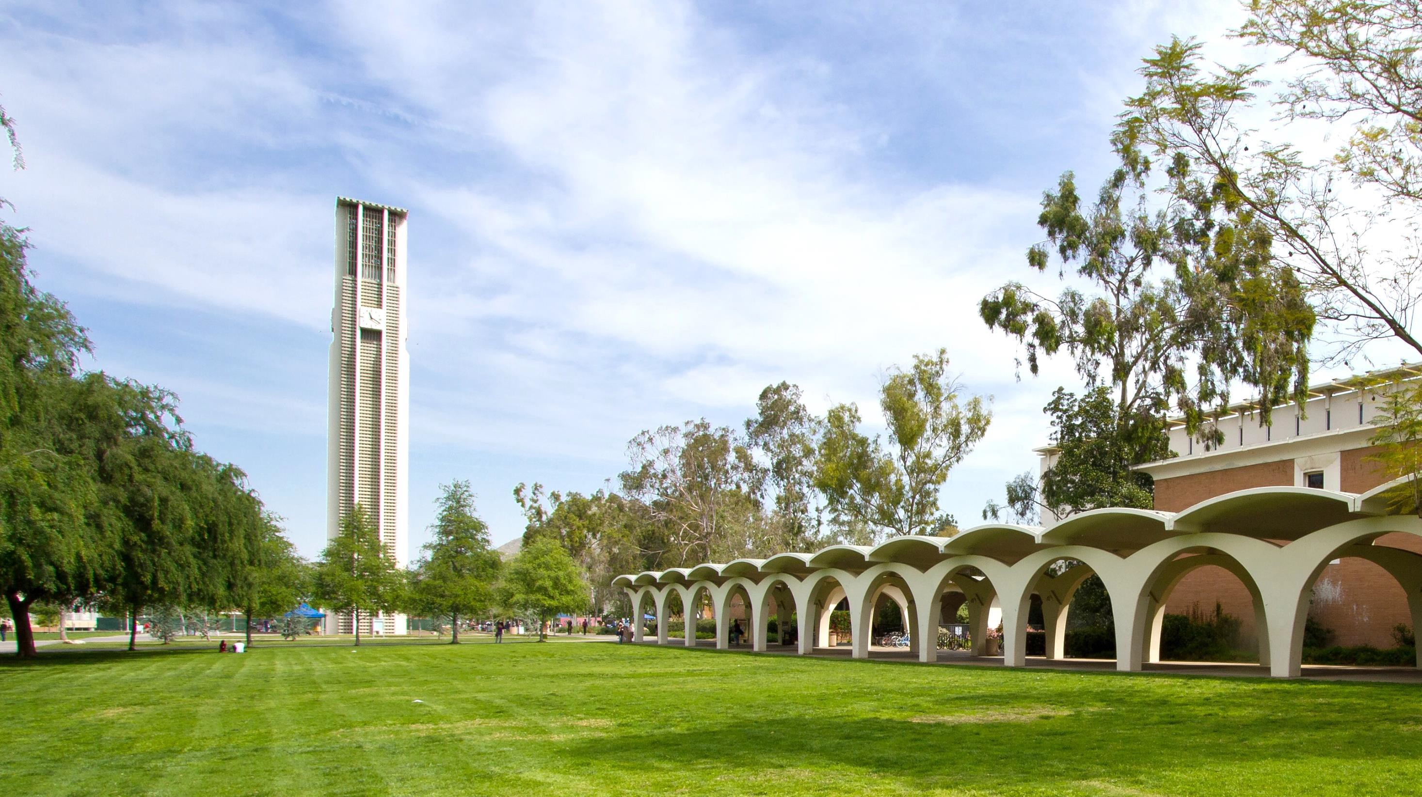
UCR Facilities & Dining Services
Zero Waste Initiatives

Slide 2
Campus Facts
A
Established 1954 – 26,000 Students, Faculty & Staff 7,000
B
Facilities Services total FTE 370
C
2020 U.S. News & World Report Best College Rankings: Top 36 Public Colleges and University #1 in Social Mobility

Slide 3
What is Zero Waste?
An Ethical Goal
Zero waste is a goal to guide people to change their lifestyles and practices to emulate sustainable natural cycles, where all discarded materials are designed to become for others to use.
Designing & Managing Processes
Systematically avoiding and eliminating the volume and toxicity of waste and materials, conserving and recovering all resources, and not burning or burying them.

Slide 4
UC’s Zero Waste Policy
A
UC Zero Waste is a sustainability practice policy adopted in 2007
B
Aspirational goal for zero waste at 90% to divert or eliminate all materials sent to landfill by 2020
C
UCR current diversion rate is 54% down from 69% after the removal of
incineration diversion & COVID – 19 impacts

Slide 5
UCR Historical Waste Data
UCR Historical Waste Data
14000
90%
12000
80%
70%
10000
60%
8000
50%
6000
40%
30%
4000
20%
2000
10%
0
0%
2009-2010 2010-2011 2011-2012 2012-2013 2013-2014 2014-2015 2015-2016 2016-2017 2017-2018 2018-2019 2019-2020 2020-2021 2021-2022
Organics
Recycled Landfill
WTE
Total Waste Generation Diversion Rate

Slide 6
UCR Historical Waste Data
Waste Category
Diversion Calculations from Spreadsheet
FY 21-22
Landfill | Landfill | 1562.31 |  | Tons
W2E | W2E total wout ash | 0 | W2E | -
C&D Landfill | C&D | 135.17 | Landfill | 1,562
Excluded Organics | Green Waste | 651.44 | Organics | 199
Organics | Food | 198.89 | Excluded Organics | 691
Excluded Organics | Mulch | 40 | Reuse | 20
Reuse | Organics: Reuse/donation | 1.78 | Recycle | 653
Recycle | Paper | 130.06 | Haz/Universal | 33
Recycle | CardBoard | 0 | C&D Recycled | 416
Recycle | Mixed R | 361.25 | Total MSW (no C&D) | 3,126
Haz/Universal | Freon | 0.00
Reuse | Carpet | 0
Reuse | Furniture | 9.2 | Allowable W2E | -
Haz/Universal | E-Waste | 15.64 | Landfill (W2E above 10% +Ash) | -
Haz/Universal | Batteries | 0
 | Auto Batteries | 7.52
Recycle | Nitrile Gloves |  | TOTALS FOR UCOP Spreadsheet
Recycle | Medical Sharps | 0 | Reduce | -
Haz/Universal | Chemicals | 17.45 | Reuse | 20
Recycle | Toner Cartrides | 0.45 | Recycle | 653
Recycle | Terracycle |  | Organics | 199
Recycle | Other: Recycled | 161.35 | Excluded Organics | 691
Reuse | Other: Reused | 8.90 | Landfill | 1,562
C&D Recycled | C&D: recycled | 415.55 | MSW no C&D Diversion | 50%
Haz/Universal | Fluro bulbs | 0 | C&D Organics | 0
Reduce | Plastic Containers | 0 | C&D Recycle | 416
 |  |  | C&D Landfill | 135
 |  |  | C&D Diversion | 75%
 |  |  | MSW w C&D Diversion | 54%

Slide 7
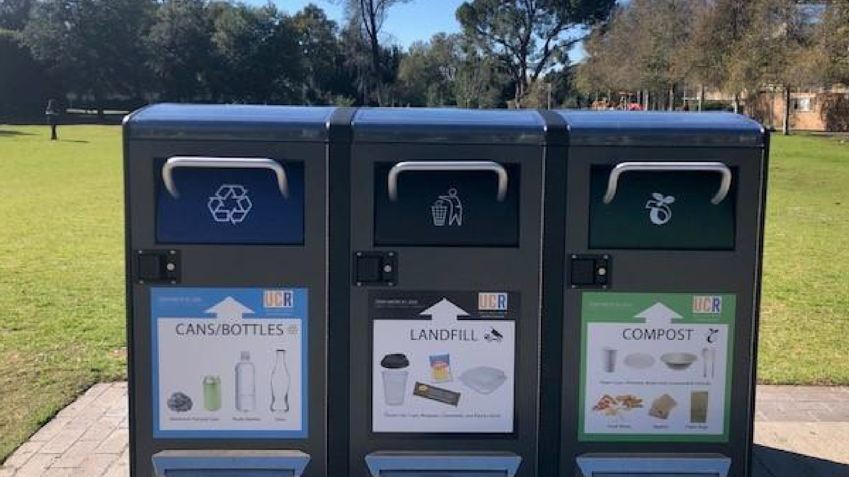
Big Belly Bins

Slide 8
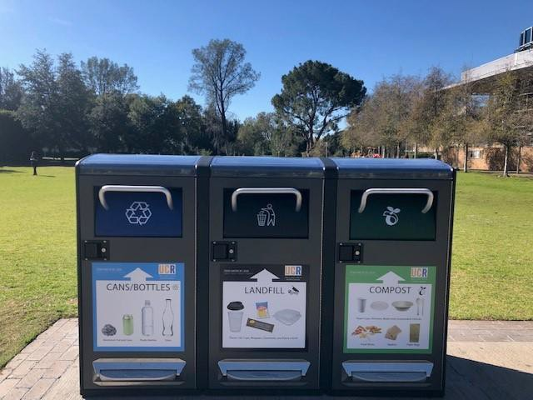
Benefits of Big Belly
Real-time collections notifications
No overflows or visible waste
Eliminate pilfering
No windblown litter access for critters
Increase recycling and composting
Showcase Campus commitment to sustainability
Maintain a cleaner Campus, better aesthetics and the oversaturation of bins

Slide 9
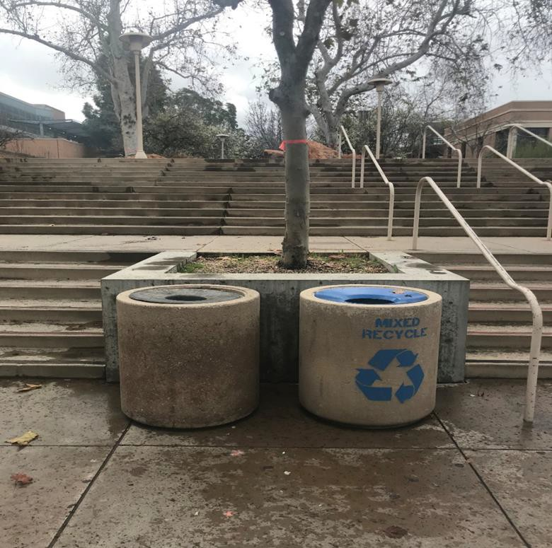
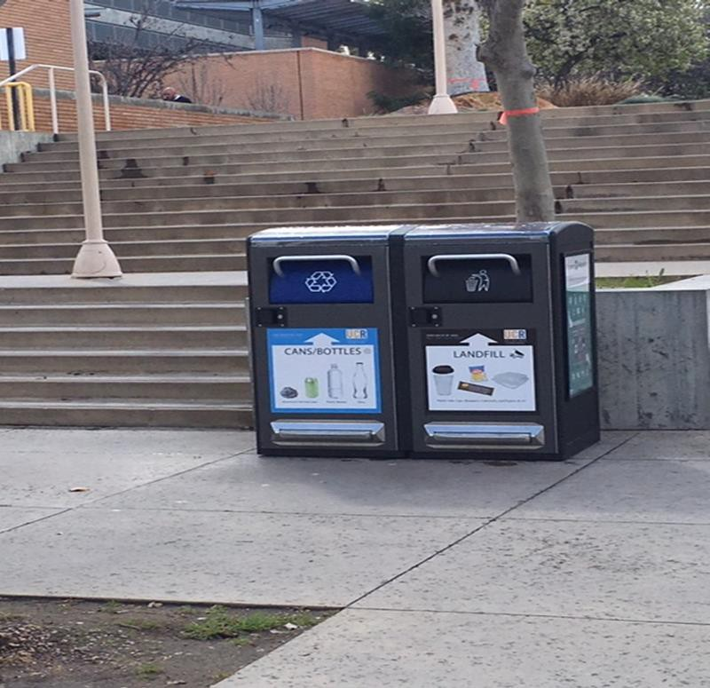
Duo Stations
Before
After

Slide 10
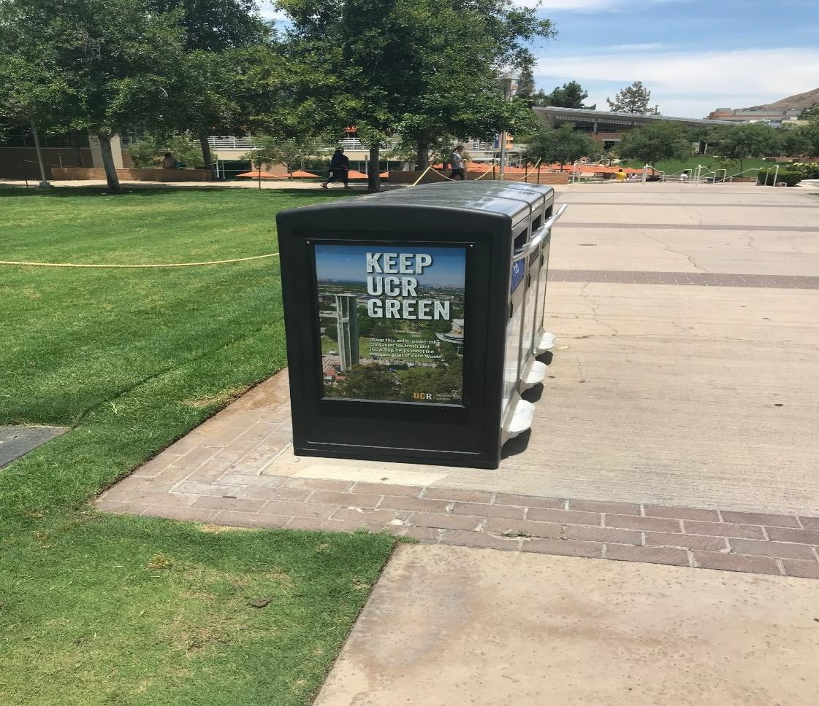
Compost Station at Food Locations

Slide 11
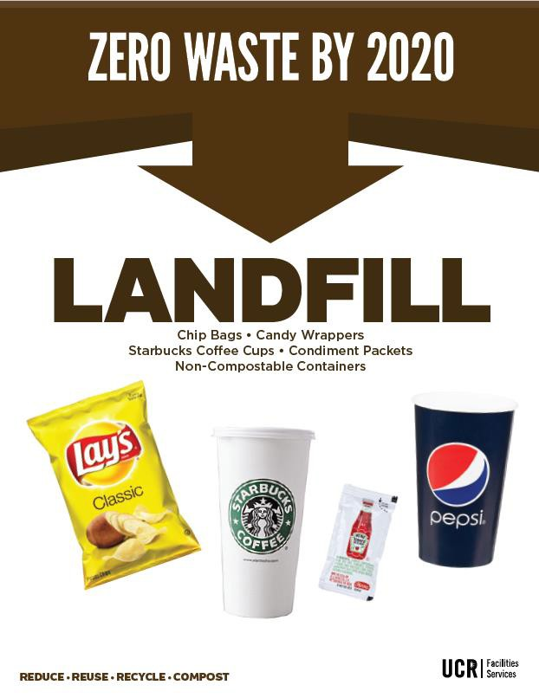
Campus Zero Waste Signage

Slide 12
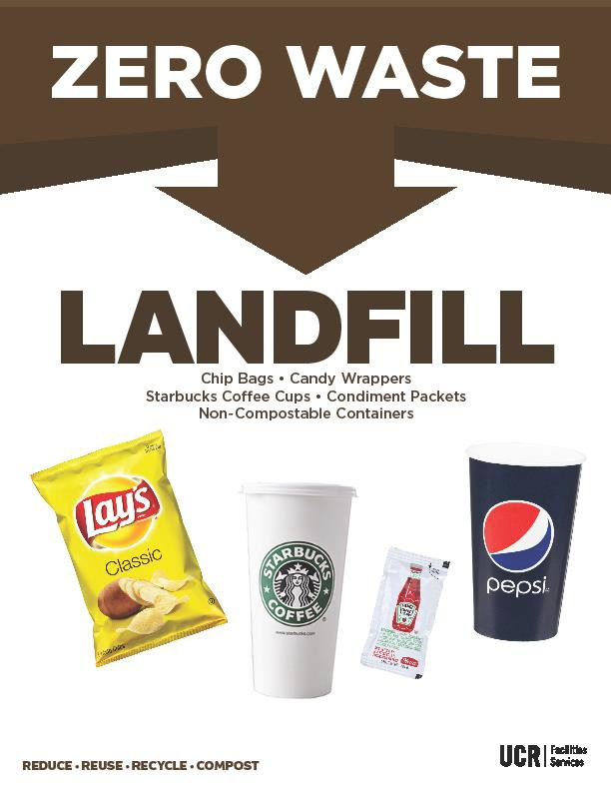
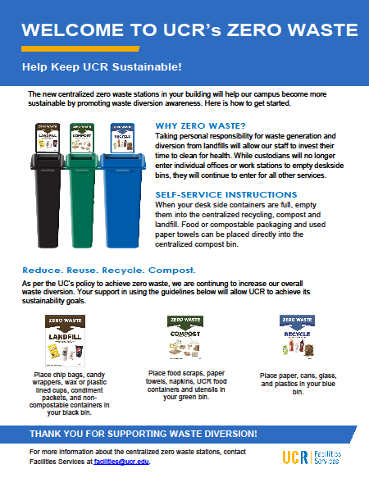
Campus Zero Waste Signage

Slide 13
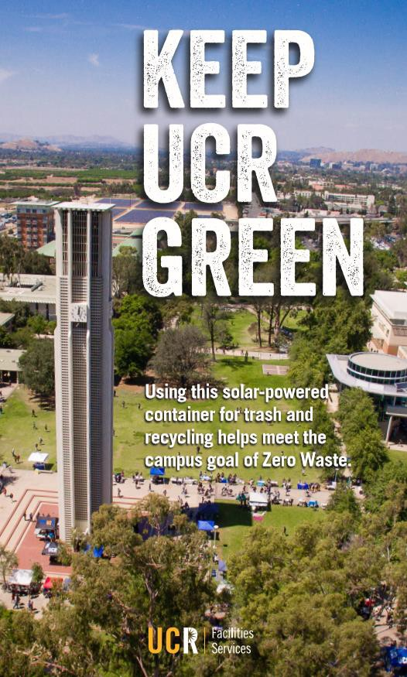
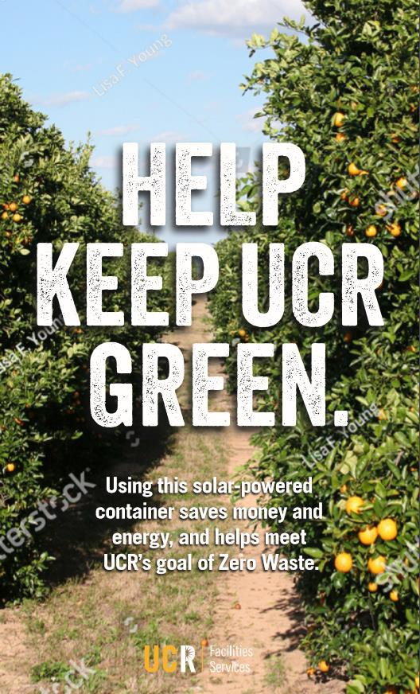
Campus Zero Waste Signage

Slide 14
FS Annex A Zero Waste

Slide 15
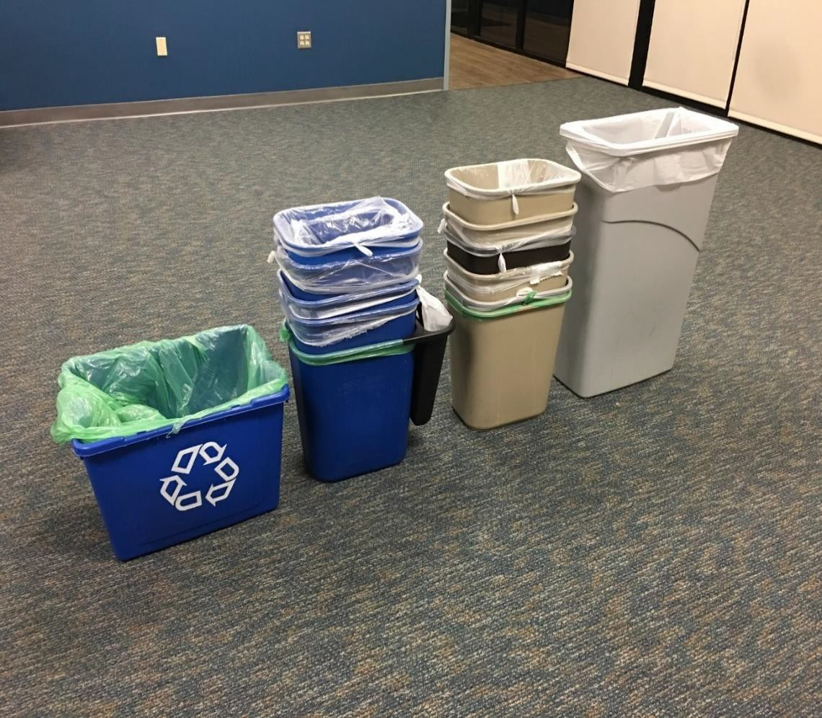
About the Initiative
Before
Facilities Services Annex A is committed to being a zero waste facility.
We set out to limit landfill waste, accelerate recycling and introduce composting in our offices
Prior to our initiative, each office had its own waste and recycle bins

Slide 16
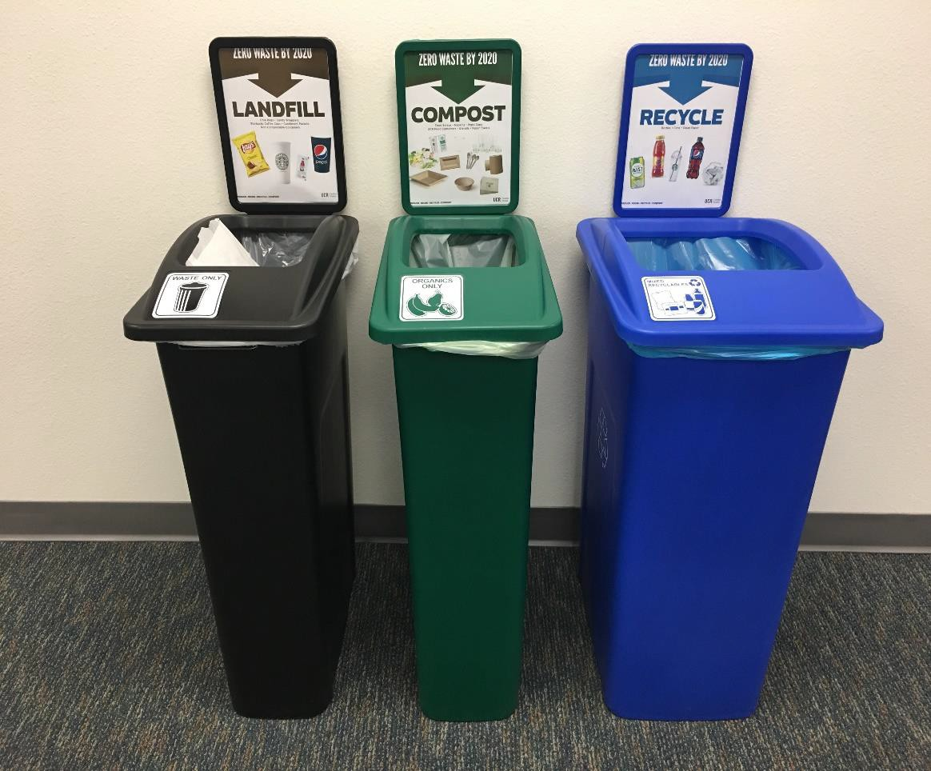
About the Initiative
After
We removed each individual bins and moved towards a community waste, recycling and composting station.
We reduced our bins from 15 trash and recycle cans to 3 community bins.
Color coded biodegradable bags with the associated color bins & waste streams

Slide 17
Minimize Waste. Maximize Recycling and Composting
15 Trash
Cans
15 Recycle
Bins
1 Waste
Bin
1 Compost Bin
1 Recycle
Bin
TO

Slide 18
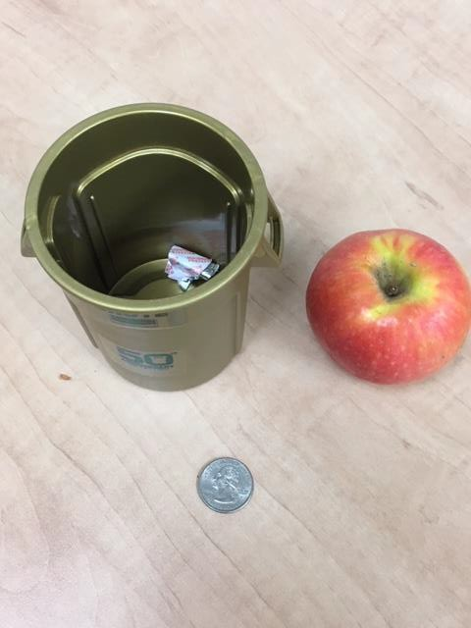
How Do I Help?
1
Follow signage and promote
Become a champion in your work space for minimizing waste and maximizing recycling and composting
2
3
Stay encouraged!

Slide 19
Dining Services Food Recovery
UCR Dining Services Annual Food Waste Composting
(in Tons)
300
250
200
150
100
50
0
2415 Tons CO2E
saved to date

Slide 20
Dining Services Food Recovery Food Donations

Slide 21
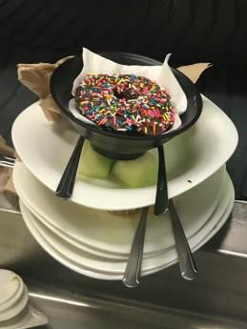
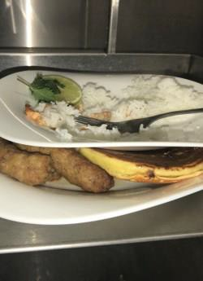
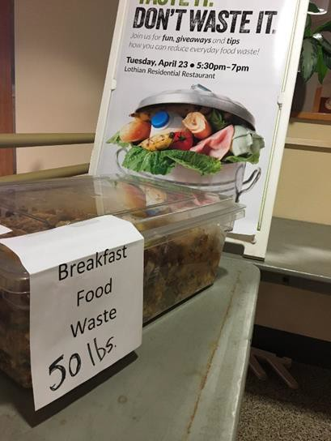
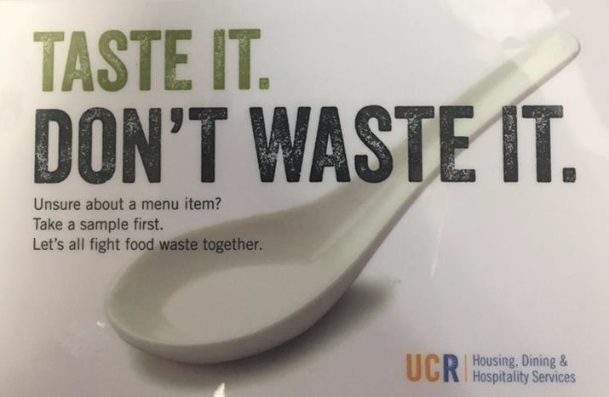

Slide 22
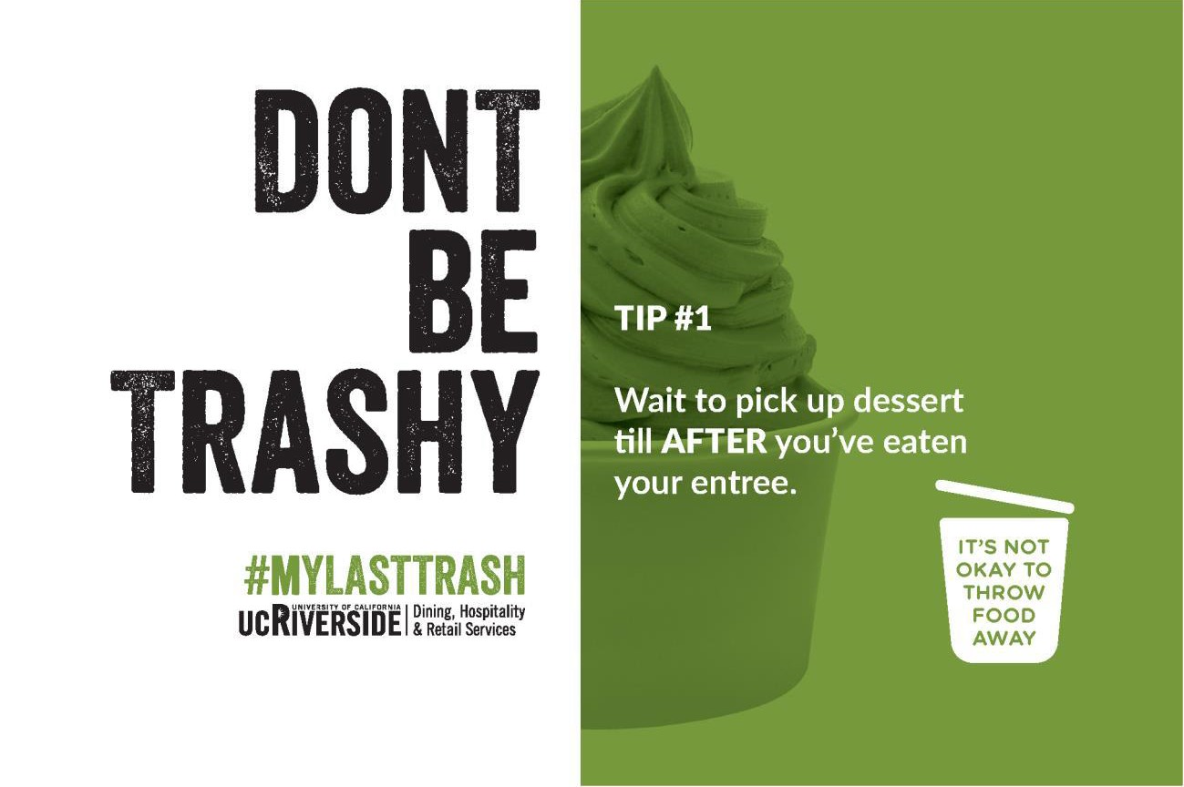
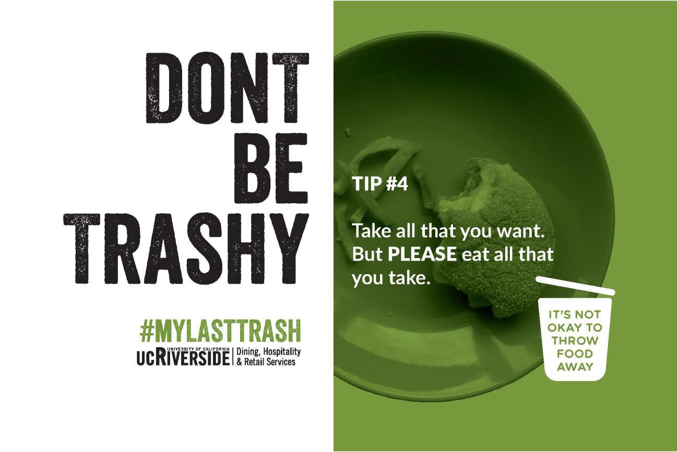

Slide 24
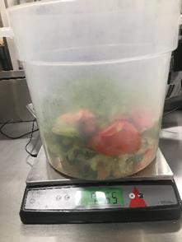
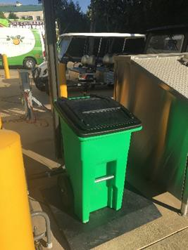
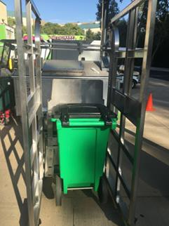
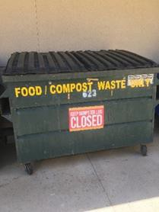

Slide 25
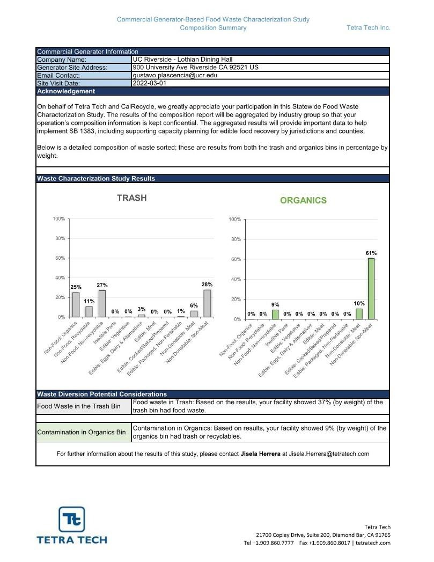
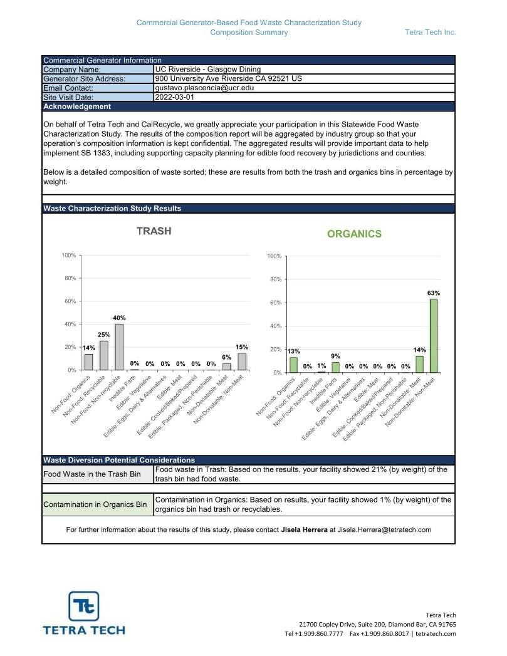
Food Waste Audits

Slide 26
Dining Services Climate Action Plan
Sustainable Procurement
Energy & Water
Sustainable Foodservices
Food Recovery
Recover maximum amount of surplus food for food donations
Climate Action
SB 1383 Implementation
Reduce food waste
Single use plastics policy implementation
Education and Outreach
Menu
Development
Zero Waste
Food
Insecurity

Slide 27
Contact information
Facilities.ucr.edu hassan.ghamlouch@ucr.edu(951) 827-4850
Dining.ucr.edu gustavo.plascencia@ucr.edu(951) 827-6061

