Slide 1
RCC Sustainability Efforts, Challenges, and Successes
Presenter: Dr. Tonya Huff
Professor, RCC Life Sciences Dept.

Slide 2
RCCD Sustainability & Climate Action Plan (SCAP)

Slide 3
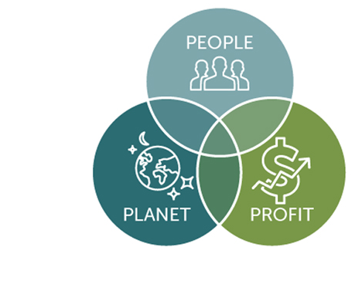
“Triple Bottom Line” Approach
Environmental Stewardship
Fiscal Responsibility
Social Equity

Slide 4
Ten Impact Areas
Academics
Decarbonization & Climate Justice
Waste Minimization and Procurement
Partnerships
Trust & Transparency
Equity & Social Justice
Water & Ecosystems
Engagement
Health & Well-Being
Resiliency

Slide 5
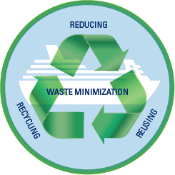
2022-23 is the Year of Sustainability at RCC!
November: Waste Minimization and Procurement
TODAY: Zero Waste Fair
Clothing swap
Career Closet pop-up
Menstrual cup give-away and education
Sustainable pet care
Low-waste gift giving and holiday meals
Tap water vs. bottled water
Test your recycling IQ

Slide 6
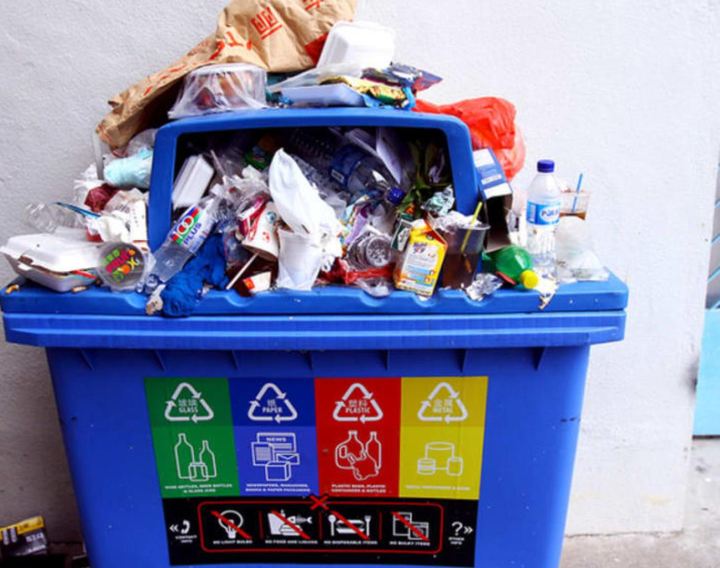
Challenges
Prioritization and support from (some) administrators
Funding & labor
Recycling expansion concerns

Slide 7
Successes
Sustainability Champions Program
A.A. and A.S. Degrees in Sustainability
Buy Nothing RCC
Share Shelves
Student Sustainability Collective
Campus Urban Forest Inventory

