Slide 1
Food Waste
& Food Rescue
‹#›
Notes:
Hi everyone! Welcome to the Food Waste Food Rescue presentation portion of our summit, where we will talk about the consequences of food waste & how to prevent it. Thank you so much for sharing your morning with me.
This presentation is available on our website in a condensed 15 minute format; and it is available in both English and with Spanish Subtitles!
As for questions, please use the chat box to post questions and feel free to post any time during the presentation. I will attempt to address questions during the presentation with the assistance of our staff. Please remember to be respectful and keep your mic muted until the end, where you can unmute yourself for our Q&A portion.
‹#›

Slide 2
Agenda
Food waste vs. wasted food
How much food is wasted?
Why is reducing food waste important?
Food rescue strategies
Community action
‹#›
Notes:
Here is the agenda for today:
We’ll go over the difference between food waste and WASTED food,
Learn about food waste statistics,
And discuss why waste reduction is important,
as well as some strategies you can implement in your daily life and some actions our community is already taking to reduce food waste
‹#›

Slide 3
What is food waste?
Food waste is the natural byproduct of preparing a meal. It is not being wasteful.
It is a watermelon rind, eggshell, carrot top or apple core. It is coffee grinds and orange peels and all the leftover food that occurs when you peel, cut, crack, chop, zest, blend, etc.
‹#›
Notes:
So what IS food waste? Generally, it is food that gets discarded into your waste bin. Food waste is the natural byproduct of preparing a meal. It’s cracking an egg, peeling an orange, or eating an apple down to the core.
It can also be a leftover watermelon rind, bread crust, skin from a piece of chicken, fat from meat, or fruit peels.
‹#›

Slide 4
What is wasted food?
Food that is half eaten, spoiled, stale or moldy.
Food that has gone past its expiration date.
Food that is never eaten because you cooked too much, purchased too much, catered too much, ordered too much or no one liked it.
Food you forgot about.
Produce left on the tree or never purchased.
‹#›
Notes:
So now: wasted food. Wasted food is what’s left when you buy too much, order too much, or cook too much.
It can also be food that has gone bad because nobody wanted to eat it or food no one had time to eat it before it spoiled. It can also be produce that was left on a tree or a vine that went bad before it was harvested.
Can anyone think of any other examples of wasted food? If you want to share, use the chat function!
Wasted food comes from wasteful behavior. Some examples of wasteful behavior include:
Retailers, like grocery stores, who may throw out foods simply because they’re bruised or ugly
Consumers who may leave food on their plates at a restaurant after grabbing too much
Buying too much food, which spoils before being used
Not using foods before their expiration dates and throwing them out as a result
Not taking home your leftovers or taking your home your leftovers and then never getting around to eating them.
https://www.usda.gov/oce/foodwaste/faqs.htm.
‹#›

Slide 5
How much food is wasted?
United States - 103 million tons – that’s 81.4 billion pounds of food waste (Equivalent to over 450,000 Statue of Liberties)
California - Californians throw away nearly 6 million tons of food scraps or food waste each year. Food waste makes up 18% of all the material that goes to landfills.
Riverside County - Riverside County generated 2.5 million tons of waste that went to landfills in 2020 - 50% of which is organic material (Equivalent to 210,000 elephants!)
‹#›
Notes:
Let’s look at some stats: how much food is wasted in the US, in CA, and in Riverside County?
In 2020, Riverside County sent 2.5 million tons of waste to the landfill, half of which was organic material
CalRecycle reported that 6 million tons of food waste is generated each day in CA. 18% of that is made up of food scraps.
In the United States, a whopping 103 million tons are generated, equivalent to the weight of over 450,000 Statue of Liberties
Food is the single largest component taking up space in US landfills. In fact, it makes up about 22% of all municipal solid waste
And unfortunately, it’s food waste and organic products that create methane. In a few slides, we will discuss how food waste creates methane, a greenhouse gas, and how that methane fits into our waste disposal system and environmental health
‹#›

Slide 6
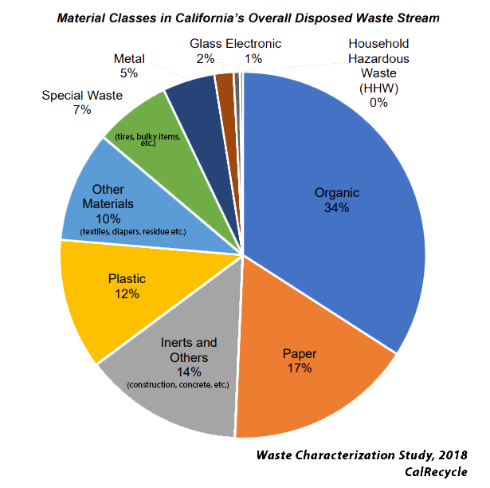
How much food is wasted?
Organic waste is composed of over 50% food waste, with the rest being landscaping/green waste
‹#›
Notes:
Again, Riverside County generates around 2.5 million tons of waste a year that goes to county landfills.
If you look at the chart and add up paper, plastic, glass and metal, you can see that nearly 40% of what goes to our landfills is potentially recyclable material.
Organic waste makes up another 34% of the waste stream – the largest component by far. 50% of that total figure is comprised of food waste! The other 50% is landscaping trimmings and other types of green waste.
Organic waste, in combination with paper, plastic, glass, and metal, is over 2/3rds of our entire waste stream. That means that over 2/3rds of all waste that gets landfilled does not have to go to the landfill.
‹#›

Slide 7
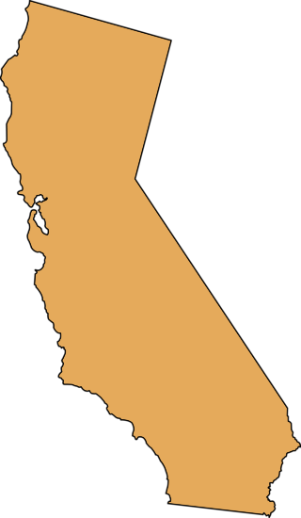
Where does the waste come from?
In Salinas Valley, growers
annually trash thousands of
tons of fresh greens that lack
sufficient shelf life for a cross
country journey.
That’s enough food to feed
2 billion people.
In Riverside County, it is estimated that per capita food waste is 400 pounds/person.
Food is the single most prevalent
item in California’s waste stream, with
nearly 6 million tons of food dumped in
landfills every year in the state.
‹#›
‹#›
Notes:
So where is all this waste coming from?
Wasted food can come from our home, from manufactures, grocery stores, and farms. Food waste happens throughout the entire food supply chain.
For instance, in Salinas Valley, which is northwest of Riverside County, growers trash thousands of fresh greens that lack sufficient shelf life. This means that even if the greens were ok to eat and even good in flavor, they will still get thrown out if the farmer or seller thinks they won’t last a cross-country journey to the grocery store
“Food loss” is defined as the amount of food that is available for human consumption after it’s been harvested but goes uneaten. This could result from agricultural conditions, such as damage from pests or weather, or improper storage conditions.
‹#›

Slide 8
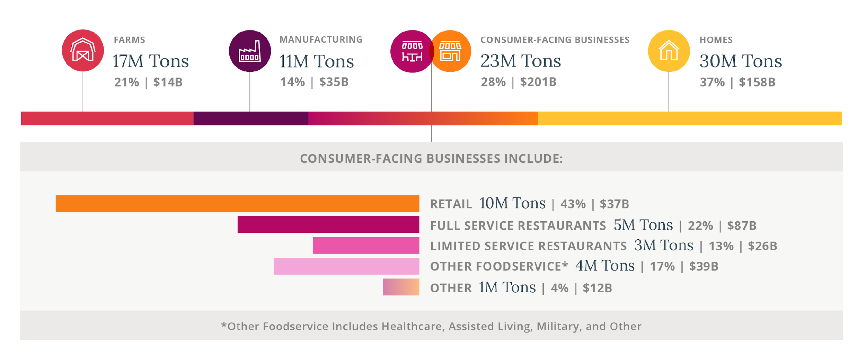
Where does the waste come from?
‹#›
Notes:
As I mentioned before, Food waste happens in every stage of the food supply chain. Let’s break it down, starting with farms:
Farms
Low market prices and high harvest costs make it uneconomical for farmers to gather all the food they produce because they are required to meet strict cosmetic standards for food. Imperfect-looking produce is thrown out, which adds to the $14 billion dollars of wasted resources. There are some efforts underway to recover this unharvested food, but the vast majority of it is still left in the fields, whether by choice, or due to uncontrollable circumstances like weather conditions.
Manufacturers As for manufacturers - Nearly 90% of surplus at a manufacturing level is made up of byproduct. Byproducts are parts not used in the main product, like peels, stems, bones, and shells. For example, potato peels are a byproduct from French fry lines.
Plus, the more variety of products sold, the more waste happens since each change in the production line requires that the entire line be emptied and cleaned.
++During the COVID-19 pandemic, some food manufacturers saw a tripling in demand, but others struggled to adjust their output to meet the needs of new customers with different product requirements – for example, manufacturers who had always produced milk in large containers for industrial markets were unable to quickly begin offering their products in smaller, consumer-friendly sizes.++
Retailers
Retailers are under an enormous amount of pressure to provide perfect food since customers have high standards for freshness and quality. Consequently, these businesses dispose of safe and edible food that may not meet cosmetic standards or whose date label causes confusion. Misunderstandings about date labels account for 50% of food waste at the retail stage.
PLUS as we might remember, in the early days of the pandemic, retailers faced unexpected upticks in demand as consumers made more bulk purchases in order to limit trips to the store; but because of that, many retailers found it super difficult to accurately order correct amounts for stock, which led to both shortages and waste.
During Covid, did you experience a product shortage or empty shelves? What product was it? If you can, please share in the chat!
Foodservice
Lastly, food service businesses have difficulty in predicting what they may need because customers expect a variety of high quality food to be available at all times. Bulk purchasing can lead to waste, But the majority of waste at the foodservice level – a huge 70% – is due to plate waste from customers who don’t eat everything they are served
---------------------------------
++Foodservice businesses have been among the hardest hit by the COVID-19 pandemic. The initial closures left many restaurants with excess food, which they struggled to sell or repurpose.++
Homes
Homes account for 37% of the total food waste – that’s more than both farms and manufacturing produce put together.
Most food waste in homes is due to poor food management, which leads to spoilage. Have you ever heard the saying “don’t shop when you’re hungry?” Consumers might buy a lot of unplanned, spur-of the moment food that leads to waste down the line. This puts some stress not only on our landfills, but also on your budget.
While buying bulk is tempting, a lot of it can go untouched and never eaten. Many consumers also lack the knowledge to repurpose ingredients and store food properly. A huge factor in home food waste is also a misunderstanding of food date labels, since this causes consumers to throw away food before it’s ever spoiled.
https://refed.com/food-waste/the-challenge/#what_is_food_waste
‹#›

Slide 9
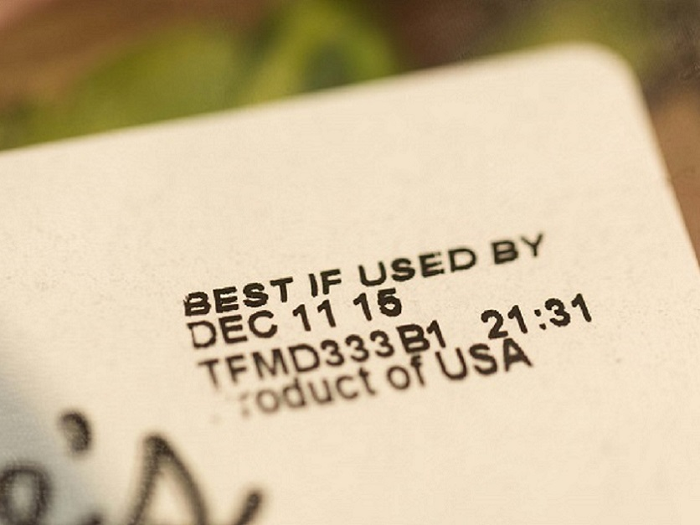
Food Date Labeling
Misinterpretation of the date labels on foods is a key factor leading to food waste in American households. Surveys show that 56 to 90 percent of consumers discard some food prematurely because of misinterpreting food date labels.
Assembly Bill 954 (2017) aims to bring awareness regarding the misinterpretation of date labels on food. It requires the California Department of Food & Agriculture to promote the widespread use of uniform phrases with meaning, "BEST if Used by" or "BEST if Used or Frozen by" to indicate freshness date labels, and "Use by" or "Use or Freeze by" to indicate safety date labels.
‹#›
Notes:
Food spoilage, whether real or perceived, is one of the major reasons people throw out food. 56-90% of Americans discard perfectly good, consumable food simply because they misunderstand expiration labels.
It’s understandable – there are a lot of labels! There’s “sell by”, “use by”, “expires on”, “best before” or “best by.” Consumers can’t be blamed for not wanting to run the risk of getting a foodborne illness. it makes sense to throw your food away when you think it’s bad. The sad thing though is that the food might not actually be bad!
To simplify all these date labels, CA passed a law that is trying to correct all this confusion. AB 954 aims to clarify any misunderstandings by requiring the CA Dept of Food and Agriculture to promote the use of uniform phrases like “Best if used by” to indicate freshness, and “use by” or “freeze by” to indicate safety date labels.
The ONLY food that has federal date labeling standards is baby formula. Everything else, even dairy, is up to the state or the manufacturer.
So our advice: look for the USE BY date as your guide. Sell By is for stock rotation. Best By is to encourage the consumer to use it by that date for the best quality, best flavor. Michele will drop a link in the comments if you’d like more information about the USDA’s food product dating.
------------------------------------------------------------------------
Source: USDA, Food Safety and Inspection Service. Food Product Dating. https://www.fsis.usda.gov/wps/portal/fsis/topics/food-safety-education/get-answers/food-safety-fact-sheets/food-labeling/food-product-dating/food-product-dating
‹#›

Slide 10
Why is reducing food waste important?
Economic view:
USDA estimates that the amount of uneaten food at the retail and consumer levels represents 31% of the available food supply, totaling about 133 billion pounds of food (worth an estimated $162 billion)
Avg. household spends between $1500 - $2000 a year on wasted food
Environmental view:
When food is disposed of in a landfill, it rots and becomes a significant source of methane –
a potent greenhouse gas with 21 times the global warming potential of carbon dioxide
30% of food is wasted globally, contributing 8 percent of total GHG emissions
25% of the fresh water supply in the US is used to produce food that is never eaten
School nutrition view:
40% of school cafeteria food is thrown out (landfill or compost)
76% of wasted food is fresh milk, fruits and vegetables – highly valued food items in food banks
‹#›
Notes:
Now that we know where food waste comes from and who contributes, we can ask ourselves: why is reducing food waste important?
Reducing food waste has environmental, economic, and social impacts:
Economics:
USDA estimates that the amount of uneaten food at the retail and consumer levels represents 31% of the available food supply, totaling about 133 billion pounds of food (worth an estimated $162 billion)
The Avg. household spends between $1500 - $2000 a year on wasted food
Environment:
- When food is disposed of in a landfill, it rots and becomes a significant source of methane. Methane is a potent greenhouse gas with 21 times the global warming potential of carbon dioxide
- 30% of food is wasted globally, contributing 8 percent of total green house gas emissions
- 25% of the fresh water supply in the US is used to produce food that is never eaten
School nutrition: As far as school nutrition goes, Schools serve what the govt says they should serve but students are notoriously wasteful. Although it’s never the cookies or the treats that are wasted, it’s usually the good healthy nutritious stuff like milk, fruits and vegetables. Luckily, programs such as the Smarter Lunchroom Movement provide programs and resources to reduce food waste in schools.
‹#›

Slide 11
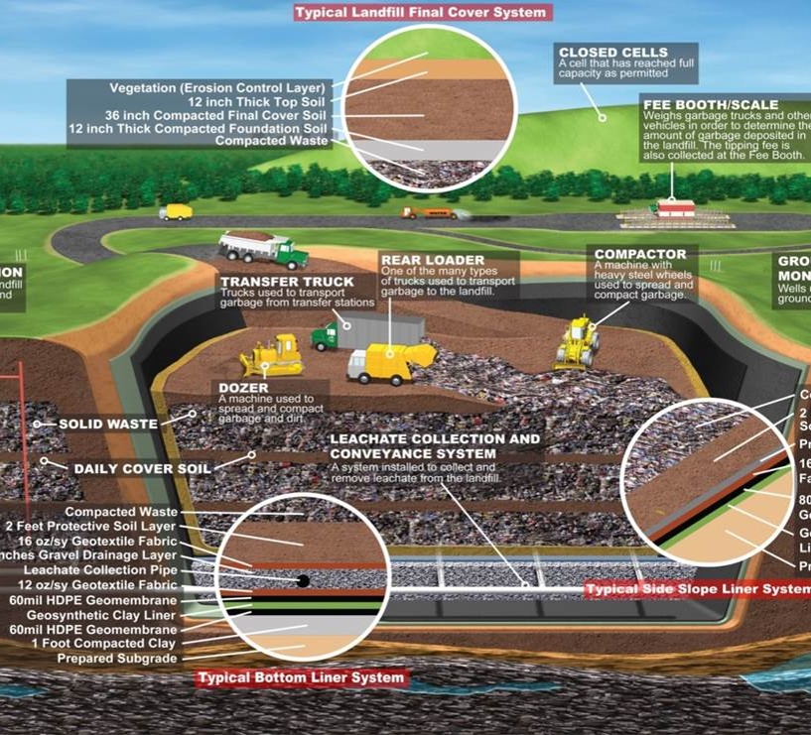
Why is
reducing food waste important?
Landfills are expensive to
site, build and maintain.
‹#›
Notes:
Let’s talk more about the landfills!
Our job here at the department of waste resources is to safely and efficiently operate each of our landfills for as long as we can keep them open. When they fill up, we will have to site and build new ones. Landfills aren’t simply “dumps” anymore where you dig a hole and cover it with dirt. Landfills are highly engineered, highly regulated and complicated operations. They are lined with a special system in order to protect the soil, water and air from contaminants.
This process is VERY expensive. Just the lining alone for a landfill costs half a million dollars an acre. Landfills also have pipes that capture as much methane and leachate as possible so it doesn’t escape into the environment. These pipes take significant resources: we need funding for the materials, for the construction, and for the talented engineers and technicians that ensure they meet state regulations.
Our goal is to make each landfill last as long as possible, not to build new ones. No one wants a new landfill built next to their home, school, or business.
So, let’s do what we can to divert as much waste as possible so that we don’t have to build any new landfills!
‹#›

Slide 12
Food deserts & food insecurity
A 2018 study found that Riverside is considered a food desert, which is defined by the USDA as an area without access to nutritious, high-quality, affordable food within close proximity.
Food deserts are any areas with a 20% or greater poverty rate, and where a third or more of the residents live more than a mile away from a supermarket
Social impacts of food waste:
In CA, 1 in 8 people are food insecure
SB 1383 aims to address this by mandating that 20% of edible food that would otherwise be disposed of be recovered for human consumption by 2025
‹#›
Notes:
Finally, food waste is tied to another social component and environmental justice issue - food insecurity and food deserts.
A 2018 study found that Riverside is considered a food desert, which is defined by the USDA as an area without access to nutritious, high-quality, affordable food within close proximity.
Food deserts are any areas with a 20% or greater poverty rate, and where a third or more of the residents live more than a mile away from a supermarket
Food deserts are linked to food insecurity, and in CA, 1 in 8 people are food insecure. A new piece of legislation, SB 1383, aims to address this by mandating that 20% of edible food that would otherwise be disposed of be recovered for human consumption by 2025. It’s a win- win for the people of CA, and for our landfills, since the edible food will be diverted from disposal, to the mouths of hungry people.
‹#›

Slide 13
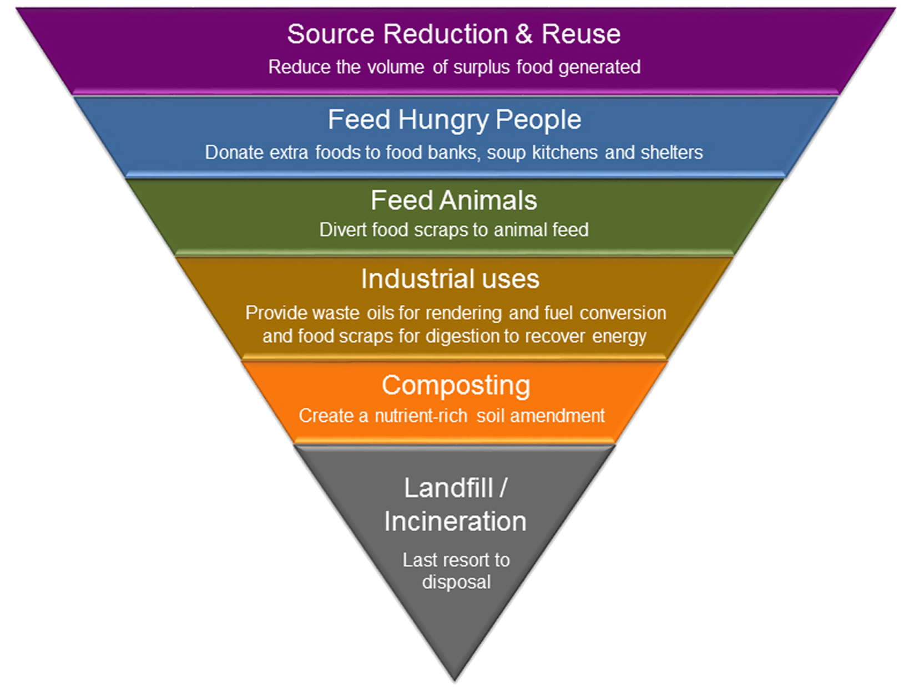
EPA Food Recovery Hierarchy
Food rescue/recovery, source reduction and diversion means
keeping food out of the landfill
‹#›
‹#›
Notes:
We can now move onto the 2nd part of our presentation: recovery!
The EPA has a clearly designated hierarchy for food recovery, pictured here: The top tier, source reduction and reuse, is the highest and best method. We should tackle food waste by not creating waste at all. Source reduction can be simply buying less food in order to decrease the likelihood you will generate food waste.
If we do have leftover food the 2nd thing we should do is feed hungry people.
When food is pass the point of healthy consumption for humans, the 3rd best thing we can do is feed animals with it.
The dark orange tier refers to Industrial Waste, which is waste that can be used by energy plants to convert and store gases released by food waste into energy.
The 5th tier is Composting, which can take many forms: commercial composting through a hauler, onsite composting at farms, or home composting
And the FINAL and last resort should be throwing it away in the garbage, where it will be landfilled forevermore. Incineration is rare in CA due to air quality restrictions, but landfilling is all too common. Unfortunately, today, landfilling is often the first resort.
Our main focus today will be on the top purple tier: source reduction. We will discuss in detail how to stop food waste in its tracks or how to manage your food scraps in a more sustainable way.
‹#›

Slide 14
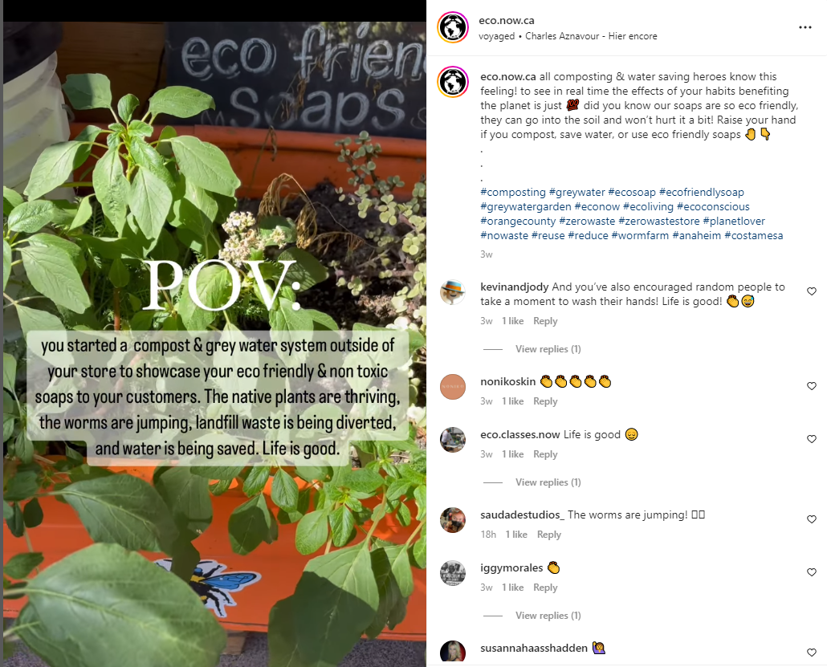
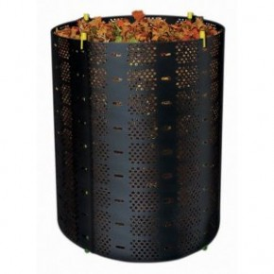
Reducing food waste
Backyard Composting
Composting is nature’s way of recycling
Compost is the best soil amendment for your lawn and garden
Utilize lawn clippings, leaves, small branches, and food to make compost
We teach how to start, maintain and troubleshoot a composting project
We sell composting bins to county residents
‹#›
Notes:
So Remember the difference between wasted food and food waste? Food waste just comes naturally from preparing a meal. It’s not necessarily wasteful to create food waste but you don’t have to landfill that organic waste either. Instead of throwing away your watermelon rind or bread crust, orange peals, zucchini shavings, you can start a compost bin so you have a designated place for all your organic waste.
If you don’t know how to compost, we offer classes in person and virtually. We host workshops pretty much every month where we can teach you the basics. If you really want to elevate your learning, we also offer a master composter certification course a couple of times a year. We have finished the live virtual courses for this year, but we just opened a new, self-paced virtual course. You have 6 months to complete the course at your own pace and you will learn various methods of composting so you can find one to fit your lifestyle.
We also sell compost bins for $13/each, limited to 3 compost bins per household. You can see the example of the Geobin on the screen.
You can also check out our virtual class or on-demand videos at www.rcwaste.org/classes where we have videos on Backyard Composting – really, we have every sort of length and video there is to get people educated on composting and help them make it fit their lifestyle. Composting can be very beneficial to business owners! I have a screenshot up on the screen of a businesses in riverside county who composts on site - and they aren’t even a food business! Eco now california composts to save on water and to provide more nutrients to their plants
‹#›

Slide 15
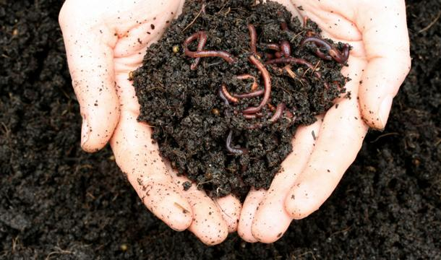
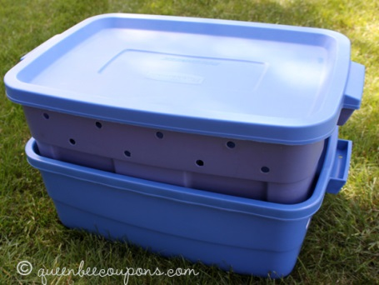
Reducing food waste
Vermicomposting
Composting with worms
Use food scraps instead of yard waste
Worm castings are highly concentrated
compost so it needs to be diluted
significantly before you apply to your lawn, garden or potting soil
Easy to manage, great for kids and reduces food waste
We teach how to start, maintain and trouble shoot
a vermicomposting bin
We sell vermicomposting bin kits
‹#›
Notes:
Let’s say you really want to compost, but you don’t have the space to do it. Vermicomposting might be the option for you!
Vermicomposting is composting, but with worms. Vermicomposting is easy, pretty self-contained, and doesn’t smell if you do it correctly. Ia have friend who lives in an apartment and places her bin on the top shelf of her hallway closet & it doesn’t smell at all! The worms also produce a secretion, which we call worm tea, that can be used as a no-chemical drain cleaner, or, if diluted, is an incredible source of nutrients for your plants. Our garden was thriving this year because we kept it happy and fulfilled with this worm tea
If you don’t have time to make your own worm bin, our department makes and sells them for $26.00. If you’d like to be more hands on, we offer a class several times a year where you can make your own worm bin.
Like with composting, we offer classes in-person and virtually and have videos posted on our website that teach you how to start, maintain and resolve any issues with your vermicomposting bin.
Or you can schedule a speaker for any of our classes if you have group of ten or more that want to meet virtually or in-person. Just go online to sign up or call us and schedule a class at rcwaste.org/outreach/speaker
‹#›

Slide 16
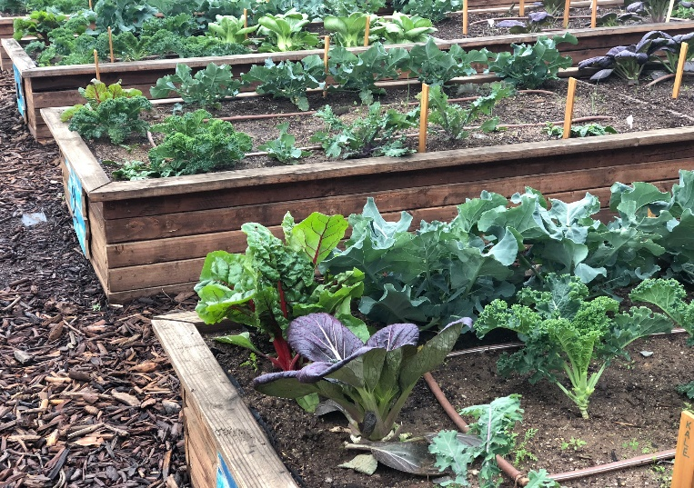
Reducing food waste
Start a garden
Community garden, work garden, school garden
City of Perris Green City Program
Human Nature: you are more invested in the product
when you have invested in its creation
Get accustomed to imperfect food
Complete the circle of life:
Grow, Eat, Compost.
Grow, Eat, Compost.
Grow, Eat, Compost.
‹#›
Notes:
An effective way to prevent food waste is to start a garden, whether it’s a community garden, work garden, or school garden. Studies have found that people who grow their own food tend to waste less since there is an appreciation for fresh fruits and vegetables as they learn how much work it takes to grow good-looking and healthy produce.
Plus, any compost that’s created can go right back into the garden to complete the circle of life. Plants grow, we eat them and use the rest as compost to make the soil nutritious for more plants to grow.
There are a couple of programs we know of, like Master Gardeners of the city of Perris Green City Program, but if you know of any other ones, please let us know!
‹#›

Slide 17
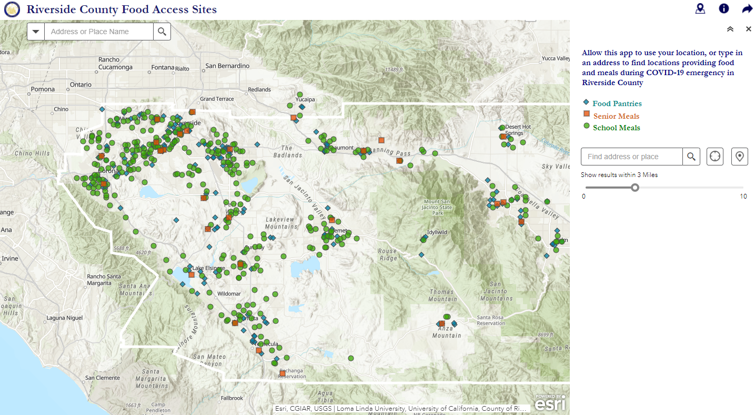
Community Action
Riverside County
Food Pantries
(search Riverside County Food Access Sites)
‹#›
Notes:
Now we can get into the final portion of our presentation: community action!
Whether you are a resident or own a business, here’s a map that lets you know of food pantries in the area. This map is on the County of Riverside’s website, but you can even just open google maps, type in food pantry & a few will pop up like this too.
Anyone can deliver or donate food to any local food pantry or food bank. You don’t have to be a part of a non-profit and you don’t even have to have a food handlers license. But before visiting a food pantry or a food bank make sure to call ahead to find out what kind of food items they can actually accept. Food Banks and some food pantries can accept everything from dry goods to frozen food because they have freezers.
But many food pantries might not have freezers and therefore can only accept dry or canned goods. Again, it’s also best to call ahead or visit before donating if you can. Also – I want to clarify that Food Banks and Food Pantries are not the same. There’s about 3 or 4 Food banks in all of Riverside County, while there are hundreds of food pantries. Food banks never feed the community directly – they’re the big warehouses that supply the smaller food pantries with food so they, the food pantries, can either prepare meals or organize drives to give food to the community directly. Knowing where food pantries are is a great resource for residents who want to make a small donation or are experiencing food insecurity. They are also a great resource for businesses who want to start a food rescue program. Different organizations organize food rescue programs, like Churches, Schools, and girl scout troops
If you are looking to get involved, food pantries are always looking for good volunteers to help with the warehouse and distribution. ​ LINK TO MAP: ​
https://countyofriverside.maps.arcgis.com/apps/webappviewer/index.html?id=52ca2b425fd14b2387f3676bf6db294e&extent=-13100249.8739%2C3944965.339%2C-12940037.8626%2C4040817.3725%2C102100​ ​ ​
​ ​ ​
‹#›

Slide 18
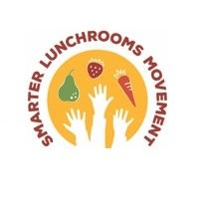
Rescuing food Businesses
STEP 1: Food planned/ordered
Order right amount
Audit previous meals
STEP 2: Food prepared/served
Presentation
Served in most appetizing order
Re-naming food to make them fun
STEP 3: Food eaten
STEP 4: Food Share
Cold slab table
Education/Signage
STEP 5: Food Recovery
Food Bank partners
Aerobic/anaerobic composting
Vermicomposting
Check waste haulers for organics p/u
Prevention
Rescue
‹#›
Notes:
There are a lot of things any business can do to prevent food waste from being created.
Step 1 is ensuring only the right amount of food is ordered, and that over-ordering is avoided. One way to do this is to audit previous meals to find out what is leftover on the plate and make adjustments from there.
Step 2 is the Smarter lunchroom movement. These are Methods and tricks schools can use to minimize food waste. First is the presentation of the food. presentation of food can make a big difference in whether it gets eaten or not. For instance, studies show that sliced apples are way more likely to be eaten by students than whole apples, and that’s the same with orange slices vs. a whole orange.
Another method is Serving meals in an appetizing order, which involves pairing or matching up certain foods together on the tray line that complement each other well. For instance, schools might pair delicious gravy right next to mash potatoes, or put milk right next to a peanut butter and jelly sandwich. Doing this increases the likelihood of kids selecting and actually eating certain foods.
Another method is re-naming boring foods. One study found that instead of calling carrots, carrots, they called them “kick butt” carrots & called spinach “muscle machine spinach.” The study found a decrease in waste and an increase of students selecting and eating those healthier options for lunch!
Step 3 is food eaten, and in a perfect world – all food on the plate is eaten
STEP 4 moves into Food Rescue and can pertain to schools or businesses
food sharing tables can be used in schools, which means that students place all their uneaten and unwanted food on a table. The food is still packaged and untouched, which allows other students the opportunity to grab whatever they want from the share table if they are still hungry or if they wanted to trade an item they had.
Both schools and businesses can create signage and provide education on food waste and food recovery measures
STEP 5, food recovery, involves forming relationships with your local food banks or food pantry. By forming relationships, this means that you find out who the coordinator is, and how the operation works, since there’s some difference across the industry.
Although, if you deal with food waste, like banana peels, apple rinds, or leftover food, then composting or vermicomposting might be better options. If composting or vermicomposting can’t be done on-site, then food waste can always be taken to a composting facility OR even to animal farms if it’s good enough for animals to eat. Food banks usually have relationships with pig and goat farmers in the area since food banks also need a way to dispose of food that has arrived past its expiration date or is unwanted for other reasons. This is a great option for food business like restaurants, hotels, catering companies and grocery stores that have food that needs disposal.
‹#›

Slide 19
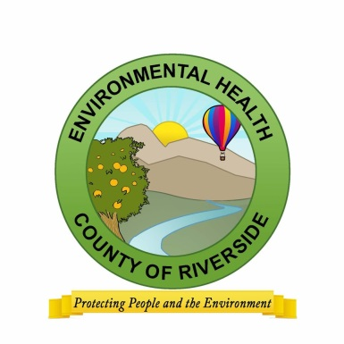
Rescuing food Businesses
Check with local health department
Cartons of milk
Packaged cheese, yogurt cups/tubes, granola, muffins and
meat jerky
Prepackaged sauces (applesauce, pasta sauce)
Prepackaged apple slices, nuts, dried fruits
Whole fruits and vegetables with an intact peel/outer skin
Sealed bottles of water, cartons of juice and other beverages
Depending on food bank, “back of the house” unopened cans and jars of food
What CAN’T be donated?
Hot food or food that was hot at one time
Open meat products
Opened/resealed products
‹#›
Notes:
Let’s get into some do’s and don’t’s when it comes to donating: first, make sure to contact environmental health, your local health department, to find out what foods are fit for donation and which aren’t
Generally, anything sealed and not expired is accepted, and that includes milk cartons, or any other dairy products that are sealed, like yogurt cups or string cheese.
Pudding and fruits cups, similarly are able to be donated as long as they are sealed.
Even packaged sauces, jarred sauces, and canned foods are usually safe to donate! So are dried fruits, sealed sliced fruits, and whole fruits and beverages. But again, you want to talk to your food pantry or food bank to find out what they will accept. Food banks can take big donations, pallets of food at a time, but I do know that Feeding America, a huge food bank in the areas, will not accept liquids in jars since there is a risk of the jars breaking and creating a hazard.
Food pantries will most likely accept jarred items, BUT they sometimes might not be able to take big quantities of anything because they lack the storage space. Food pantry space varies every day so you never know until you call. Additionally, maybe the food pantry got a ton of dried goods from a business, but they lack sauces or fresh produce. Calling ahead can give you a better idea of what is needed or not.
What can’t be donated is food that’s been sitting out in a buffet line, open meat products, and unsealed or open products of any kind. But don’t just write off a product because you just assume it won’t be accepted. It’s always worth a call since your donated items, no mater how big or small, will always make a huge difference environmentally and in our community
‹#›
The key starting point for any food service operation that wants to develop a food rescue program is to start with their local Environmental Health department. There are health and safety concerns relative to storing and donating food so please consult with your local inspectors.
https://www.rivcoeh.org/
Review the basics above.

Slide 20
Rescuing food Businesses
Bill Emerson Good Samaritan Food Donation Act
www.gpo.gov/fdsys/pkg/PLAW-104publ210/pdf/PLAW-104publ210.pdf
Any food facility may donate food to a food bank or to another
nonprofit organization for distribution to persons free of charge.
A permitted food facility that donates food would not be subject to civil or criminal liability or penalty for violation of any laws, regulations or ordinances regulating the labeling or packaging of the donated product or, with respect to any other laws, regulations or ordinances, for a violation occurring after the time of donation.
Exceptions are gross negligence and willful act
‹#›
Notes:
Lastly, if you’re a business that is worried about donating because of possible liabilities, there is a law that protect you from such liability and makes donating food easier then ever. The Bill Emerson Good Samaritan Food Donation Act provides liability protections for food agencies who are donating in good faith and protects businesses from civil and criminal liability should the product donated in good faith later cause harm to the recipient, like in the form of food-borne illnesses. The purpose of the Good Samaritan Food Donation Act is to encourage the donation of food and grocery products to nonprofit organizations for distribution to needy individuals.
Of course, gross negligence and willful act are not included in these protections.
‹#›
One of main concerns about food rescue programs is the liability to the donating organizations. The Good Samaritan Act protects businesses from anything except grow negligence or a willful act.
Review the Act above.

Slide 21
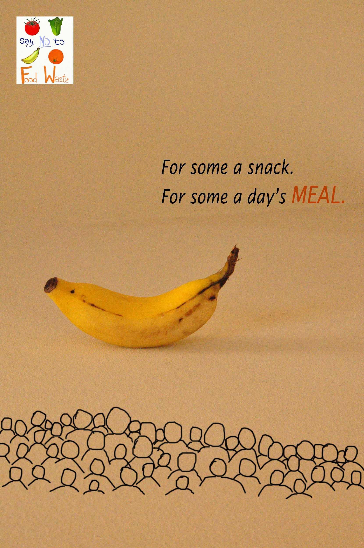
‹#›
Notes:
I will leave you all with this little reminder! Thank you for joining us - I hope this class was educational and that it helps you make some progress in your daily life as it pertains to reducing your food waste. Really, anything helps!
‹#›

Slide 22
Questions?
‹#›
Notes:
We can open the floor for questions if you’d like to unmute yourself or ask a question in the chat.
‹#›

Slide 23
STAY CONNECTED !
TikTok: @rcwaste
Instagram: @rcwaste
Facebook: Riverside County Department of Waste Resources
Follow us on social media!
Headquarters Office:
14310 Frederick Street Moreno Valley, CA 92553
Phone: 951- 486 - 3200
‹#›
Notes:
If you’d like to hear more of us, here are our social media handles. It was a pleasure spending the morning with you all – have a nice day!
‹#›

